Slide 1
Psych 156A/ Ling 150: Acquisition of Language II
Lecture 14
Poverty of the Stimulus III

Slide 2
Announcements
Pick up HW2 if you haven’t already
Be working on HW3 (due: 5/29/12)
Next time: Look over Ch.1 and Ch.2 from Baker (2001)
Correction to Poverty of the Stimulus II lecture notes from last time (please download them again to make sure you have the most up-to-date version)

Slide 3
Poverty of the Stimulus
The data encountered are compatible with both the correct hypothesis and other, incorrect hypotheses about the rules and patterns of the language.
Items in English
Items not in English
Items Encountered

Slide 4
Reasonable questions
What are some examples of linguistic knowledge that seem to present a poverty of the stimulus situation?
Structure-dependent rules

Slide 5
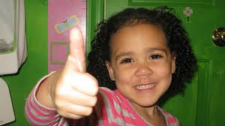
English Yes/No Questions
Crain & Nakayama (1987) showed that children as young as 3 years old know how to form complex yes/no questions. They use a structure-dependent rule.
Rule: Move main clause auxiliary
Is the girl who can solve the labyrinth happy?

Slide 6
English Yes/No Questions
The problem is that simple yes/no questions are compatible with a lot of different rules, both structure-independent and structure-dependent.
Rule: Move first auxiliary?
Jareth can alter time.
Can Jareth alter time?
Rule: Move last auxiliary?
Rule: Move main clause auxiliary?
Rule: Move auxiliary in even-numbered position in sentence?
Rule: Move auxiliary closest to a noun?

Slide 7
English Yes/No Questions
The correct rule is a structure-dependent rule (it requires the child to know that sentences can be divided into main and embedded clauses).
Rule: Move first auxiliary?
Jareth can alter time.
Can Jareth alter time?
Rule: Move last auxiliary?
Rule: Move main clause auxiliary
Rule: Move auxiliary in even-numbered position in sentence?
Rule: Move auxiliary closest to a noun?

Slide 8
English Yes/No Questions
How do children choose the right rule from all the possible rules that are compatible? That is, how do they generalize the right way from the subset of the data they encounter?
structure-dependent generalization/rule
structure-independent
generalization/rule
Items Encountered
Rule: Move main clause auxiliary
Is the girl who can solve the labyrinth happy?

Slide 9
Reasonable questions
What are some examples of linguistic knowledge that seem to present a poverty of the stimulus situation?
Structure-dependent rules
Anaphoric one in English

Slide 10
Anaphoric One
Look - a red bottle!
Do you see another one?

Slide 11
Anaphoric One
Look - a red bottle!
Do you see another one?
red bottle
Process: First determine the linguistic antecedent of one (what words one is referring to). “red bottle”

Slide 12
Anaphoric One
Look - a red bottle!
Do you see another one?
red bottle
Process: Because the antecedent (“red bottle”) includes the modifier “red”, the property RED is important for the referent of one to have.
referent of one = RED BOTTLE

Slide 13
Anaphoric One
Look - a red bottle!
Do you see another one?
Two steps:
Identify syntactic antecedent (based on syntactic category of one)
Identify semantic referent (based on syntactic antecedent)

Slide 14
Anaphoric One: Syntactic Category
Standard linguistic theory says that one in these kind of utterances is a syntactic category smaller than an entire noun phrase, but larger than just a noun (N⁰). This category is sometimes called N′. This category includes sequences like “bottle” and “red bottle”.
NP
NP
det
N′
det
N′
another
N⁰
another
adj
N′
bottle
red
N⁰
bottle
[_{NP} another [_{N’} [_{N0} bottle]]]
[_{NP} another [_{N’} red [_{N’} [_{N0} bottle]]]]

Slide 15
Anaphoric One: Syntactic Category
Standard linguistic theory says that one in these kind of utterances is a syntactic category smaller than an entire noun phrase, but larger than just a noun (N⁰). This category is sometimes called N′. This category includes sequences like “bottle” and “red bottle”.
“another one”
“another red one”
NP
NP
one
det
N′
det
N′
another
N⁰
another
adj
N′
bottle
red
N⁰
“another one”
bottle
[_{NP} another [_{N’} [_{N0} bottle]]]
[_{NP} another [_{N’} red [_{N’} [_{N0} bottle]]]]

Slide 16
Anaphoric One: Syntactic Category
Importantly, one is not N⁰. If it was, it could only have strings like “bottle” as its antecedent, and could never have strings like “red bottle” as its antecedent.
NP
NP
det
N′
det
N′
another
N⁰
another
adj
N′
bottle
red
N⁰
bottle
[_{NP} another [_{N’} [_{N0} bottle]]]
[_{NP} another [_{N’} red [_{N’} [_{N0} bottle]]]]

Slide 17
Anaphoric One: Interpretations based on Syntactic Category
If one was N⁰, we would have a different interpretation of
“Look – a red bottle! Do you see another one?”
Because one’s antecedent could only be “bottle”, we would have to interpret the second part as “Do you see another bottle?” and the purple bottle would be a fine referent for one.
Since one’s antecedent is “red bottle”, and “red bottle” cannot be N⁰, one must not be N⁰.

Slide 18
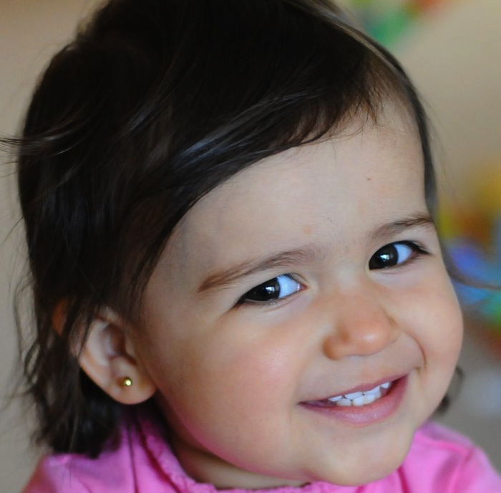
Anaphoric One: Children’s Knowledge
Lidz, Waxman, & Freedman (2003) found that 18-month-olds have a preference for the red bottle in the same situation.
“Look – a red bottle! Do you see another one?”
Lidz et al. interpretation & conclusion:
Preference for the RED BOTTLE means the preferred syntactic antecedent is “red bottle”.
Lidz et al. conclude that 18-month-old knowledge =
syntactic category of one = N′
when modifier (like “red”) is present, syntactic antecedent includes modifier (e.g., red) = referent must have modifier property
NP
det
N′
a
adj
N′
red
N⁰
bottle
Notes:
18

Slide 19
Anaphoric One: The induction problem
Acquisition: Children must learn the right syntactic category for one, and the right interpretation preference for one in situations with more than one option.

Slide 20
Anaphoric One: The induction problem
Acquisition: Children must learn the right syntactic category for one, and the right interpretation preference for one in situations with more than one option.
Problem: Most data children encounter are ambiguous.
Syntactically (SYN) ambiguous data:
“Look – a bottle! Oh, look – another one.”
one’s referent = BOTTLE
one’s antecedent = [_{N’}[_{N0} bottle]] or [_{N0} bottle]?

Slide 21
Anaphoric One: The induction problem
Acquisition: Children must learn the right syntactic category for one, and the right interpretation preference for one in situations with more than one option.
Problem: Most data children encounter are ambiguous.
Semantically and syntactically (SEM-SYN) ambiguous:
“Look – a red bottle! Oh, look – another one.”
one’s referent = RED BOTTLE or BOTTLE?
one’s antecedent = [_{N’} red[_{N’}[_{N0} bottle]]] or [_{N’}[_{N0} bottle]] or [_{N0} bottle]?

Slide 22
Anaphoric One: The induction problem
Acquisition: Children must learn the right syntactic category for one, and the right interpretation preference for one in situations with more than one option.
Problem: Unambiguous data are extremely rare
Unambiguous (UNAMB) data:
“Look – a red bottle! Hmmm - there doesn’t seem to be another one here, though.”
one’s referent = BOTTLE? If so, one’s antecedent = “bottle”.
But it’s strange to claim there’s not another bottle here.
So, one’s referent must be RED BOTTLE, and one’s antecedent =
[_{N’} red[_{N’}[_{N0} bottle]]].

Slide 23
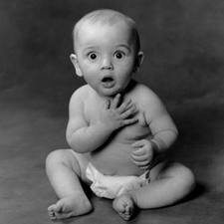
Anaphoric One: The induction problem
Acquisition: Children must learn the right syntactic category for one, and the right interpretation preference for one in situations with more than one option.
Problem: Unambiguous data are extremely rare
Pearl & Mis (2011) looked at 36,500 child-directed speech utterances (from CHILDES), and discovered that none of them were unambiguous for anaphoric one.

Slide 24
Anaphoric One: The induction problem
Acquisition: Children must learn the right syntactic category for one, so they end up with the right interpretation for one.
Problem: If children don’t encounter unambiguous data often enough to notice them, they are left with data that are compatible with both hypotheses – that one is N⁰ and that one is N′. How do children know which is the right generalization?
one is N⁰
one is N’
bottle
red bottle
Ambiguous one data

Slide 25
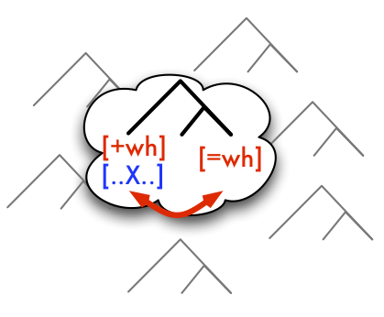
Reasonable questions
What are some examples of linguistic knowledge that seem to present a poverty of the stimulus situation?
Structure-dependent rules
Anaphoric one in English
Syntactic islands

Slide 26
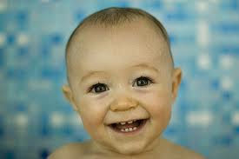
Syntactic Islands
Dependencies between a wh-word and where it’s understood (its gap) can exist when these two items are not adjacent, and these dependencies do not appear to be constrained by length (Chomsky 1965, Ross 1967).
What does Jack think __?
What does Jack think that Lily said __?
What does Jack think that Lily said that Sarah heard __?
What does Jack think that Lily said that Sarah heard that Jareth stole __?

Slide 27
Syntactic Islands
However, if the gap position appears inside certain structures (called “syntactic islands” by Ross (1967)), the dependency seems to be ungrammatical.
*What did you make [the claim that Jack bought __]?
*What do you think [the joke about __] offended Jack?
*What do you wonder [whether Jack bought __]?
*What do you worry [if Jack buys __]?
*What did you meet [the scientist who invented __]?
*What did [that Jack wrote __] offend the editor?
*What did Jack buy [a book and __]?
*Which did Jack borrow [__ book]?

Slide 28
The input: Induction problems
Data from four corpora of child-directed speech (Brown-Adam, Brown-Eve, Valian, Suppes) from CHILDES (MacWhinney 2000): speech to 24 children between the ages of one and four years old.
Total utterances: 101,838
Utterances containing a wh-word and a verb: 20,923
Pearl & Sprouse (2011, submitted) discovered that more complex dependencies were fairly rare in general (<0.01% of the input).

Slide 29
The input: Induction problems
What does the input look like?
76.7% What did you see __?
12.8% What __ happened?
5.6% What did she want to do __?
2.5% What did she read from __?
1.1% What did she think he said __?
…

Slide 30
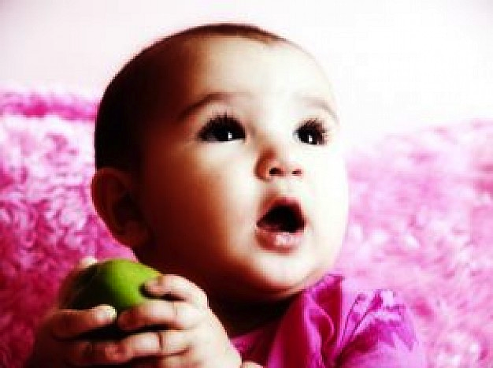
The input: Induction problems
Important: Some grammatical utterances never appeared at all. This means that only a subset of grammatical utterances appeared, and the child has to generalize appropriately from this subset.

Slide 31
Syntactic Islands: Induction Problem
Items in English
Items not in English
Items Encountered
Wh-questions in input (usually fairly simple)
What did you see?
What happened?
…

Slide 32
Syntactic Islands: Induction Problem
Items in English
Items not in English
Items Encountered
Grammatical wh-questions
What did you see?
What happened?
Who did Jack think that Lily saw?
What did Jack think happened?

Slide 33
Syntactic Islands: Induction Problem
Items in English
Items not in English
Items Encountered
Ungrammatical wh-questions: Syntactic islands
*What did you make [the claim that Jack bought __]?
*What do you think [the joke about __] offended Jack?
*What do you wonder [whether Jack bought __]?
*What do you worry [if Jack buys __]?

Slide 34
Reasonable questions
When there is a poverty of the stimulus situation, what kind of “knowledge” do children need in order to end up with the right answer?
Knowledge kinds (at least three dimensions to consider):

Slide 35
Reasonable questions
When there is a poverty of the stimulus situation, what kind of “knowledge” do children need in order to end up with the right answer?
Knowledge kinds (at least three dimensions to consider):
Domain-general or domain-specific?
domain-specific
domain-general

Slide 36
Reasonable questions
When there is a poverty of the stimulus situation, what kind of “knowledge” do children need in order to end up with the right answer?
Knowledge kinds (at least three dimensions to consider):
Domain-general or domain-specific?
Innate or derived from prior linguistic experience?
domain-specific
derived
innate
domain-general

Slide 37
Reasonable questions
When there is a poverty of the stimulus situation, what kind of “knowledge” do children need in order to end up with the right answer?
Knowledge kinds (at least three dimensions to consider):
Domain-general or domain-specific?
Innate or derived from prior linguistic experience?
Knowledge about linguistic structure or knowledge about how to learn?
innate
domain-specific
linguistic structure
derived
innate
how to learn
domain-general

Slide 38
Reasonable questions
Nativists believe that the necessary knowledge is innate, but may be either domain-specific or domain-general.
innate
innate
domain-specific
linguistic structure
derived
innate
how to learn
domain-general

Slide 39
Reasonable questions
Linguistic nativists believe that the necessary knowledge is both innate and domain-specific. This is sometimes called the Universal Grammar (UG) hypothesis. Linguistics nativists believe that because children have Universal Grammar, they can solve these poverty of the stimulus problems.
innate
innate
innate
domain-specific
linguistic structure
derived
innate
how to learn
domain-general

Slide 40
Reasonable questions
How can we test different ideas about what the necessary knowledge might be?
Computational modeling studies can help us identify the necessary knowledge
We can construct a model where we have precise control over these:
The hypotheses the child is considering at any given point
[hypothesis space]
How the child represents the data & which data the child uses
[data intake]
How the child changes belief based on those data
[update procedure]

Slide 41
Computational modeling studies
Several recent computational models have attempted to address poverty of the stimulus questions, and rely on probabilistic learning (often Bayesian inference) as the main method of learning. By modeling the acquisition process for these linguistic phenomena, these models hope to pinpoint the kind of knowledge required for language acquisition.
Anaphoric one: Regier & Gahl (2004), Foraker et al. (2009), Pearl & Lidz (2009), Pearl & Mis (2011, submitted)
Syntactic islands: Pearl & Sprouse (2011, submitted)

Slide 42
English anaphoric one
Baker (1978) assumed only unambiguous data are informative, and these data are rare. So, he proposed that children needed to know that one could not be syntactic category N⁰.
innate
innate
domain-specific
one is not category N⁰
derived
innate
Learn only from unambiguous data
derived
derived
domain-general

Slide 43
English anaphoric one
Regier & Gahl (2004) used a Bayesian learner computational model to show that children could learn one is category N′ if they learned from some of the available ambiguous data and used their statistical learning abilities to track suspicious coincidences in the input.
innate
innate
innate
domain-specific
derived
innate
Learn from additional informative data
Use statistical learning abilities
derived
derived
derived
domain-general

Slide 44
English anaphoric one
Pearl & Lidz (2009) discovered that a Bayesian learner must ignore certain ambiguous data (even if they’re informative) in order to learn that one is category N′. This can be derived from an innate, domain-general preference for learning when there is uncertainty in the utterance heard.
innate
innate
innate
innate
domain-specific
Ignore certain ambiguous data in the input
derived
innate
Learn from additional informative data
Use statistical learning abilities
Learn only when there is local uncertainty
derived
derived
derived
derived
domain-general

Slide 45
English anaphoric one
Pearl & Mis (2011, submitted) discovered that a Bayesian learner can learn from all ambiguous one data and still learn to interpret one appropriately in experiments like Lidz, Waxman, & Freedman (2003), if the learner also learns from data containing other pronouns like it.
innate
innate
innate
innate
innate
domain-specific
One is one of many referential pronouns
derived
innate
Use statistical learning abilities
derived
derived
derived
derived
derived
domain-general

Slide 46
Syntactic islands
Chomsky (1973), Huang (1982), and Lasnik & Saito (1984) proposed that children must know that dependencies cannot cross 2 or more bounding nodes (a domain-specific representation).
Wh … [_{BN2} … [_{BN1} … ___{wh} ]]
X
BN = {CP, IP, NP}?

Slide 47
Syntactic islands
Chomsky (1973), Huang (1982), and Lasnik & Saito (1984) proposed that children must know that dependencies cannot cross 2 or more bounding nodes (a domain-specific representation).
innate
innate
innate
innate
innate
innate
domain-specific
Bounding nodes are the relevant unit of representation
Dependencies must not cross 2 or more bounding nodes
derived
innate
derived
derived
derived
derived
derived
derived
domain-general

Slide 48
Syntactic islands
Pearl & Sprouse (2011, submitted) discovered that a probabilistic learner that tracks sequences of container nodes (a linguistic representation) can learn some of the syntactic islands.
[_{CP} Who did [_{IP} she [_{VP} like ___{who}]]]?
IP VP
Container node sequence characterizing this dependency: IP-VP
Container nodes

Slide 49
Syntactic islands
Pearl & Sprouse (2011, submitted) discovered that a probabilistic learner that tracks sequences of container nodes (a linguistic representation) can learn some of the syntactic islands. It’s unclear whether knowledge of container nodes is innate or derived.
innate
innate
innate
innate
innate
innate
innate
domain-specific
Track container nodes?
Track container nodes?
derived
innate
Use statistical learning abilities to track sequences of container nodes
derived
derived
derived
derived
derived
derived
derived
domain-general

Slide 50
Recap
There are several examples of poverty of the stimulus problems in language learning, such as the representation of English anaphoric one, and the existence of syntactic islands.
Children require some knowledge to help them solve these problems, but there are different kinds of knowledge they could have.
Nativists believe at least some of the knowledge is innate. Linguistic nativists believe that at least some of the knowledge is both innate and domain-specific.
Computational modeling studies can help us determine what knowledge is necessary for successful acquisition to occur.

Slide 51
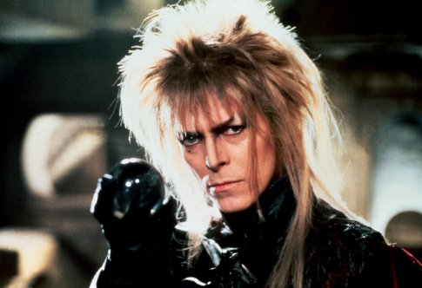
Questions?
You should be able to do all the questions on HW3 and the review questions for poverty of the stimulus. Use the rest of the time to work on these and ask us questions about them.

