Slide 1
Psych 156A/ Ling 150:
Acquisition of Language II
Lecture 2
Introduction:
Mechanism of Language Acquistion

Slide 2
Announcements
Start working on HW1 (due: 4/19/12)
Be looking over the review questions for introduction
Readings for next time:
Werker (1995) + (recommended) Swingley (2009)
Notes:
2

Slide 3
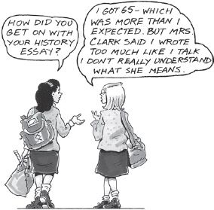
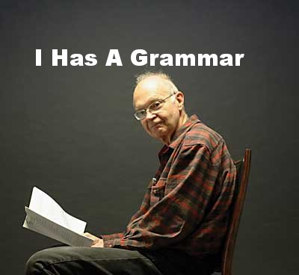
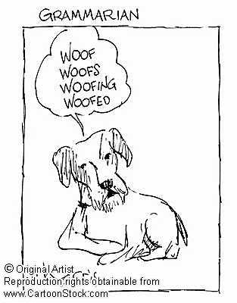
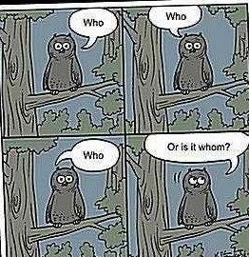
What’s being learned:
Patterns or “rules” of language = grammar

Slide 4
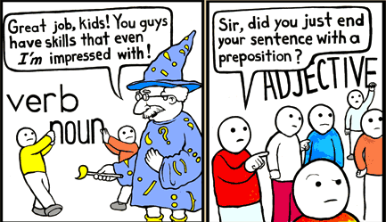
A distinction: Prescriptive vs. Descriptive Grammar Rules
Prescriptive: what you have to be taught in school, what is prescribed by some higher “authority”. You don’t learn this just by listening to native speakers talk.
“Don’t end a sentence with a preposition.”
“ ‘Ain’t’ is not a word.”
Notes:
4

Slide 5
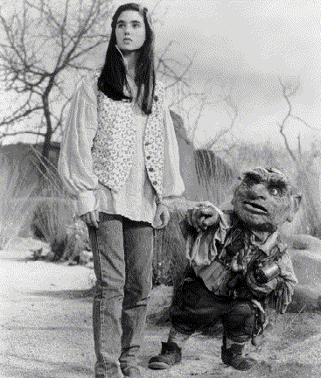
A distinction: Prescriptive vs. Descriptive Grammar Rules
Descriptive: what you pick up from being a native speaker of the language, how people actually speak in their day-to-day interactions. You don’t have to be explicitly taught to follow these rules.
The dwarf is who Sarah first talked with.
“You’re horrible!” “No, I ain’t - I’m Hoggle!”

Slide 6
Possible objections to a mental rule set
“Why should I believe I store a set of rules unconsciously in my mind? I just understand sentences because they make sense.”
Notes:
6

Slide 7
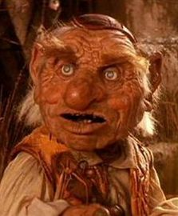
Possible objections to a mental rule set
“Why should I believe I store a set of rules unconsciously in my mind? I just understand sentences because they make sense.”
But why do some sentences make sense and others don’t?
Hoggle has two jewels.
*Two Hoggle jewels has.
Notes:
7

Slide 8
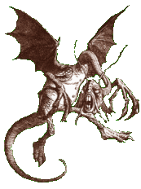
Possible objections to a mental rule set
Why can we recognize patterns even when some of the words are unknown?
‘Twas brillig, and the slithy toves
did gyre and gimble in the wabe...
Notes:
8

Slide 9
Possible objections to an unconscious rule set
“When I talk, the talk just comes out - I’m not consulting any rule set.”
Notes:
9

Slide 10

Possible objections to an unconscious rule set
“When I talk, the talk just comes out - I’m not consulting any rule set.”
Analogy: wiggling your fingers
When you want to wiggle your fingers, you “just wiggle them”.
But your finger-wiggling intention was turned into commands sent by your brain to your muscles, and you’re never conscious of the process unless something interferes with it. Nonetheless, there is a process, even if you’re not aware of it.
Notes:
10

Slide 11
Main points
Language acquisition is a process that involves inferring a structured system from the available input.
How do we explain how this process works?
Notes:
11

Slide 12
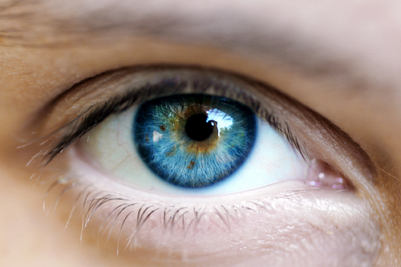
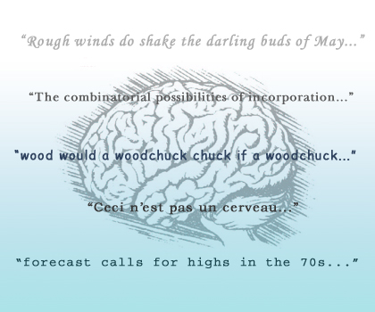
Levels of Representation
Marr (1982)
Notes:
12

Slide 13
Describing vs. Explaining in Vision
“…it gradually became clear that something important was missing …neurophysiology and psychophysics have as their business to describe the behavior of cells or of subjects but not to explain such behavior….What are the problems in doing it that need explaining, and what level of description should such explanations be sought?” - Marr (1982)
Notes:
13

Slide 14
On Explaining (Marr 1982)
“But the important point is that if the notion of different types of understanding is taken very seriously, it allows the study of the information-processing basis of perception to be made rigorous. It becomes possible, by separating explanations into different levels, to make explicit statements about what is being computed and why…”
Notes:
14

Slide 15
On Explaining (Marr 1982)
“But the important point is that if the notion of different types of understanding is taken very seriously, it allows the study of the information-processing basis of perception to be made rigorous. It becomes possible, by separating explanations into different levels, to make explicit statements about what is being computed and why…”
Our goal: Substitute “language learning” for “perception”.
Notes:
15

Slide 16
The three levels
Computational
What is the goal of the computation?
Algorithmic
How can this computational theory be implemented? What is the representation for the input and output, and what is the algorithm for the transformation?
Implementational
How can the representation and algorithm be realized physically?
Notes:
16

Slide 17

The three levels:
An example with the cash register
Computational
What does this device do?
Arithmetic (ex: addition).
Addition: Mapping a pair of numbers to another number.
(3,4) 7 (often written (3+4=7))
Properties:
(3+4) = (4+3) [commutative]
(3+4)+5 = 3+(4+5) [associative]
(3+0) = 3 [identity element]
(3+ -3) = 0 [inverse element]
True no matter how numbers are represented: this is what is being computed
Notes:
17

Slide 18
The three levels:
An example with the cash register
Computational
What does this device do?
Arithmetic (ex: addition).
Addition: Mapping a pair of numbers to another number.
Algorithmic
What is the input, output, and method of transformation?
Input: arabic numerals (0,1,2,3,4…)
Output: arabic numerals (0,1,2,3,4…)
Method of transformation: rules of addition, where least significant digits are added first and sums over 9 have their next digit carried over to the next column
99
+ 5
Notes:
18

Slide 19
The three levels:
An example with the cash register
Computational
What does this device do?
Arithmetic (ex: addition).
Addition: Mapping a pair of numbers to another number.
Algorithmic
What is the input, output, and method of transformation?
Input: arabic numerals (0,1,2,3,4…)
Output: arabic numerals (0,1,2,3,4…)
Method of transformation: rules of addition, where least significant digits are added first and sums over 9 have their next digit carried over to the next column
99
+ 5
14
Notes:
19

Slide 20
The three levels:
An example with the cash register
Computational
What does this device do?
Arithmetic (ex: addition).
Addition: Mapping a pair of numbers to another number.
Algorithmic
What is the input, output, and method of transformation?
Input: arabic numerals (0,1,2,3,4…)
Output: arabic numerals (0,1,2,3,4…)
Method of transformation: rules of addition, where least significant digits are added first and sums over 9 have their next digit carried over to the next column
1
99
+ 5
4
Notes:
20

Slide 21
The three levels:
An example with the cash register
Computational
What does this device do?
Arithmetic (ex: addition).
Addition: Mapping a pair of numbers to another number.
Algorithmic
What is the input, output, and method of transformation?
Input: arabic numerals (0,1,2,3,4…)
Output: arabic numerals (0,1,2,3,4…)
Method of transformation: rules of addition, where least significant digits are added first and sums over 9 have their next digit carried over to the next column
1
99
+ 5
104
Notes:
21

Slide 22
The three levels:
An example with the cash register
Computational
What does this device do?
Arithmetic (ex: addition).
Addition: Mapping a pair of numbers to another number.
Algorithmic
What is the input, output, and method of transformation?
Input: arabic numerals (0,1,2,3,4…)
Output: arabic numerals (0,1,2,3,4…)
Method of transformation: rules of addition
Implementational
How can the representation and algorithm be realized physically?
A series of electrical and mechanical components inside the cash register.
Notes:
22

Slide 23
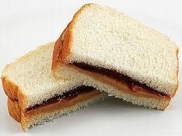
The three levels:
An example with a sandwich
Computational
What is the goal?
Make a peanutbutter and jelly sandwich.
Properties:
- slices of bread containing both peanutbutter and jelly
- number of bread slices: 2
- sandwich is sliced in half
- crusts are left on
- jelly type: grape
- peanutbutter type: crunchy
etc.
Algorithmic
What is the input, output, and method of transformation?
Input: arabic numerals (0,1,2,3,4…)
Output: arabic numerals (0,1,2,3,4…)
Method of transformation: rules of addition
Implementational
How can the representation and algorithm be realized physically?
A series of electrical and mechanical components inside the cash register.

Slide 24
The three levels:
An example with a sandwich
Computational
What is the goal?
Make a peanutbutter and jelly sandwich.
Algorithmic
What is the input, output, and method of transformation?
Input: ingredients (peanutbutter, jelly, bread slices), tools (knife, spoon)
Output: completed, edible sandwich with the required properties
Method: Use the spoon to put jelly on one slice & spread it with the knife. Use the spoon to put peanutbutter on the other slice & spread it with the knife. Put the two slices of bread together, with the spread sides facing each other. Cut the joined slices in half with the knife.
Implementational
How can the representation and algorithm be realized physically?
A series of electrical and mechanical components inside the cash register.

Slide 25

The three levels:
An example with a sandwich
Computational
What is the goal?
Make a peanutbutter and jelly sandwich.
Algorithmic
What is the input, output, and method of transformation?
Input: ingredients (peanutbutter, jelly, bread slices), tools (knife, spoon)
Output: completed, edible sandwich with the required properties
Method: PBJ-making steps.
Implementational
How can the representation and algorithm be realized physically?
Directing your younger sibling to follow the steps above to make you a sandwich.

Slide 26
Mapping the Framework:
Algorithmic Theory of Language Learning
Goal: Understanding the “how” of language learning
First, we need a computational-level description of the learning problem.
Computational Problem: Divide sounds into contrastive categories
x
x
x
x
x
x
x
x
x
C2
x
x
C1
x
x
x
x
x
x
x
x
x
x
x
x
x
x
x
x
x
x
x
x
x
C4
C3
x
x
x
x
x
x
x
x
x
x
x
x
x
x
Notes:
26

Slide 27


Mapping the Framework:
Algorithmic Theory of Language Learning
Goal: Understanding the “how” of language learning
First, we need a computational-level description of the learning problem.
Computational Problem: Divide spoken speech into words
who‘s afraid of the big bad wolf
Notes:
27

Slide 28


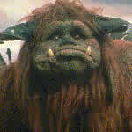
Mapping the Framework:
Algorithmic Theory of Language Learning
Goal: Understanding the “how” of language learning
First, we need a computational-level description of the learning problem.
Computational Problem: Map word forms to speaker-invariant forms
friends
fwiends
“friends”
friends
Notes:
28

Slide 29
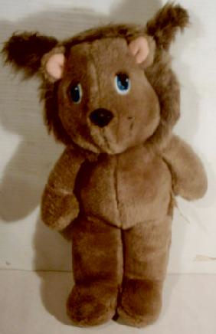
Mapping the Framework:
Algorithmic Theory of Language Learning
Goal: Understanding the “how” of language learning
First, we need a computational-level description of the learning problem.
Computational Problem: Identify grammatical categories
“This is a DAX.”
DAX = noun
Notes:
29

Slide 30
Mapping the Framework:
Algorithmic Theory of Language Learning
Goal: Understanding the “how” of language learning
First, we need a computational-level description of the learning problem.
Computational Problem: Identify the concept a word is associated with
(Word-meaning mapping)
“I love my daxes.”
Dax = that specific toy, teddy bear, stuffed animal, toy, object, …?

Slide 31
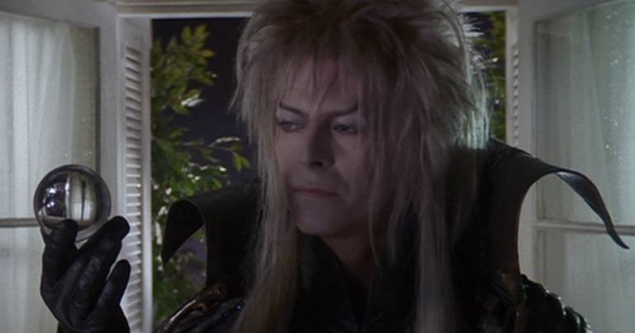
Mapping the Framework:
Algorithmic Theory of Language Learning
Goal: Understanding the “how” of language learning
First, we need a computational-level description of the learning problem.
Computational Problem: Identify the rules of word order for sentences.
Jareth juggles crystals
Subject Verb Object
English
Kannada
German
Subject Verb Object
Subject t_{Object} Verb Object
Subject Verb t_{Subject} Object t_{Verb}
Notes:
31

Slide 32
Mapping the Framework:
Algorithmic Theory of Language Learning
Goal: Understanding the “how” of language learning
Second, we need to be able to identify the algorithmic-level description:
Input = sounds, syllables, words, phrases, …
Output = sound categories, words, words with affixes, grammatical categories, sentences, …
Method = statistical learning, prior knowledge about how human languages work, …
Notes:
32

Slide 33
Recap: Levels of Representation
Language acquisition can be viewed as an information-processing task where the child takes the native language input encountered and uses it to construct the adult rule system (grammar) for the language.
Main idea: The point is not just to describe what children know about their native language and when they know it, but also how they learned it.
Three levels:
computational: what is the problem to be solved
algorithmic: what procedure will solve the problem, transforming input to desired output form
implementational: how is that procedure implemented/instantiated in the available medium
Notes:
33

Slide 34
Computational Modeling:
Understanding the Mechanism
Computational Level:
Theoretical linguistic studies can often tell us what needs to be learned about language. Experimental studies can often tell us about when children seem to know different kinds of language knowledge. This defines the goal of language acquisition:
Learn the appropriate what by the appropriate when.

Slide 35
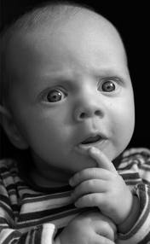
Computational Modeling:
Understanding the Mechanism
Algorithmic Level:
But how do we know what the input is, what the output ought to look like, and what method(s) children use to get from the input to the output?

Slide 36
Computational Modeling:
Understanding the Mechanism
Algorithmic Level:
Input: The CHILDES database has a wealth of child-directed speech transcripts and videos from a number of different languages. This can help us figure out what children’s input looks like.
http://childes.psy.cmu.edu/

Slide 37
Computational Modeling:
Understanding the Mechanism
Algorithmic Level:
Output: Theoretical linguistics and experimental studies can tell us what the output should look like by observing adult and child knowledge of various linguistic phenomena.
Example problem: word segmentation
input
output
who‘s afraid of the big bad wolf

Slide 38
Computational Modeling:
Understanding the Mechanism
Algorithmic Level:
Method: Computational modeling can often help us figure out how children are getting from the input to the output.
What goes here?
who‘s afraid of the big bad wolf

Slide 39
Computational Modeling:
What a “Digital” Child Can Tell Us
We can construct a model where we have precise control over these:
  The hypotheses the child is considering at any given point
  [hypothesis space]
  How the child represents the data & which data the child uses
  [data intake]
  How the child changes belief based on those data
  [update procedure]
“I love my daxes.”
Dax = that specific toy, teddy bear, stuffed animal, toy, object, …?

Slide 40
Computational Modeling:
What a “Digital” Child Can Tell Us
We can construct a model where we have precise control over these:
  The hypotheses the child is considering at any given point
  [hypothesis space]
  How the child represents the data & which data the child uses
  [data intake]
  How the child changes belief based on those data
  [update procedure]
daxes
“I love my daxes.”
Dax = that specific toy, teddy bear, stuffed animal, toy, object, …?

Slide 41
Computational Modeling:
What a “Digital” Child Can Tell Us
We can construct a model where we have precise control over these:
  The hypotheses the child is considering at any given point
  [hypothesis space]
  How the child represents the data & which data the child uses
  [data intake]
  How the child changes belief based on those data
  [update procedure]
dax = that specific toy more probable
dax = any object less probable

Slide 42
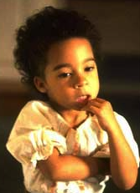
Computational Modeling:
What a “Digital” Child Can Tell Us
Models are most informative when they’re grounded empirically.
This is why most models make use of the child-directed speech data available through databases like CHILDES.
Many models will try to make cognitively plausible assumptions about how the child is representing and processing input data:
  Processing data points as they are encountered
  Assuming children have memory limitations (ex: memory of data points may decay over time)

Slide 43
General Modeling Process
Decide what kind of learner the model represents (ex: normally developing 6- to 8-month-old child learning first language)
Decide what data the child learns from (ex: Bernstein corpus from CHILDES) and how the child processes that data (ex: divide speech stream into syllables)
Decide what hypotheses the child has (ex: what the words are) and what information is being tracked in the input (ex: transitional probability between syllables)
Decide how belief in different hypotheses is updated (ex: based on transitional probability between syllables)
Notes:
43

Slide 44
General Modeling Process
Decide what kind of learner the model represents (ex: normally developing 6- to 8-month-old child learning first language)
Decide what data the child learns from (ex: Bernstein corpus from CHILDES) and how the child processes that data (ex: divide speech stream into syllables)
Decide what hypotheses the child has (ex: what the words are) and what information is being tracked in the input (ex: transitional probability between syllables)
Decide how belief in different hypotheses is updated (ex: based on transitional probability between syllables)

Slide 45
General Modeling Process
Decide what kind of learner the model represents (ex: normally developing 6- to 8-month-old child learning first language)
Decide what data the child learns from (ex: Bernstein corpus from CHILDES) and how the child processes that data (ex: divide speech stream into syllables)
Decide what hypotheses the child has (ex: what the words are) and what information is being tracked in the input (ex: transitional probability between syllables)
Decide how belief in different hypotheses is updated (ex: based on transitional probability between syllables)

Slide 46
General Modeling Process
Decide what kind of learner the model represents (ex: normally developing 6- to 8-month-old child learning first language)
Decide what data the child learns from (ex: Bernstein corpus from CHILDES) and how the child processes that data (ex: divide speech stream into syllables)
Decide what hypotheses the child has (ex: what the words are) and what information is being tracked in the input (ex: transitional probability between syllables)
Decide how belief in different hypotheses is updated (ex: based on transitional probability between syllables)

Slide 47
General Modeling Process
Decide what the measure of success is
ex: making correct generalizations
    Knowing that dax refers to all teddy bears, even ones the child hasn’t seen before
ex: achieving a certain knowledge state by the end of the learning period
    Recognizing words in a fluent speech stream
Notes:
47

Slide 48
The goal of modeling
Remember: the goal is generally to see if a particular learning strategy (as described by the hypothesis space, data intake, and update procedure) will allow the child to go from the input to the output. This then tells us about the process of language acquisition (the algorithmic level of explanation).
What goes here?
who‘s afraid of the big bad wolf

Slide 49
Recap: Mechanism of Acquisition
One of the main goals of the study of language acquisition is to explain it, rather than just describe it.
There are three different levels of explanation, according to Marr: the computational level, the algorithmic level, and the implementational level.
The algorithmic level focuses on the process (the “how”) of acquisition, and computational modeling is a technique that can be used to investigate different strategies a child might use to learn language.

Slide 50
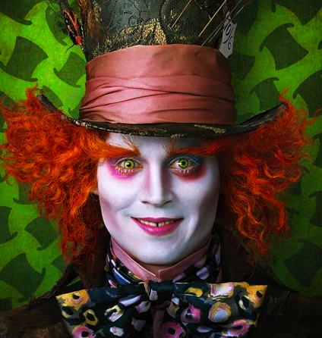
Questions?
Use the rest of this class period to look over the review questions and work together on HW1. You should be able to do all the introductory review questions and up through question 2 on HW1.
Notes:
50

