Slide 1
Psych 156A/ Ling 150: Acquisition of Language II
Lecture 4
Sounds

Slide 2
Announcements
Be working on HW1 (due 4/19/12)
Be working on the sounds & sounds of words review questions
Read Stager & Werker (1997) for next time

Slide 3
What Happens
Divide sounds into contrastive categories (phonemes)
x
x
x
x
x
x
x
x
x
C2
x
x
C1
x
x
x
x
x
x
x
x
x
x
x
x
x
x
x
x
x
x
x
x
x
C4
C3
x
x
x
x
x
x
x
x
x
x
x
x
x
x

Slide 4
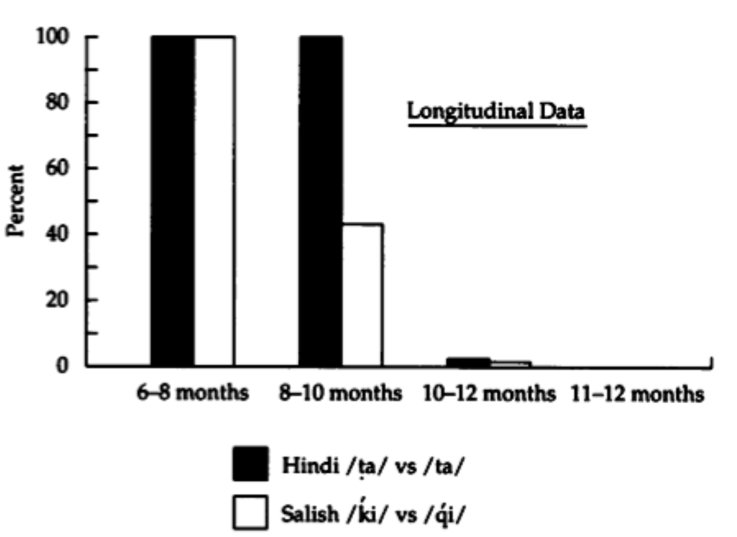
When It Happens
Around 10 months
Werker & Tees (1984), testing English infants

Slide 5
How Change Happens
Maintenance & Loss Theory
“Use it or lose it”
Infants maintain contrasts being used in their language and lose all the others.
Phonology
Structure-changing
Phonetics
Patricia Kuhl
“Perceptual Magnet”
Acoustics

Slide 6
How Change Happens
Maintenance & Loss Theory
“Use it or lose it”
Infants maintain contrasts being used in their language and lose all the others.
Infants maintain contrasts being used in their language and lose all the others.
Phonology
Structure-changing
Phonetics
Patricia Kuhl
“Perceptual Magnet”
Acoustics

Slide 7
How Change Happens
Maintenance & Loss Theory
“Use it or lose it”
Infants maintain contrasts being used in their language and lose all the others.
Natural boundaries
(acoustically salient)
Patricia Kuhl
“Perceptual Magnet”

Slide 8
How Change Happens
Maintenance & Loss Theory
“Use it or lose it”
Infants maintain contrasts being used in their language and lose all the others.
Sounds from Language 1
x
x
x
x
x
x
Patricia Kuhl
x
x
x
x
x
x
x
x
x
x
x
x
x
x
x
x
x
x
x
x
x
x
x
x
x
x
x
x
x
x
x
x
x
x
x
x
x
x
x
x
x
x
x
x
x
“Perceptual Magnet”

Slide 9
How Change Happens
Maintenance & Loss Theory
“Use it or lose it”
Infants maintain contrasts being used in their language and lose all the others.
Category boundaries that are maintained to keep these sound clusters distinct
x
x
x
x
x
x
Patricia Kuhl
x
x
x
x
x
x
x
x
x
x
x
x
x
x
x
x
x
x
x
x
x
x
x
x
x
x
x
x
x
x
x
x
x
x
x
x
x
x
x
x
x
x
x
x
x
“Perceptual Magnet”

Slide 10
How Change Happens
Maintenance & Loss Theory
“Use it or lose it”
Infants maintain contrasts being used in their language and lose all the others.
Sounds from Language 2
x
x
x
x
Patricia Kuhl
x
x
x
x
x
x
x
x
x
x
x
x
x
x
x
x
x
x
x
x
x
x
x
x
x
x
x
x
“Perceptual Magnet”

Slide 11
How Change Happens
Maintenance & Loss Theory
“Use it or lose it”
Infants maintain contrasts being used in their language and lose all the others.
Category boundaries that are maintained to keep these sound clusters distinct
x
x
x
x
Patricia Kuhl
x
x
x
x
x
x
x
x
x
x
x
x
x
x
x
x
x
x
x
x
x
x
x
x
x
x
x
x
“Perceptual Magnet”

Slide 12
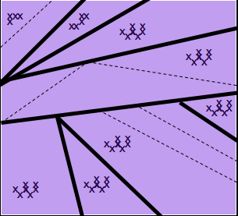
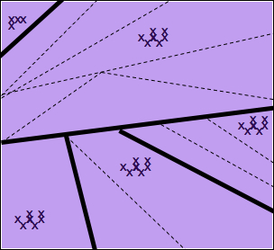
How Change Happens
Maintenance & Loss Theory
“Use it or lose it”
Infants maintain contrasts being used in their language and lose all the others.
Cross-linguistic variation in which contrasts are maintained, depending on language input
Patricia Kuhl
“Perceptual Magnet”

Slide 13
How Change Happens
Maintenance & Loss Theory
“Use it or lose it”
Prediction for performance on non-native contrasts over time:
Loss of discrimination ability is permanent and absolute
Should never be able to hear this distinction again

Slide 14
How change happens
Problems with the Maintenance & Loss Theory
If it doesn’t sound like speech, adults can tell the difference. Werker & Tees (1984) showed this with truncated portions of syllables of non-native contrasts. They told subjects the sounds were water dropping into a bucket, and to tell them when the bucket changed. Adults who could not perceive the difference when they heard the entire syllable could perceive the difference when they processed the consonant sounds separately as a non-linguistic sound - like water dropping into a bucket.
Non-linguistic perception

Slide 15
How change happens
Problems with the Maintenance & Loss Theory
Pisoni et al. (1982), Werker & Logan (1985): adults can be trained if given enough trials or tested in sensitive procedures with low memory demands.
Maintenance & Loss would predict that this ability should be irrevocably lost - and it shouldn’t matter how much training adults receive, or how the task is manipulated to help them.

Slide 16
How change happens
Problems with the Maintenance & Loss Theory
Some non-native contrasts are easy for older infants and adults to discriminate, even though these sounds are never heard in their own languages. (Click languages (Zulu) - click sounds like “tsk tsk” nonspeech)
http://hctv.humnet.ucla.edu/departments/linguistics/VowelsandConsonants/course/chapter6/zulu/zulu.html

Slide 17
How change happens
Another theory: Functional reorganization
Phonology
Janet Werker
Phonetics
Structure-building
Native language
phonemes
built from
universal phones
Acoustics

Slide 18
How change happens
Another theory: Functional reorganization
conscious perception of language sound
Linguistic level
Janet Werker
Unconscious filter imposed
Changes attested experimentally reflect operation of postperceptual processes that activate for language sounds.
Data distributions determine what the category boundaries are in the filter. Importantly, constructing this filter does not affect base-level sound perception.
Perception of sound
Non-linguistic level

Slide 19
How change happens
Another theory: Functional reorganization
Explanatory power: the whole story
Very young infants respond to any detectable variation - so they can pick up any salient contrasts in surrounding language. Adults have a bias for phonemic contrasts since those are the ones relevant to language. If they’re in a non-language setting, adults can distinguish non-native contrastive sounds because their postperceptual language filter isn’t activated.

Slide 20
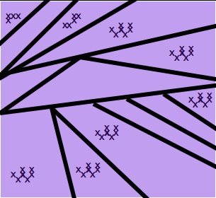
How it happens
Idea 1: Maintenance & Loss
Data distributions determine which boundaries are maintained and which ones are lost/ignored
Problem: Doesn’t seem to be permanent loss, and doesn’t seem to affect sounds if processed as non-language

Slide 21
How it happens
Idea 2:
Functional Reorganization
Unconscious filter imposed when sounds are processed as language. Data distributions determine what the boundaries are in the filter.
conscious perception of language sound
Linguistic level
Unconscious filter imposed
Perception of sound
Non-linguistic level
Common theme: data distributions determine construction of relevant category boundaries for language

Slide 22
Learning Sounds: Taking stock
One of the things children must do is figure out what the meaningful contrastive sounds (phonemes) in their native language are.
Phonemes vary from one language to another.
Children initially can hear many contrastive sounds, even non-native ones. However, they seem to have lost this ability by 10-12 months and instead only consciously hear the contrastive sounds of their native language.
Evidence suggests that this perceptual change is a specialized unconscious filter that is only active when the brain believes it is processing language sounds.

Slide 23
More about contrastive sounds
There are a number of acoustically salient features for sounds. All it takes for sounds to be contrastive is for them to have “opposite” values for one feature.
Example:
English sounds “k” and “g” differ only with respect to voicing. They are pretty much identical on all other features. Many contrastive sounds in English use the voicing feature as the relevant feature of contrast (p/b, t/d, s/z, etc.). However, there are other features that are used as well (air flow, manner of articulation, etc.).
Task for the child: Figure out which features are used contrastively by the language. Contrastive sounds for the language will usually vary with respect to one of those features.
Notes:
23

Slide 24
Experimental Study: Dietrich, Swingley & Werker (2007)
Testing children’s perception of contrastive sounds
Dutch and English contrastive features differ.
In English, the length of the vowel is not contrastive
“cat” = “caat”
In Dutch, the length of the vowel is contrastive
“cat” ≠ “caat”
(Japanese also uses this feature)
Notes:
24

Slide 25
Does the data distribution show this?
Dutch and English vowel sounds in the native language environment also seem to differ
“…studies suggest that differences between the long and short vowels of Dutch are larger than any analogous differences for English.”
Frequency of sound in input
Dutch
English
0
Vowel duration
Notes:
25

Slide 26
Does the data distribution show this?
Dutch and English vowel sounds in the native language environment also seem to differ
“…studies suggest that differences between the long and short vowels of Dutch are larger than any analogous differences for English.”
Dutch vowel length used contrastively; vowels tend to be either very short or very long
Frequency of sound in input
Dutch
English
0
Vowel duration
Notes:
26

Slide 27
Does the data distribution show this?
Dutch and English vowel sounds in the native language environment also seem to differ
“…studies suggest that differences between the long and short vowels of Dutch are larger than any analogous differences for English.”
English vowel length not used contrastively; vowels tend to be less short and less long (comparatively)
Frequency of sound in input
Dutch
English
0
Vowel duration
Notes:
27

Slide 28
Does the data distribution show this?
Dutch and English vowel sounds in the native language environment also seem to differ
“…studies suggest that differences between the long and short vowels of Dutch are larger than any analogous differences for English.”
Dutch = bimodal distribution?
English = unimodal distribution?
Frequency of sound in input
Dutch
English
0
Vowel duration
Notes:
28

Slide 29
Does the data distribution show this?
Dutch and English vowel sounds in the native language environment also seem to differ
“…studies suggest that differences between the long and short vowels of Dutch are larger than any analogous differences for English.”
Dutch = bimodal distribution?
English = unimodal distribution?
Frequency of sound in input
Dutch
English
0
Vowel duration
Notes:
29

Slide 30
Learning from real data distributions
How do we know that children are sensitive to distributional information?
Notes:
30

Slide 31
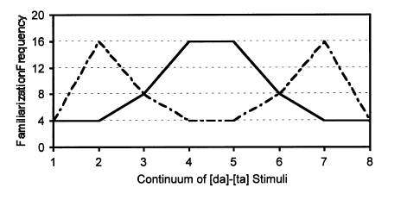
Maye, Werker, & Gerken (2002)
Created synthetic sounds ranging from [da] to [ta] that were non-native for the infants (because they were unaspirated).
Notes:
31

Slide 32
Maye, Werker, & Gerken (2002)
Familiarized 6 to 8-month-old infants to one of two sets
Bimodal Set: Sounds on the ends near [da] and [ta].
Unimodal Set: Sounds in the middle.
Test preference for:
3 6 3 6… (Alternating) vs. 3 3 3 3… (Non-alternating) stimuli
Notes:
32

Slide 33
Maye, Werker, & Gerken (2002)
3 6 3 6 …
3 3 3 3
=
=
<
<
Notes:
33

Slide 34
Maye, Werker, & Gerken (2002)
Infants trained on the Bimodal data had a novelty preference for non-alternating trials. They learned to expect alteration, and were surprised by non-alteration.
3 6 3 6 …
3 3 3 3
=
=
<
<
Notes:
34

Slide 35
Maye, Werker, & Gerken (2002)
Infants trained on the Unimodal data did not prefer/disprefer one over the other. The did not seem to learn any expectation.
3 6 3 6 …
3 3 3 3
=
=
<
<
Notes:
35

Slide 36
Back to Dietrich, Swingley, & Werker (2007)
Dutch and English vowel sounds in the native language environment also seem to differ
“…studies suggest that differences between the long and short vowels of Dutch are larger than any analogous differences for English.”
Dutch = bimodal distribution?
English = unimodal distribution?
Frequency of sound in input
Dutch
English
0
Vowel duration
Notes:
36

Slide 37
Back to Dietrich, Swingley, & Werker (2007)
Prediction if children are sensitive to this distribution
Dutch children interpret vowel duration as a meaningful contrast because the distribution is more bimodal
Implication: Change to vowel duration = new word
English children should not interpret vowel duration as a meaningful contrast because the distribution is more unimodal
Implication: Change to vowel duration = same word as before
Notes:
37

Slide 38
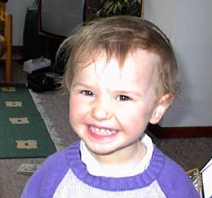
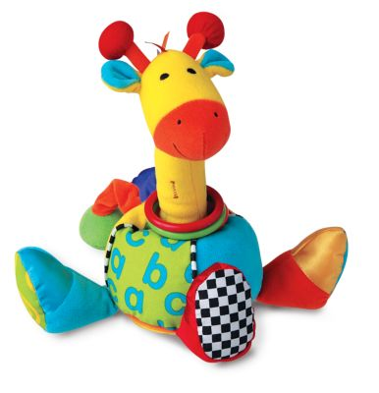
Dietrich, Swingley, & Werker (2007)
Tests with 18-month-old children who know some words (and so have figured out the meaningful sounds in their language)
“Switch” Procedure: measures looking time
…this is a tam…look at the tam
Habituation
Same:
look at the tam!
Switch:
look at the taam!
Test
Notes:
38

Slide 39
Dietrich, Swingley, & Werker (2007)
Experiment 1: Testing English and Dutch kids on Dutch vowel durations
Frequency of sound in input
0
Vowel duration
Dutch kids
difference
5.04 sec
9.23 sec
English kids
no difference
6.66 sec
7.15 sec
Same:
look at the tam!
Switch:
look at the taam!
Test
Notes:
39

Slide 40
Dietrich, Swingley, & Werker (2007)
Experiment 2: Testing English and Dutch kids on English vowel durations
Frequency of sound in input
0
Vowel duration
Dutch kids
difference
5.92 sec
8.16 sec
English kids
no difference
7.34 sec
8.04 sec
Same:
look at the tam!
Switch:
look at the taam!
Test
Notes:
40

Slide 41
Dietrich, Swingley, & Werker (2007)
Experiment 3: Testing English and Dutch kids on vowel quality contrast (a/e)
Frequency of sound in input
0
Vowel duration
(This is a control condition to make sure English kids can do the task when the sound is contrastive for them)
Dutch kids
difference
4.08 sec
5.72 sec
English kids
difference
6.31 sec
9.31 sec
Same:
look at the tam!
Switch:
look at the tem!
Test
Notes:
41

Slide 42
Dietrich, Swingley, & Werker (2007)
Implications of experiments 1, 2, and 3: Dutch children recognize vowel duration as contrastive for their language while English children do not. This can only be due to the data encountered by each set of children in their language.
Dutch children have a category boundary approximately here.
English children do not.
Frequency of sound in input
Dutch
English
0
Vowel duration
Notes:
42

Slide 43
What drives children to learn the distinction?
“One frequently raised hypothesis…is that it is driven by contrast in the vocabulary. Dutch children might learn that [a] and [a:] are different because the words [stat]…and [sta:t]…mean different things…however, children that young do not seem to know many word pairs that could clearly indicate a distinction between [a] and [a:].” - Dietrich, Swingley, & Werker (2007)
Notes:
43

Slide 44
Dietrich, Swingley, & Werker (2007)
“The other current hypothesis is that children begin to induce phonological categories “bottom-up”, based on their discovery of clusters of speech sounds in phonetic space…undoubtedly implicated in infants’ early phonetic category learning, which begins before infants know enough words for vocabulary-based hypotheses to be feasible…”
Notes:
44

Slide 45
Dietrich, Swingley, & Werker (2007)
“A necessary condition for such learning to be the driving force behind Dutch children’s phonological interpretation in the present studies is that long and short vowels be more clearly separable in Dutch than in English…preliminary examination of this problem using corpora of Dutch child-directed speech indicated that the set of long and short instances formed largely overlapping distributions.”
Frequency of sound in input
Dutch
English
0
Vowel duration
Implication: Dutch children need other cues to help them out

Slide 46
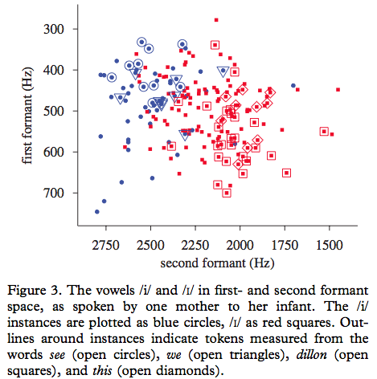
Swingley (2009)
One potential source of information: keep some contextual information for each vowel sound (what word it came from, if it comes from a frequent word).
Feldman et al. (2009) also suggest that associating sounds with particular words (specifically, learning about sounds and words at the same time) can be helpful.

Slide 47
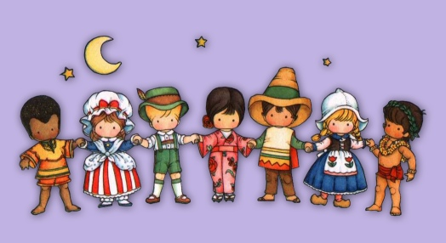
Discovering contrastive sounds: What’s the point of it again?
The idea is that once children discover the meaningful sounds in their language, they can begin to figure out what the words are.
Ex: An English child will know that “cat” and “caat” are the same word (and should have the same meaning).
As adults, we can look at a language and figure out what the contrastive sounds are by looking at what changes a word’s meaning. But children can’t do this - they figure out the contrastive sounds before they figure out words and word meanings.
Notes:
47

Slide 48
Recap: Sounds
It seems that we learn to have a language filter that abstracts away from the raw acoustic signal when we think we’re listening to language (a language sound filter that creates phonemes).
Children need to learn what the phonemes of their language are by listening to their native language input, and phonemes will be constrastive with respect to at least one phonetic feature (like duration or voicing).
It may be helpful for children to keep track of where they hear particular sounds (that is, in which words) in order to figure out the phonemes of their language.

Slide 49
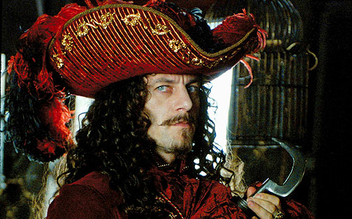
Questions?
You should be able to do up through question 5 on HW1 and up through question 17 on the sounds review questions.

