Slide 1
Psych 156A/ Ling 150: Acquisition of Language II
Lecture 7
Words in Fluent Speech II

Slide 2
Announcements
Be working on HW2
Be working on word segmentation review questions
Midterm on Tuesday, 5/8

Slide 3
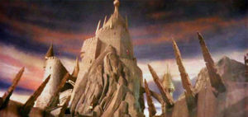
Computational Problem
Divide fluent speech into individual words
to the castle beyond the goblin city

Slide 4
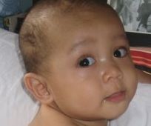
Recap: Saffran, Aslin, & Newport (1996)
Experimental evidence suggests that 8-month-old infants can track statistical information such as the transitional probability between syllables. This can help them solve the task of word segmentation.
Evidence comes from testing children in an artificial language paradigm, with very short exposure time.

Slide 5
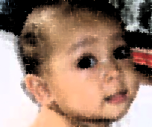
Computational Modeling Data (Digital Children)
Computational model: a program that simulates the mental processes occurring in a child. This requires knowing what the input and output are, and then testing the strategies that can take the given input and transform it into the desired output.

Slide 6
Computational Modeling Data (Digital Children)
For example, in word segmentation, the input could be a sequence of syllables and the desired output is words (groups of syllables).
Input: “un der stand my po si tion”
Desired Output: “understand my position”

Slide 7
How good is transitional probability on real data?
Gambell & Yang (2006): Computational model goal
Real data, Psychologically plausible learning algorithm
Realistic data is important to use since the experimental study of Saffran, Aslin, & Newport (1996) used artificial language data, and it’s not clear how well the results they found will map to real language.
A psychologically plausible learning algorithm is important since we want to make sure whatever strategy the model uses is something a child could use, too. (Transitional probability would probably work, since Saffran, Aslin, & Newport (1996) showed that infants can track this kind of information in the artificial language.)

Slide 8
How do we measure word segmentation performance?
Perfect word segmentation:
identify all the words in the speech stream (recall)
only identify syllables groups that are actually words (precision)
the big bad wolf

Slide 9
How do we measure word segmentation performance?
Perfect word segmentation:
identify all the words in the speech stream (recall)
only identify syllables groups that are actually words (precision)
the big bad wolf
Recall calculation:
# of real words found / # of actual words
Identified 4 real words: the, big, bad, wolf
Should have identified 4 words: the, big, bad, wolf
Recall Score: 4 words found/4 should have found = 1.0

Slide 10
How do we measure word segmentation performance?
Perfect word segmentation:
identify all the words in the speech stream (recall)
only identify syllables groups that are actually words (precision)
the big bad wolf
Precision calculation:
# of real words found / # of words guessed
Identified 4 real words: the, big, bad, wolf
Identified 4 words total: the, big, bad, wolf
Precision Score: 4 real words found/4 words found= 1.0

Slide 11
How do we measure word segmentation performance?
Perfect word segmentation:
identify all the words in the speech stream (recall)
only identify syllables groups that are actually words (precision)
Error
thebig bad wolf

Slide 12
How do we measure word segmentation performance?
Perfect word segmentation:
identify all the words in the speech stream (recall)
only identify syllables groups that are actually words (precision)
Error
thebig bad wolf
Recall calculation:
Identified 2 real words: bad, wolf
Should have identified 4 words: the, big, bad, wolf
Recall Score: 2 real words found/4 should have found = 0.5

Slide 13
How do we measure word segmentation performance?
Perfect word segmentation:
identify all the words in the speech stream (recall)
only identify syllables groups that are actually words (precision)
Error
thebig bad wolf
Precision calculation:
Identified 2 real words: bad, wolf
Identified 3 words total: thebig, bad, wolf
Precision Score: 2 real words/3 words identified = 0.666…

Slide 14
How do we measure word segmentation performance?
Perfect word segmentation:
identify all the words in the speech stream (recall)
only identify syllables groups that are actually words (precision)
Want good scores on both of these measures in order to be sure that word segmentation is really successful

Slide 15
Where does the realistic data come from?
CHILDES
Child Language Data Exchange System
http://childes.psy.cmu.edu/
Large collection of child-directed speech data (usually parents interacting with their children) transcribed by researchers. Used to see what children’s input is actually like.

Slide 16
Where does the realistic data come from?
Gambell & Yang (2006)
Looked at Brown corpus files in CHILDES (226,178 words made up of 263,660 syllables).
Converted the transcriptions to pronunciations using a pronunciation dictionary called the CMU Pronouncing Dictionary.
http://www.speech.cs.cmu.edu/cgi-bin/cmudict

Slide 17
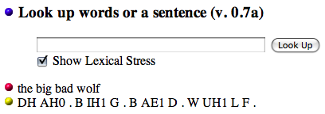
Where does the realistic data come from?
Converting transcriptions to pronunciations
Gambell and Yang (2006) tried to see if a model learning from transitional probabilities between syllables could correctly segment words from realistic data.
the big bad wolf
DH AH0 . B IH1 G . B AE1 D . W UH1 L F .

Slide 18
Segmenting Realistic Data
Gambell and Yang (2006) tried to see if a model learning from transitional probabilities between syllables could correctly segment words from realistic data.
DH AH0 B IH1 G B AE1 D W UH1 L F
“There is a word boundary AB and CD if
TrProb(A --> B) > TrProb(B-->C) < TrProb(C --> D).”
Transitional probability minimum

Slide 19
Segmenting Realistic Data
Gambell and Yang (2006) tried to see if a model learning from transitional probabilities between syllables could correctly segment words from realistic data.
Desired word segmentation
DH AH0 B IH1 G B AE1 D W UH1 L F
the big bad wolf

Slide 20
Modeling Results for Transitional Probability
Precision: 41.6%
Recall: 23.3%
A learner relying only on transitional probability does not reliably segment words such as those in child-directed English.
About 60% of the words posited by the transitional probability learner are not actually words (41.6% precision) and almost 80% of the actual words are not extracted (23.3% recall).

Slide 21
Why such poor performance?
“We were surprised by the low level of performance. Upon close examination of the learning data, however, it is not difficult to understand the reason….a sequence of monosyllabic words requires a word boundary after each syllable; a [transitional probability] learner, on the other hand, will only place a word boundary between two sequences of syllables for which the [transitional probabilities] within [those sequences] are higher than [those surrounding the sequences]...” - Gambell & Yang (2006)

Slide 22
Why such poor performance?
“We were surprised by the low level of performance. Upon close examination of the learning data, however, it is not difficult to understand the reason….a sequence of monosyllabic words requires a word boundary after each syllable; a [transitional probability] learner, on the other hand, will only place a word boundary between two sequences of syllables for which the [transitional probabilities] within [those sequences] are higher than [those surrounding the sequences]...” - Gambell & Yang (2006)
TrProb1
TrProb2
TrProb3

Slide 23
Why such poor performance?
“We were surprised by the low level of performance. Upon close examination of the learning data, however, it is not difficult to understand the reason….a sequence of monosyllabic words requires a word boundary after each syllable; a [transitional probability] learner, on the other hand, will only place a word boundary between two sequences of syllables for which the [transitional probabilities] within [those sequences] are higher than [those surrounding the sequences]...” - Gambell & Yang (2006)
0.6
0.3
0.7

Slide 24
Why such poor performance?
“We were surprised by the low level of performance. Upon close examination of the learning data, however, it is not difficult to understand the reason….a sequence of monosyllabic words requires a word boundary after each syllable; a [transitional probability] learner, on the other hand, will only place a word boundary between two sequences of syllables for which the [transitional probabilities] within [those sequences] are higher than [those surrounding the sequences]...” - Gambell & Yang (2006)
0.6
0.3
0.7
0.6 > 0.3 < 0.7

Slide 25
Why such poor performance?
“We were surprised by the low level of performance. Upon close examination of the learning data, however, it is not difficult to understand the reason….a sequence of monosyllabic words requires a word boundary after each syllable; a [transitional probability] learner, on the other hand, will only place a word boundary between two sequences of syllables for which the [transitional probabilities] within [those sequences] are higher than [those surrounding the sequences]...” - Gambell & Yang (2006)
learner posits one word boundary at minimum TrProb
0.6
0.3
0.7
0.6 > 0.3, 0.3 < 0.7

Slide 26
Why such poor performance?
“We were surprised by the low level of performance. Upon close examination of the learning data, however, it is not difficult to understand the reason….a sequence of monosyllabic words requires a word boundary after each syllable; a [transitional probability] learner, on the other hand, will only place a word boundary between two sequences of syllables for which the [transitional probabilities] within [those sequences] are higher than [those surrounding the sequences]...” - Gambell & Yang (2006)
…but nowhere else
0.6
0.3
0.7
0.6 > 0.3, 0.3 < 0.7

Slide 27
Why such poor performance?
“We were surprised by the low level of performance. Upon close examination of the learning data, however, it is not difficult to understand the reason….a sequence of monosyllabic words requires a word boundary after each syllable; a [transitional probability] learner, on the other hand, will only place a word boundary between two sequences of syllables for which the [transitional probabilities] within [those sequences] are higher than [those surrounding the sequences]...” - Gambell & Yang (2006)
…but nowhere else

Slide 28
Why such poor performance?
“We were surprised by the low level of performance. Upon close examination of the learning data, however, it is not difficult to understand the reason….a sequence of monosyllabic words requires a word boundary after each syllable; a [transitional probability] learner, on the other hand, will only place a word boundary between two sequences of syllables for which the [transitional probabilities] within [those sequences] are higher than [those surrounding the sequences]...” - Gambell & Yang (2006)
…but nowhere else
thebig badwolf
Precision for this sequence: 0 words correct out of 2 found
Recall: 0 words correct out of 4 that should have been found

Slide 29
Why such poor performance?
“More specifically, a monosyllabic word is followed by another monosyllabic word 85% of the time. As long as this is the case, [a transitional probability learner] cannot work.” - Gambell & Yang (2006)

Slide 30
Additional Learning Bias
Gambell & Yang (2006) idea
Children are sensitive to the properties of their native language like stress patterns very early on. Maybe they can use those sensitivities to help them solve the word segmentation problem.
Hypothesis: Unique Stress Constraint (USC)
Children think a word can bear at most one primary stress.
no stress
stress
stress
stress
the big bad wolf

Slide 31
Additional Learning Bias
Gambell & Yang (2006) idea
Children are sensitive to the properties of their native language like stress patterns very early on. Maybe they can use those sensitivities to help them solve the word segmentation problem.
Hypothesis: Unique Stress Constraint (USC)
Children think a word can bear at most one primary stress.
the big bad wolf
Learner gains knowledge: These must be separate words

Slide 32
Additional Learning Bias
Gambell & Yang (2006) idea
Children are sensitive to the properties of their native language like stress patterns very early on. Maybe they can use those sensitivities to help them solve the word segmentation problem.
Hypothesis: Unique Stress Constraint (USC)
Children think a word can bear at most one primary stress.
who’s a fraid of the big bad wolf
Get these boundaries because stressed (strong) syllables are next to each other.

Slide 33
Additional Learning Bias
Gambell & Yang (2006) idea
Children are sensitive to the properties of their native language like stress patterns very early on. Maybe they can use those sensitivities to help them solve the word segmentation problem.
Hypothesis: Unique Stress Constraint (USC)
Children think a word can bear at most one primary stress.
who’s a fraid of the big bad wolf
Can use this in tandem with transitional probabilities when there are weak (unstressed) syllables between stressed syllables.

Slide 34
Additional Learning Bias
Gambell & Yang (2006) idea
Children are sensitive to the properties of their native language like stress patterns very early on. Maybe they can use those sensitivities to help them solve the word segmentation problem.
Hypothesis: Unique Stress Constraint (USC)
Children think a word can bear at most one primary stress.
?
?
who’s a fraid of the big bad wolf
There’s a word boundary at one of these two.

Slide 35
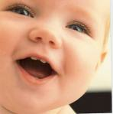
USC + Transitional Probabilities
Precision: 73.5%
Recall: 71.2%
A learner relying on transitional probability but who also has knowledge of the Unique Stress Constraint does a much better job at segmenting words such as those in child-directed English.
Only about 25% of the words posited by the transitional probability learner are not actually words (73.5% precision) and about 30% of the actual words are not extracted (71.2% recall).

Slide 36
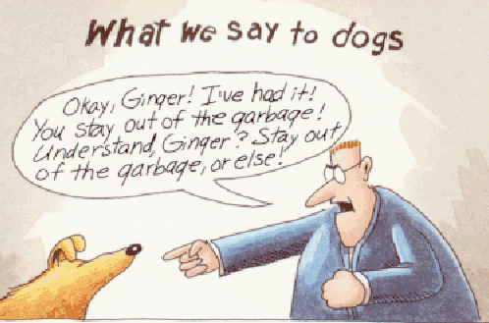
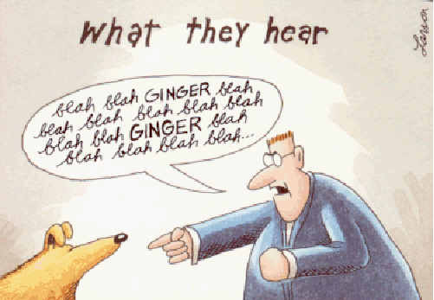
Another Strategy
Using words you recognize to help you figure out words you don’t recognize

Slide 37
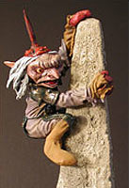
Another Strategy: Algebraic Learning
Algebraic Learning (Gambell & Yang (2003))
Subtraction process of figuring out unknown words.
“Look, honey - it’s a big goblin!”
= big (familiar word)
= (new word)

Slide 38
Evidence of Algebraic Learning in Children
“Behave yourself!”
“I was have!”
(be-have = be + have)
“Was there an adult there?”
“No, there were two dults.”
(a-dult = a + dult)
“Did she have the hiccups?”
“Yeah, she was hiccing-up.”
(hicc-up = hicc + up)

Slide 39
Experimental Evidence of Algebraic Learning
Experimental studies show young infants can use familiar words to segment novel words from their language
Bortfeld, Morgan, Golinkoff, & Rathbun 2005:
6-month-old English infants use their own name or Mommy/Mama
Hallé, Durand, Bardies, & de Boysson 2008
11-month-old French infants use French articles like le, les, and la
Shi, Werker, & Cutler 2006
11-month-old English infants use English articles like her, its, and the
Shi, Cutler, Werker, & Cruickshank 2006
11-month-old English infants (but not 8-month-old English infants) use the English article the

Slide 40
Using Algebraic Learning + USC
WeakSyl StrongSyl StrongSyl StrongSyl
the big bad wolf
“the big bad wolf”

Slide 41
Using Algebraic Learning + USC
Familiar word: “the” (algebraic learning)
WeakSyl StrongSyl StrongSyl StrongSyl
the big bad wolf
“the big bad wolf”

Slide 42
Using Algebraic Learning + USC
USC says these must be separate words
WeakSyl StrongSyl StrongSyl StrongSyl
the big bad wolf
“the big bad wolf”

Slide 43
Using Algebraic Learning + USC
Correct segmentation!
WeakSyl StrongSyl StrongSyl StrongSyl
the big bad wolf
“the big bad wolf”

Slide 44
Algebraic Learning + USC
Precision: 95.9%
Recall: 93.4%
A learner relying on algebraic learning and who also has knowledge of the Unique Stress Constraint does a really great job at segmenting words such as those in child-directed English - even better than one relying on the transitional probability between syllables.
Only about 5% of the words posited by the transitional probability learner are not actually words (95.9% precision) and about 7% of the actual words are not extracted (93.4% recall).

Slide 45
Gambell & Yang 2006 Summary
Learning from transitional probabilities alone doesn’t work so well on realistic data, even though experimental research suggests that infants are capable of tracking and learning from this information.
Models of children that have additional knowledge about the stress patterns of words seem to have a much better chance of succeeding at word segmentation if they learn via transitional probabilities.
However, models of children that use algebraic learning and have additional knowledge about the stress patterns of words perform even better at word segmentation than any of the models learning from the transitional probability between syllables.

Slide 46
Gambell & Yang 2006 Critiques
Do children have access to the Unique Stress Constraint (USC)?
-Children definitely use TPs & Algebraic Learning
Does dictionary stress really match actual stress patterns?
Gambell & Yang: the big bad wolf
Typical speech: the big bad wolf
It’s unclear how well this algorithm works with real stress patterns…

Slide 47
Pearl, Goldwater, & Steyvers 2011
What if children are capable of tracking more sophisticated distributional information (that is, they’re not just restricted to transitional probability minima)? In that case, how well do they do on realistic data, if all they’re using is statistical learning (no stress information)?

Slide 48
Pearl, Goldwater, & Steyvers 2011
What if children can use Bayesian inference?
Human cognitive behavior is consistent with this kind of reasoning.
(Tenenbaum & Griffiths 2001, Griffiths & Tenenbaum 2005,
Xu & Tenenbaum 2007)
Bayesian inference is a sophisticated kind of probabilistic reasoning that tries to find hypotheses that
(1) are consistent with the observed data
(2) conform to a child’s prior expectations

Slide 49
Bayesian inference for word segmentation
What kind of hypotheses might a child have for word segmentation?
Observed data:
“to the ca stle be yond the go blin ci ty”
Hypothesis = sequence of vocabulary items producing this observable data
Hypothesis 1:
“tothe castle beyond thegoblin city”
Items: tothe, castle, beyond, thegoblin, city
Some sample hypotheses
Hypothesis 2:
“to the castle beyond the goblin city”
Items: to, the, castle, beyond, goblin, city
Note: the is used twice

Slide 50
Bayesian model: Pearl et al. 2011
Learner expectations about word segmentation:
(1) Words tend to be shorter rather than longer
(2) Vocabulary tends to be small rather than large
How would a Bayesian learner with these kind of expectations decide between the two hypotheses from before?
Hypothesis 1:
“tothe castle beyond thegoblin city”
Items: tothe, castle, beyond, thegoblin, city
How long are words? Between 4 and 9 letters
How large is the vocabulary? 5 words

Slide 51
Bayesian model: Pearl et al. 2011
Learner expectations about word segmentation:
(1) Words tend to be shorter rather than longer
(2) Vocabulary tends to be small rather than large
How would a Bayesian learner with these kind of expectations decide between the two hypotheses from before?
Hypothesis 2:
“to the castle beyond the goblin city”
Items: to, the, castle, beyond, goblin, city
How long are words? Between 3 and 6 letters
How large is the vocabulary? 6 words

Slide 52
Bayesian model: Pearl et al. 2010
Comparing hypotheses - which is most likely?
Hypothesis 1: longer words, but fewer words
How long are words? Between 4 and 9 letters
How large is the vocabulary? 5 words
Hypothesis 2: shorter words, but more words
How long are words? Between 3 and 6 letters
How large is the vocabulary? 6 words
A Bayesian learner makes a decision based on how important each of its expectations is (in this case, it’s a balance of the two constraints: fewer words vs. shorter words).

Slide 53
Bayesian model: Pearl et al. 2010
Comparing hypotheses - which is most likely?
Hypothesis 1: longer words, but fewer words
How long are words? Between 4 and 9 letters
How large is the vocabulary? 5 words
Hypothesis 2: shorter words, but more words
How long are words? Between 3 and 6 letters
How large is the vocabulary? 6 words
There will be some probability the Bayesian learner assigns to each hypothesis. The most probable hypothesis will be the one the learner chooses.

Slide 54
Bayesian model: Pearl et al. 2010
Comparing hypotheses - which is most likely?
Hypothesis 1: longer words, but fewer words
How long are words? Between 4 and 9 letters
How large is the vocabulary? 5 words
Probability: 0.33
Hypothesis 2: shorter words, but more words
How long are words? Between 3 and 6 letters
How large is the vocabulary? 6 words
Probability: 0.67
There will be some probability the Bayesian learner assigns to each hypothesis. The most probable hypothesis will be the one the learner chooses.

Slide 55
Bayesian model: Pearl et al. 2010
Comparing hypotheses - which is most likely?
Hypothesis 1: longer words, but fewer words
How long are words? Between 4 and 9 letters
How large is the vocabulary? 5 words
Probability: 0.33
Hypothesis 2: shorter words, but more words
“to the castle beyond the goblin city”
Probability: 0.67
There will be some probability the Bayesian learner assigns to each hypothesis. The most probable hypothesis will be the one the learner chooses.

Slide 56
Realistic Bayesian Learners: Pearl et al. 2011
Pearl et al. 2011 tested their Bayesian learners on realistic data:
9790 utterances of child-directed speech from the Bernstein-Ratner corpus in CHILDES. (Average utterance length: 3.4 words)
Best performance by a Bayesian learner:
Precision: 72%
Recall: 74%
This is much better than what we found for a learner that hypothesizes a word boundary at a transitional probability minimum (41.6% precision, 23.3% recall). Statistical learning by itself isn’t always so bad after all!

Slide 57
Model Comparison
So which model performs better?
-Rate only based on Recall and Precision scores?
Any model makes assumptions which should be included in analysis!
Gambell & Yang:
- Syllables, TPs, USC, Lexicon, Algebraic Learning, Dictionary Stress
- Less processing power
Pearl et al:
- Phonemes, TPs, Lexicon, Bayesian Inference, Bias for shorter/fewer words
- More processing power

Slide 58
Statistical Learning for Word Segmentation
Saffran et al. (1996) found that human infants are capable of tracking transitional probability between syllables and using that information to accomplish word segmentation in an artificial language.
Gambell & Yang (2006) found that this same statistical learning strategy (positing word boundaries at transitional probability minima) failed on realistic child-directed speech data.
Pearl et al. (2011) found that more sophisticated statistical learning (Bayesian inference) did much better on realistic child-directed speech data, suggesting that children may be able to use statistical learning to help them with word segmentation - even if they don’t use other strategies like lexical stress.

Slide 59
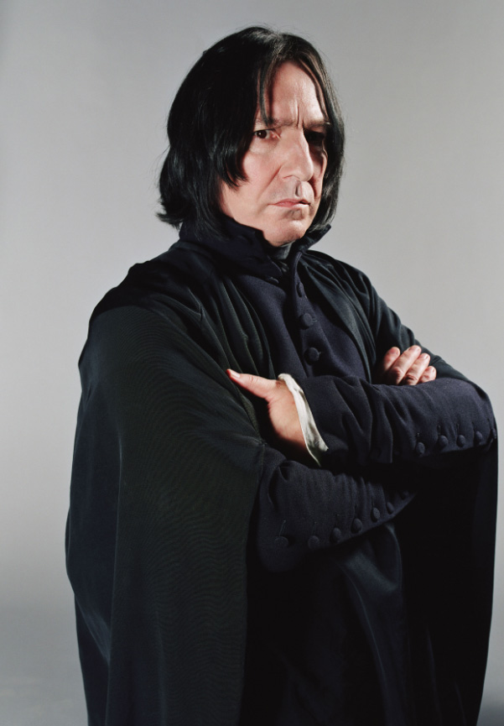
Questions?
Use the remaining time to work on HW2 and the review questions for word segmentation.

