Slide 1
Psych 156A/ Ling 150: Acquisition of Language II
Lecture 9
Word Meaning 2

Slide 2
Announcements
Pick up HW1 if you haven’t already
Be working on HW2 (due 5/15/12)
In-class midterm review 5/3/12
Midterm during class 5/8/12

Slide 3
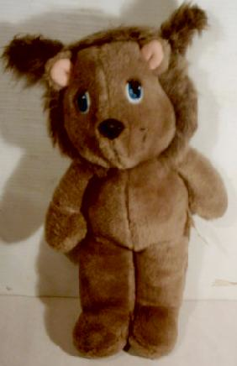
Computational Problem
“I love my dax.”
Dax = that specific toy, teddy bear, stuffed animal, toy, object, …?

Slide 4
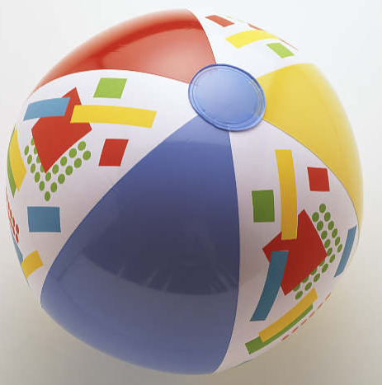
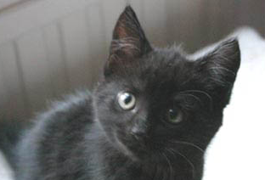
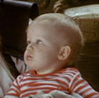
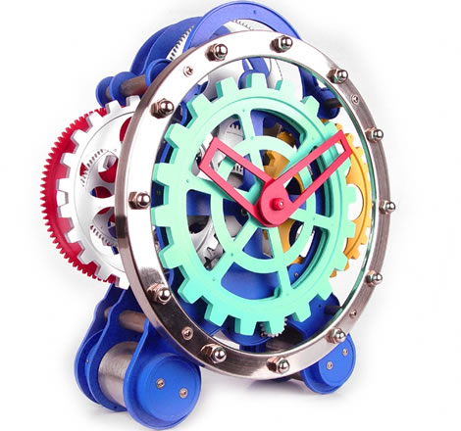
What we know about the process of word-learning
Word meanings are learned from very few examples. Fast-mapping is the extreme case of this, where one exposure is enough for children to infer the correct word-meaning mapping. However, cross-situational learning could work this way too, with a few very informative examples having a big impact.
ball
“Can I have the zib?”
kitty
bear
20 months
[unknown]

Slide 5
What we know about the process of word-learning
(2) Word meanings are often inferred from only positive examples. This means that children usually only see examples of what something is, rather than being explicitly told what something is not.
“What a cute dax!”
“I love my dax.”

Slide 6
What we know about the process of word-learning
(3) The target of word-learning is a system of overlapping concepts. That is, words pick out different aspects of our world, and it’s often the case that different words can refer to the same observable thing in the world.
“I love my teddy.”
“He’s my favorite toy.”
“He’s brown and cuddly.”

Slide 7
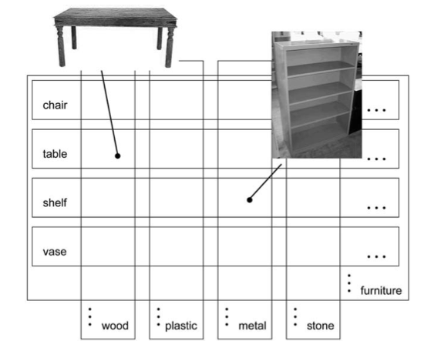
What we know about the process of word-learning
(3) The target of word-learning is a system of overlapping concepts. That is, words pick out different aspects of our world, and it’s often the case that different words can refer to the same observable thing in the world.
Shape vs. material labeling:
This is a desk.
It’s made of wood.
This bookcase is also made of wood.

Slide 8
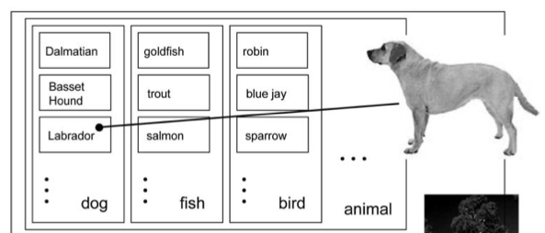
What we know about the process of word-learning
(3) The target of word-learning is a system of overlapping concepts. That is, words pick out different aspects of our world, and it’s often the case that different words can refer to the same observable thing in the world.
What level of specificity (object-kind labeling)?
“This is my labrador, who is a great dog, and a very friendly animal in general.”

Slide 9
What we know about the process of word-learning
(4) Inferences about word meaning based on examples should be graded, rather than absolute. That is, the child probably still has some uncertainty after learning from the input. This is particularly true if the input is ambiguous (as in cross-situational learning).
“I love my dax and my kleeg.”
“There are my favorite dax and kleeg!”
Some uncertainty remains abut whether “dax” is this or this.

Slide 10
Bayesian learning for word-meaning mapping
Xu & Tenenbaum (2007: Psychological Review) hypothesize that a child using Bayesian learning would show these behaviors during word learning.
Claim: “Learners can rationally infer the meanings of words that label multiple overlapping concepts, from just a few positive examples. Inferences from more ambiguous patterns of data lead to more graded and uncertain patterns of generalization.”

Slide 11
The importance of the hypothesis space
An important consideration: Bayesian learning can only operate over a defined hypothesis space.
Example of a potential hypothesis space for dog:
dog = dog parts, front half of dog, dog spots, all spotted things, all running things, all dogs + one cat
Two traditional constraints on children’s hypothesis (learning biases):
Whole Object constraint: First guess is that a label refers to a whole object, rather than part of the object (dog parts, front half of dog) or an attribute of the object (dog spots)
Taxonomic constraint (Markman 1989): First guess about an unknown label is that it applies to the taxonomic class (ex: dog, instead of all running things or all dogs + one cat)

Slide 12
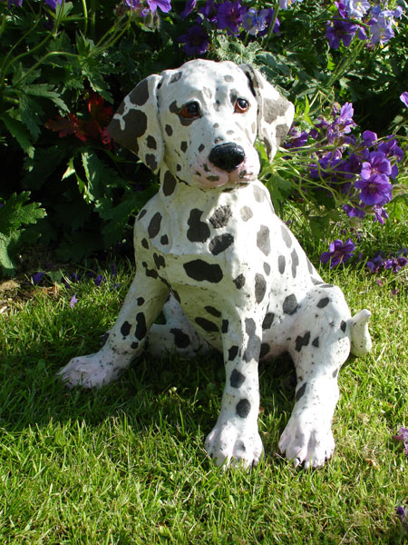
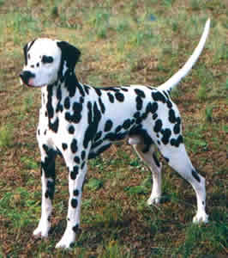
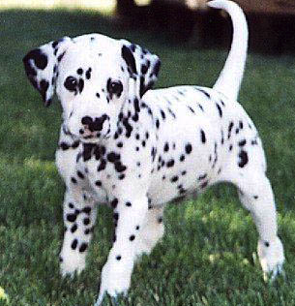
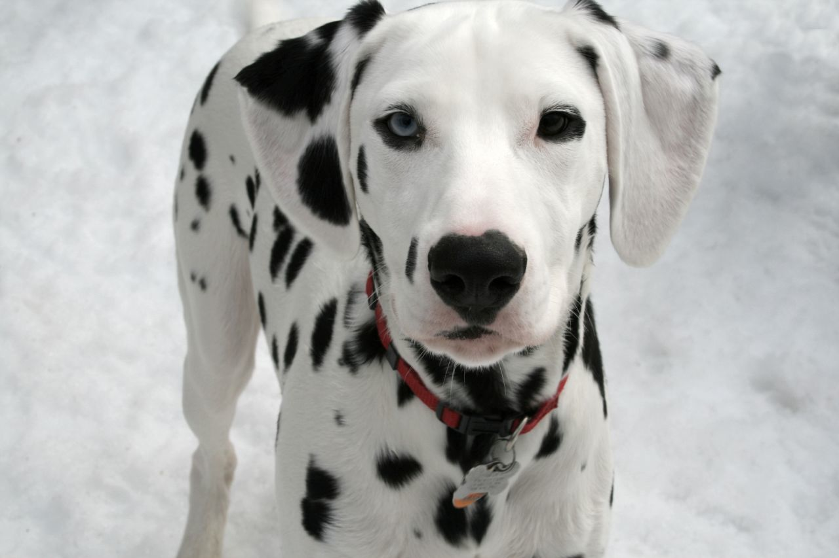
Suspicious coincidences & Bayesian learning
Situation:
fep
fep
fep
fep
Suspicious: Why is no other animal or other kind of dog a fep if fep can really label any animal or any kind of dog?
Bayesian reasoning: Would expect to see other animals (or dogs) labeled as fep if fep really could mean those things. If fep continues not to be used this way, this is growing support that fep cannot mean those things.

Slide 13
Formal instantiation of “suspicious coincidence”
Has to do with expectation of the data points that should be encountered in the input
If the more-general generalization (dog) is correct, the learner should encounter some data that can only be accounted for by the more-general generalization (like beagles or poodles). This data would be incompatible with the less-general generalization (dalmatian).
More-General (dog)
Less-general (dalmatian)
Notes:
13

Slide 14
Formal instantiation of “suspicious coincidence”
Has to do with expectation of the data points that should be encountered in the input
If the learner keeps not encountering data compatible only with the more-general generalization, the less-general generalization becomes more and more likely to be the generalization responsible for the language data encountered.
More-General (dog)
Less-general (dalmatian)
Notes:
14

Slide 15
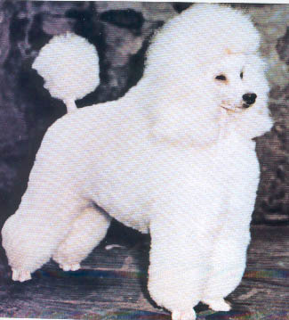
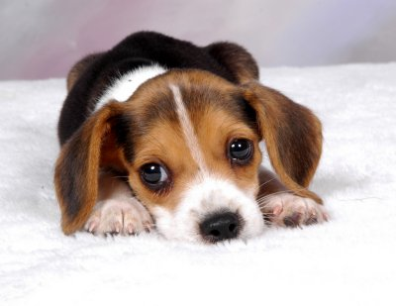
Formal instantiation of “suspicious coincidence”
Another way to think about it: probability of generating data points
Suppose there are only 5 dogs in the world that we know about, as shown in this diagram.
Hypothesis 1 (H1): The less-general hypothesis is true, and fep means dalmatian.
Hypothesis 2 (H2): The more-general hypothesis is true, and fep means dog.
More-General (dog)
Less-general (dalmatian)
Notes:
15

Slide 16
Formal instantiation of “suspicious coincidence”
Another way to think about it: probability of generating data points
What’s the likelihood of selecting this dog for each hypothesis?
p( | H1) = 1/3
(since only three dogs are possible)
p( | H2) = 1/5
(since all five dogs are possible)
More-General (dog)
Less-general (dalmatian)

Slide 17
Formal instantiation of “suspicious coincidence”
Another way to think about it: probability of generating data points
This means the likelihood for the less-general hypothesis is always going to be larger than the likelihood of the more-general hypothesis for data points that both hypotheses can account for.
More-General (dog)
Less-general (dalmatian)

Slide 18
Formal instantiation of “suspicious coincidence”
Another way to think about it: probability of generating data points
If the prior is equal (ex: before any data, both hypotheses are equally likely), then the posterior probability will be greater for the less-general hypothesis.
p(H1 | ) ∝ p( | H1) * p(H1)
∝ 1/3 * p(H1)
p(H2 | ) ∝ p( | H2) * p(H2)
∝ 1/5 * p(H2)
More-General (dog)
Less-general (dalmatian)

Slide 19
Suspicious coincidences and children
Xu & Tenenbaum (2007) wanted to see if children have this kind of response to suspicious coincidences. If so, that means that they make specific generalizations when they encounter data that are compatible with multiple hypotheses about word meaning, in particular:
subordinate (least-general), ex: dalmatian
basic, ex: dog
superordinate (most-general), ex: animal

Slide 20
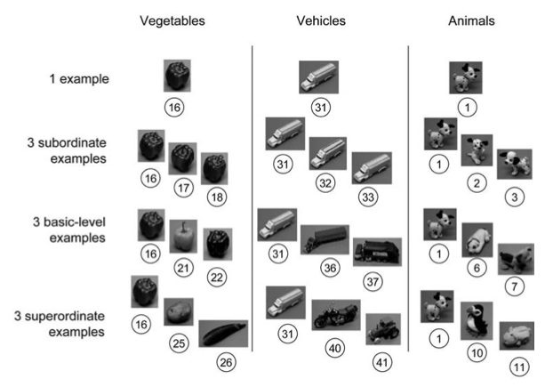
Testing children
Subjects: 3- and 4-year-old children
Task, part 1: Children were presented with three examples of a novel word (“blick”, “fep”, or “dax”) during training. (“This is a blick/fep/dax”) There were three classes of stimuli: vegetables, vehicles, and animals.
The vegetable class had these levels:
subordinate: green pepper
basic: pepper
superordinate: vegetable

Slide 21
Testing children
Subjects: 3- and 4-year-old children
Task, part 1: Children were presented with three examples of a novel word (“blick”, “fep”, or “dax”) during training. (“This is a blick/fep/dax”) There were three classes of stimuli: vegetables, vehicles, and animals.
The vehicle class had these levels:
subordinate: yellow truck
basic: truck
superordinate: vehicle

Slide 22
Testing children
Subjects: 3- and 4-year-old children
Task, part 1: Children were presented with three examples of a novel word (“blick”, “fep”, or “dax”) during training. (“This is a blick/fep/dax”) There were three classes of stimuli: vegetables, vehicles, and animals.
The animal class had these levels:
subordinate: terrier
basic: dog
superordinate: animal

Slide 23
Testing children
Subjects: 3- and 4-year-old children
Task, part 1: Children were presented with three examples of a novel word (“blick”, “fep”, or “dax”) during training. (“This is a blick/fep/dax”) There were three classes of stimuli: vegetables, vehicles, and animals.
There were four conditions:
The 1-example condition presented the same object & label three times.

Slide 24
Testing children
Subjects: 3- and 4-year-old children
Task, part 1: Children were presented with three examples of a novel word (“blick”, “fep”, or “dax”) during training. (“This is a blick/fep/dax”) There were three classes of stimuli: vegetables, vehicles, and animals.
There were four conditions:
The 1-example condition presented the same object & label three times.
“This is a fep.”
“This is a fep.”
“This is a fep.”

Slide 25
Testing children
Subjects: 3- and 4-year-old children
Task, part 1: Children were presented with three examples of a novel word (“blick”, “fep”, or “dax”) during training. (“This is a blick/fep/dax”) There were three classes of stimuli: vegetables, vehicles, and animals.
There were four conditions:
The 3-subordinate example condition presented a subordinate object & label three times.

Slide 26
Testing children
Subjects: 3- and 4-year-old children
Task, part 1: Children were presented with three examples of a novel word (“blick”, “fep”, or “dax”) during training. (“This is a blick/fep/dax”) There were three classes of stimuli: vegetables, vehicles, and animals.
There were four conditions:
The 3-subordinate example condition presented a subordinate object & label three times.
“This is a fep.”
“This is a fep.”
“This is a fep.”

Slide 27
Testing children
Subjects: 3- and 4-year-old children
Task, part 1: Children were presented with three examples of a novel word (“blick”, “fep”, or “dax”) during training. (“This is a blick/fep/dax”) There were three classes of stimuli: vegetables, vehicles, and animals.
There were four conditions:
The 3-basic-level example condition presented a basic-level object & label three times.

Slide 28
Testing children
Subjects: 3- and 4-year-old children
Task, part 1: Children were presented with three examples of a novel word (“blick”, “fep”, or “dax”) during training. (“This is a blick/fep/dax”) There were three classes of stimuli: vegetables, vehicles, and animals.
There were four conditions:
The 3-basic-level example condition presented a basic-level object & label three times.
“This is a fep.”
“This is a fep.”
“This is a fep.”

Slide 29
Testing children
Subjects: 3- and 4-year-old children
Task, part 1: Children were presented with three examples of a novel word (“blick”, “fep”, or “dax”) during training. (“This is a blick/fep/dax”) There were three classes of stimuli: vegetables, vehicles, and animals.
There were four conditions:
The 3-superordinate example condition presented a superordinate object & label three times.

Slide 30
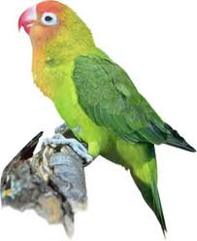
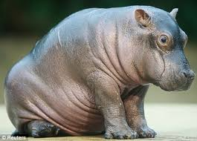
Testing children
Subjects: 3- and 4-year-old children
Task, part 1: Children were presented with three examples of a novel word (“blick”, “fep”, or “dax”) during training. (“This is a blick/fep/dax”) There were three classes of stimuli: vegetables, vehicles, and animals.
There were four conditions:
The 3-superordinate example condition presented a superordinate object & label three times.
“This is a fep.”
“This is a fep.”
“This is a fep.”

Slide 31
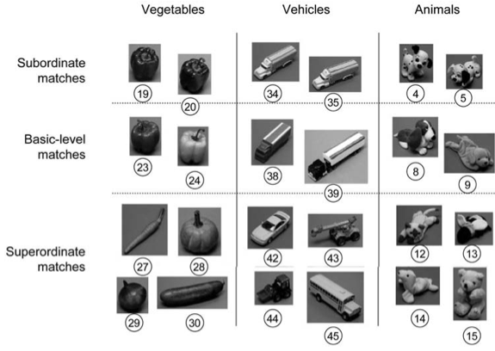
Testing children
Subjects: 3- and 4-year-old children
Task, part 2: generalization (asked to help Mr.Frog identify only things that are “blicks”/ “feps”/ “daxes” from a set of new objects)
There were three kinds of matches available:
Subordinate matches (which were the least general, given the examples the children were trained on)

Slide 32
Testing children
Subjects: 3- and 4-year-old children
Task, part 2: generalization (asked to help Mr.Frog identify only things that are “blicks”/ “feps”/ “daxes” from a set of new objects)
There were three kinds of matches available:
Basic-level matches (which were more general, given the examples the children were trained on)

Slide 33
Testing children
Subjects: 3- and 4-year-old children
Task, part 2: generalization (asked to help Mr.Frog identify only things that are “blicks”/ “feps”/ “daxes” from a set of new objects)
There were three kinds of matches available:
Superordinate-level matches (which were the most general, given the examples the children were trained on)

Slide 34
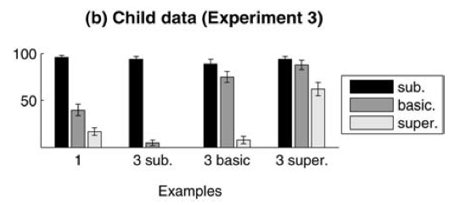
Children’s generalizations
When children heard a single example three times, they readily generalized to the subordinate class, but were less likely to generalize to the basic-level, and even less likely to generalize to the superordinate level. This shows that young children are fairly conservative in their generalization behavior.
“This is a fep.”
“This is a fep.”
“This is a fep.”

Slide 35
Children’s generalizations
When children had only subordinate examples as input, they readily generalized to the subordinate class, but almost never generalized beyond that. They were sensitive to the suspicious coincidence, and chose the least-general hypothesis compatible with the data.
“This is a fep.”
“This is a fep.”
“This is a fep.”

Slide 36
Children’s generalizations
When children had basic-level examples as input, they readily generalized to the subordinate class and the basic-level class, but almost never generalized beyond that. They were again sensitive to the suspicious coincidence, and chose the least-general hypothesis compatible with the data.
“This is a fep.”
“This is a fep.”
“This is a fep.”

Slide 37
Children’s generalizations
When children had superordinate-level examples as input, they readily generalized to the subordinate class and the basic-level class, and often generalized to the superordinate class. They were again sensitive to the suspicious coincidence, though they were still a little uncertain how far to extend the generalization.
“This is a fep.”
“This is a fep.”
“This is a fep.”

Slide 38
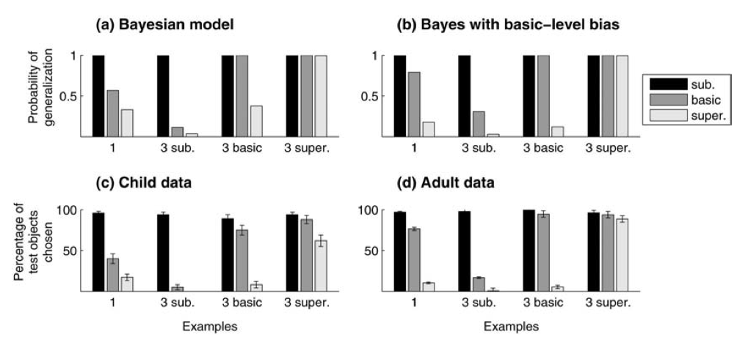
Modeling children’s responses
Xu & Tenenbaum (2007) found that children’s responses were best captured by a learning model that used Bayesian inference (and so was sensitive to suspicious coincidences).

Slide 39
Accounting for other observed behavior
How could a child using Bayesian inference make use of evidence like the following:
“That’s a dalmatian. It’s a kind of dog.”
This explicitly tells children that this object can be labeled as both “dalmatian” and “dog”, and moreover that “dog” is a more general term than “dalmatian”.

Slide 40
Accounting for other observed behavior
How could a child using Bayesian inference make use of evidence like the following:
“That’s a dalmatian. It’s a kind of dog.”
A Bayesian learner can treat this as conclusive evidence that dalmatian is a subset of dog and give 0 probability to any hypothesis where dalmatian is not contained within the set of dogs.
dog
spotted
This hypothesis now has 0 probability.

Slide 41
Accounting for other observed behavior
How could a child using Bayesian inference incorporate lexical contrast, where the meaning of all words must somehow differ?
This is particularly important when the child already knows some words like “dog” (ex: “cat”, “puppy”, “pet”)
In a Bayesian learner, the prior of hypotheses whose set of referents overlap is lower.
Lower prior
Higher prior
Known word’s set of referents

Slide 42
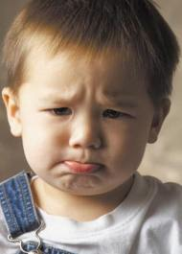
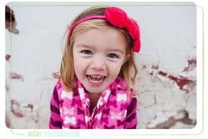
An open question
Early word-learning (younger than 3-years-old) appears to be slow & laborious – if children are using Bayesian inference, this shouldn’t be the case. Why would this occur?
Potential explanations:
(1) Bayesian inference capacity isn’t yet active in early word-learners. Even though older children (such as the ones tested in Xu & Tenenbaum (2007)) can use this ability, younger children cannot.

Slide 43
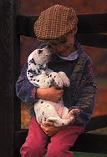
An open question
Early word-learning (younger than 3-years-old) appears to be slow & laborious – if children are using Bayesian inference, this shouldn’t be the case. Why would this occur?
Potential explanations:
(2) The hypothesis spaces of young children may not be sufficiently constrained to make strong inferences. For example, even though adults know that the set of dogs is much larger than the set of dalmatians, young children may not know this - especially if their family dog is a dalmatian, and they don’t know many other dogs.

Slide 44
An open question
Early word-learning (younger than 3-years-old) appears to be slow & laborious – if children are using Bayesian inference, this shouldn’t be the case. Why would this occur?
Potential explanations:
(3) Young children’s ability to remember words and/or their referents isn’t stable. That is, even if someone points out a dalmatian to a child, the child can’t remember the word form or the referent long enough to use that word-meaning mapping as input. (Remember - there’s a lot going on in children’s worlds, and they have limited cognitive resources!) This makes the child’s input much less informative than that same input would be to an adult.

Slide 45
Recap
Word-learning is difficult because many words refer to concepts that can overlap in the real world. This means that there isn’t just one word for every thing in the world - there are many words, each picking out a different aspect of that thing.
Bayesian learning may be a strategy that can help children overcome this difficulty, and experimental evidence suggests that their behavior is consistent with a Bayesian learning strategy.
However, Bayesian learning may not be active or help sufficiently at the very earliest stages of word-learning.

Slide 46
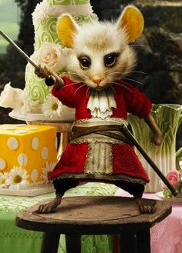
Questions?
Use the remaining time to work on HW2 and the review questions for word meaning. You should be able to do up through question 5 on HW2 and all the review questions.

