Slide 1
Psych 56L/ Ling 51: Acquisition of Language
Lecture 10
Lexical Development II
Notes:
1

Slide 2
Announcements
Be working on review questions for lexical development
HW2 due 2/21/13
Notes:
2

Slide 3
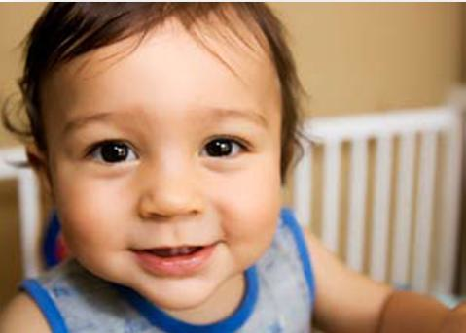
The Course of Early Lexical Development
Notes:
3

Slide 4
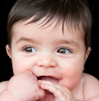
First Words
10-15 months: first words produced that actually sound like the words the child is trying to approximate (and they have a fixed meaning, as opposed to being sound sequences the child likes to say)
Note: This doesn’t mean children don’t understand words before this age, though. Bergelson & Swingley (2012) show that 6- to 9-month-olds understand familiar words like “nose” and “cookie”.
Notes:
4

Slide 5
First Words
10-15 months: first words produced that actually sound like the words the child is trying to approximate (and they have a fixed meaning, as opposed to being sound sequences the child likes to say)
These tend to be context-bound:
ex: “car” said when looking at cars out of apartment window, but not when looking at cars up close or when seeing a picture of a car
Children’s usage: have simply identified one particular event in the context of which it’s appropriate to use that word, but haven’t realized its more abstract coverage

Slide 6
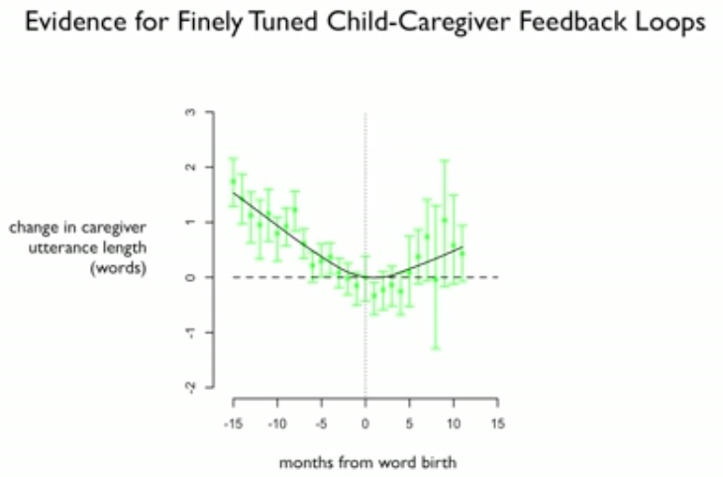
First Words
First words video & why might these words be learned earlier
http://www.ted.com/talks/deb_roy_the_birth_of_a_word.html
(~5:45 through ~11:00 of 19:52)

Slide 7
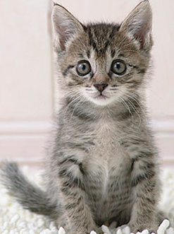
First Words
Even if children realize a word has more extended use, they still may not realize it has the meaning that adults have for it
Ex: “more” = request for more, not general comparison
Often, first words are parts of routines or language games. Children must then realize that these words can be extended.
kitty
Notes:
7

Slide 8
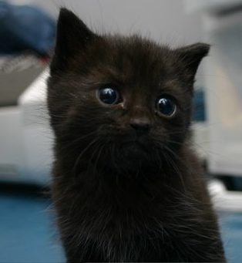
First Words
Even if children realize a word has more extended use, they still may not realize it has the meaning that adults have for it
Ex: “more” = request for more, not general comparison
Often, first words are parts of routines or language games. Children must then realize that these words can be extended.
kitty
Notes:
8

Slide 9
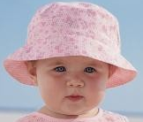
First Words
The extension process doesn’t happen at the same time for all words. Some referential words may coexist with words that are contextual. Which words are which will vary from child to child.
Jacqui: “no” = context-bound, used when refusing something offered by her mother (wouldn’t say it when offered by someone else or while indicating her dislike of something, etc.)
no
Notes:
9

Slide 10
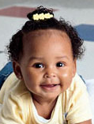
First Words
The extension process doesn’t happen at the same time for all words. Some referential words may coexist with words that are contextual. Which words are which will vary from child to child.
Jenny: “no” = referential, used when pushing a drink away, while crawling to a step she was not allowed to climb, while refusing a request by her mother
no
Notes:
10

Slide 11
First Words
In general, it’s not because children don’t hear these words in different contexts that they have a narrower meaning than adults do. Their parents used the words in many different contexts.
So what’s the problem?
It’s not an easy task to extract the common meaning from different contexts.
kitty = ?
Notes:
11

Slide 12
First Words
In general, it’s not because children don’t hear these words in different contexts that they have a narrower meaning than adults do. Their parents used the words in many different contexts.
So what’s the problem?
It’s not an easy task to extract the common meaning from different contexts.
cute = ?
Notes:
12

Slide 13
From 0 to 50 words
Vocabularies of children with 50 or less words are heavily concentrated on experiences child has: names for people, food, body parts, clothing, animals, household items. (In general, a lot of nouns = noun bias)
Adult and older children have more variety, including more abstract nouns, as well as other grammatical categories like prepositions (with, from), determiners (the, a), and adjectives (silly).
Notes:
13

Slide 14
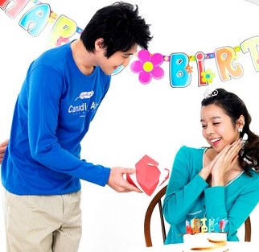
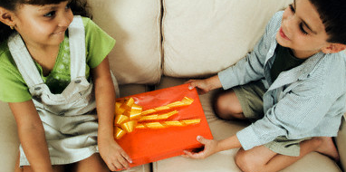
The Preponderance of Nouns
One idea: the meaning of nouns is easier to identify than the meaning of other words, like verbs
kitty = ?
give = ?
Notes:
14

Slide 15
The Preponderance of Nouns
How do we test if it’s true that the meaning of nouns is easier to learn from observation than the meaning of verbs?
Snedeker, Gleitman, & Brent (1999) asked adult speakers (who are presumably “cognitively mature”) to view scenes of what mothers are saying to their children and see which words they could learn.

Slide 16
Experiment with English Speakers
Snedeker, Gleitman, and Brent (1999)
Stimuli preparation
Videotape English speaking mothers playing with their 18- to 24-month-old children
2. Transcribe video tape for mothers’ 24 most
frequent nouns and 24 most frequent verbs.
3. For each of the most frequent words, randomly select 6 uses of the word.
4. Edit each instance for 40 second clips.
Audio was removed and a beep is sounded at instant word uttered.

Slide 17
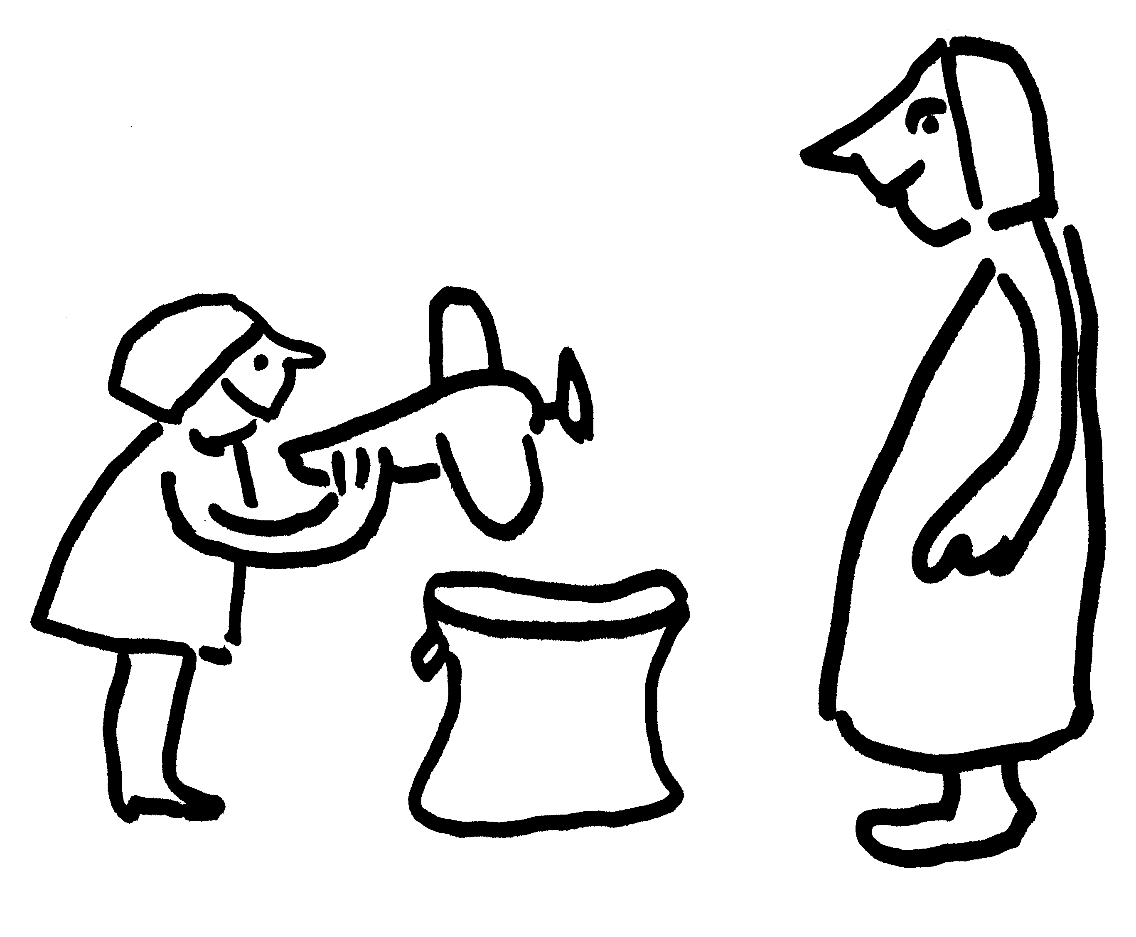
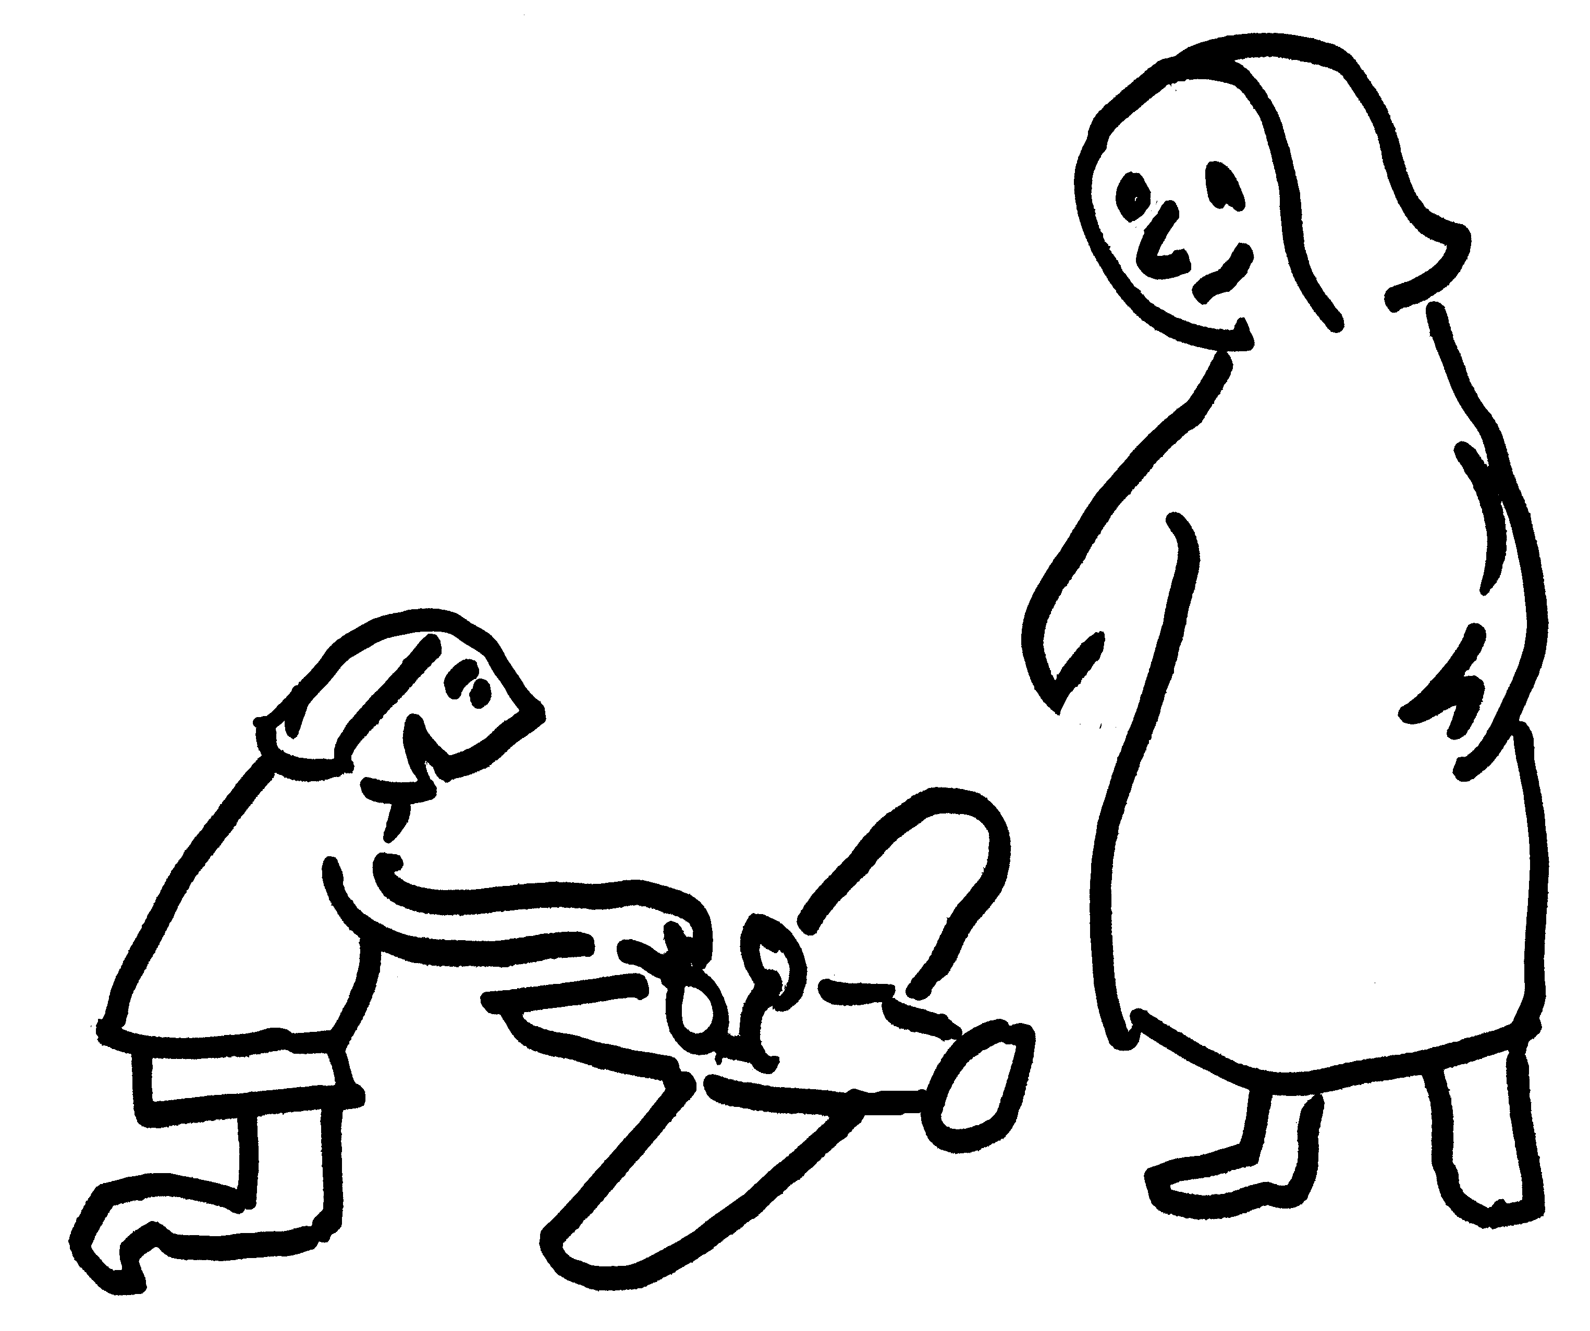
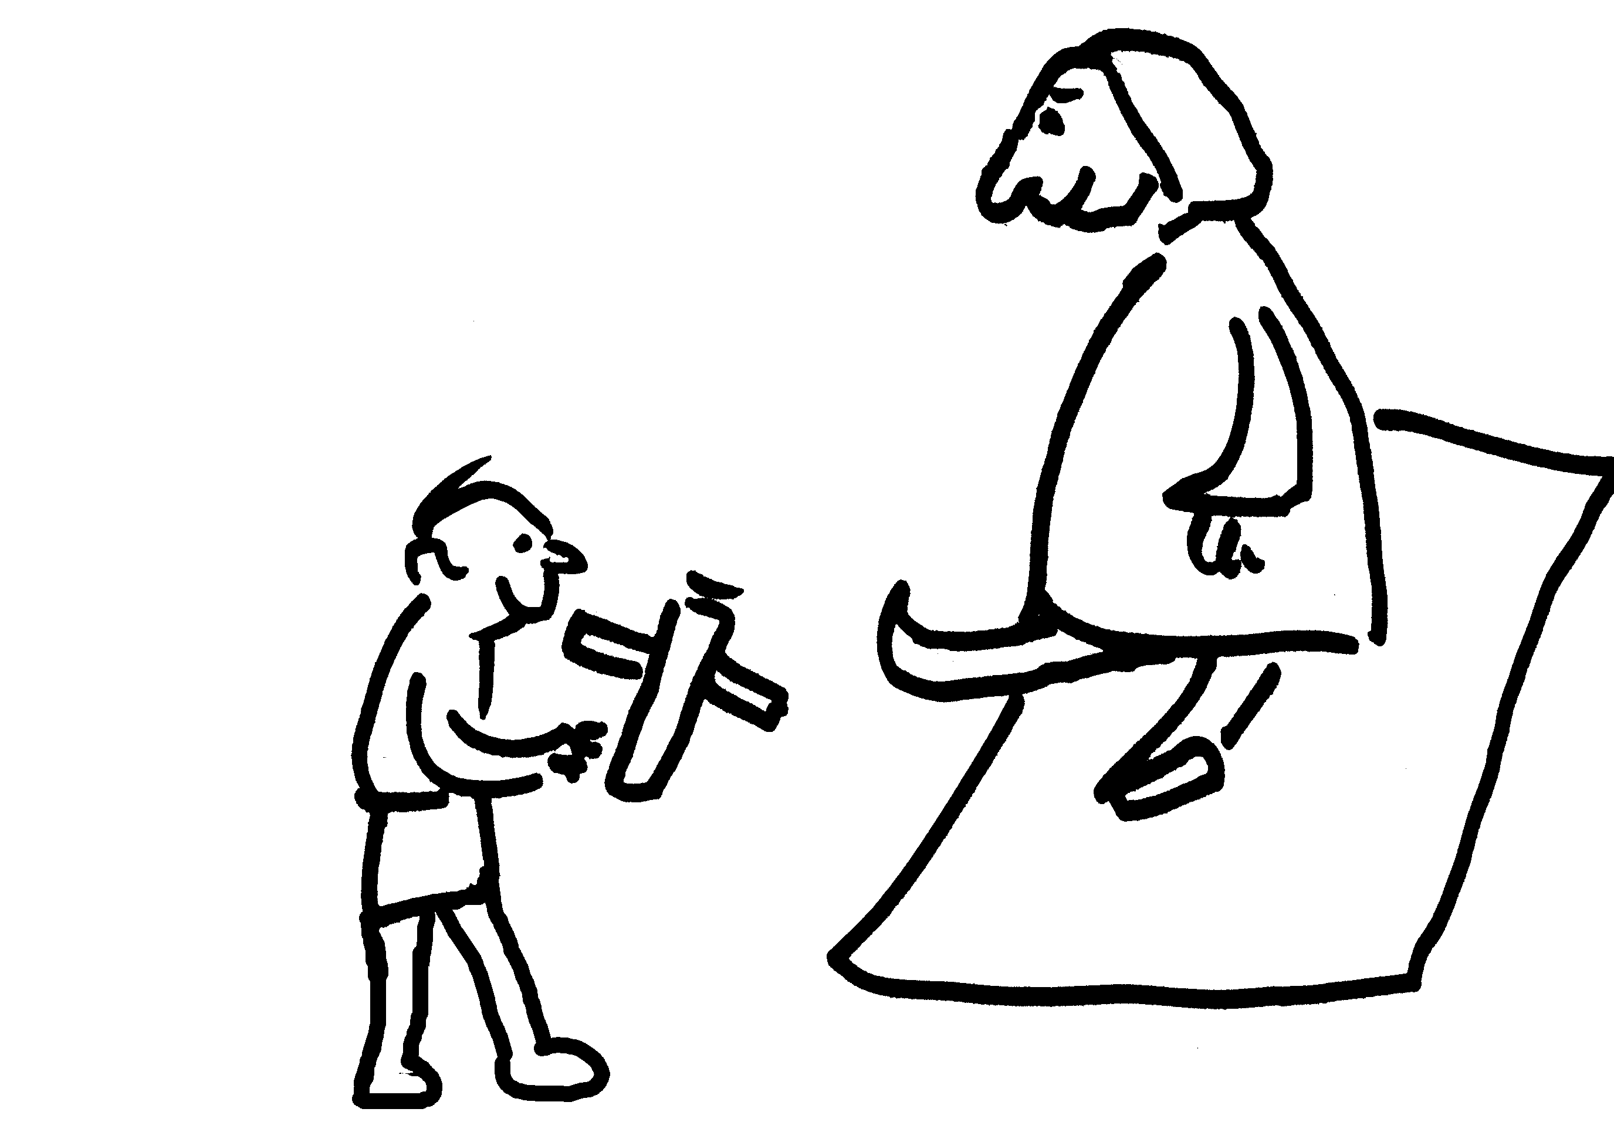
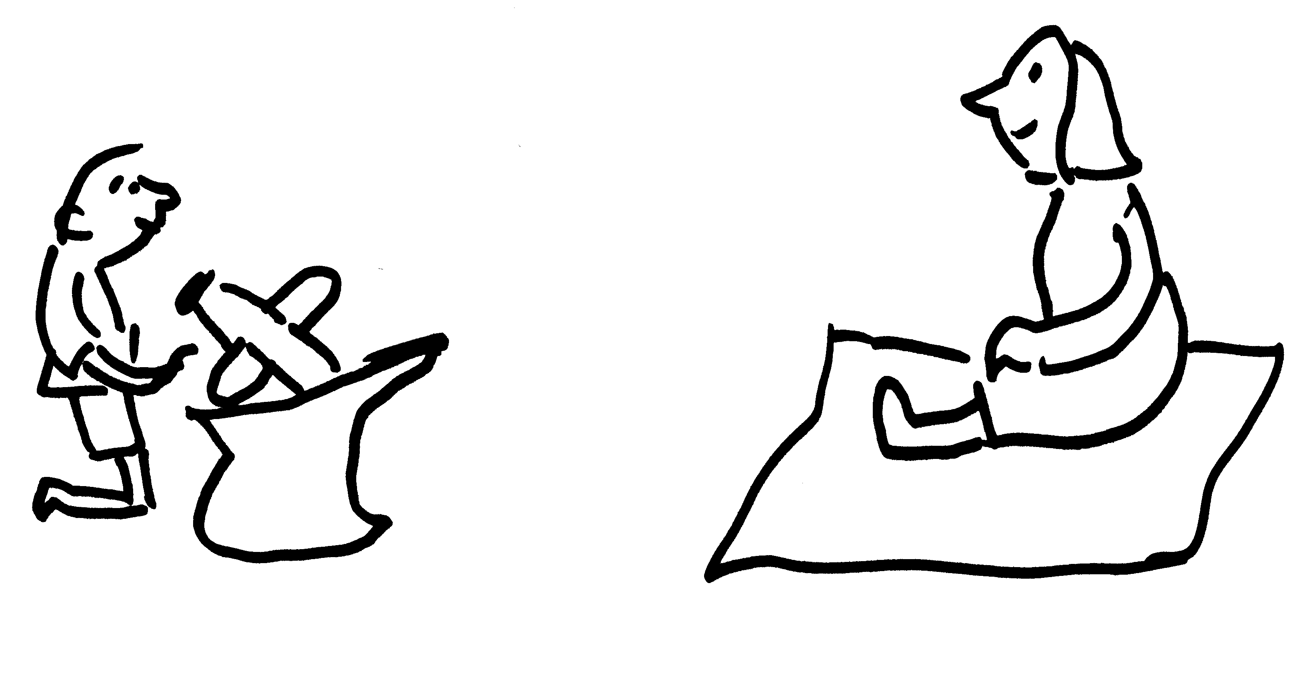
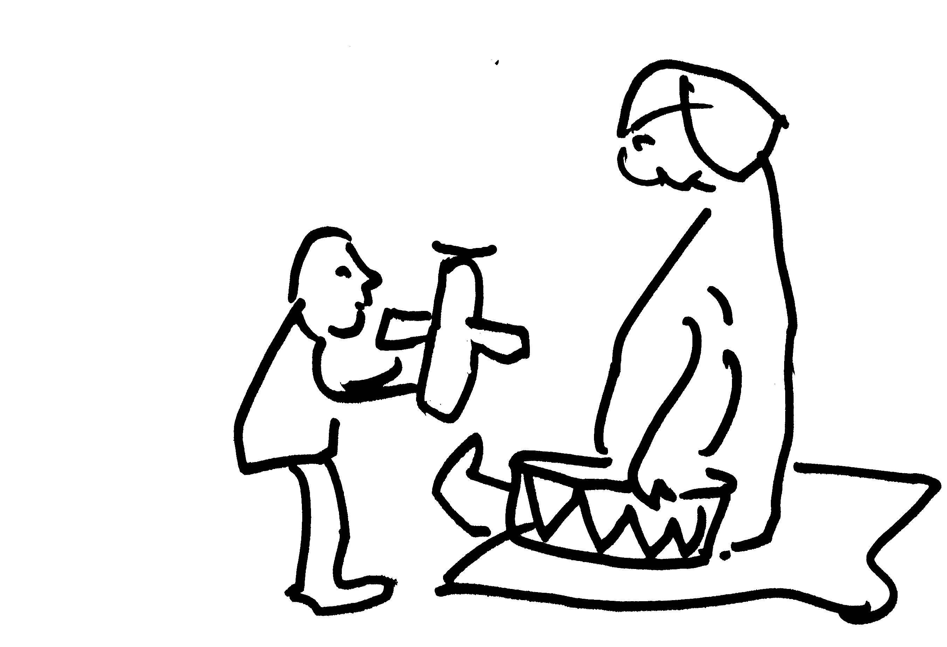
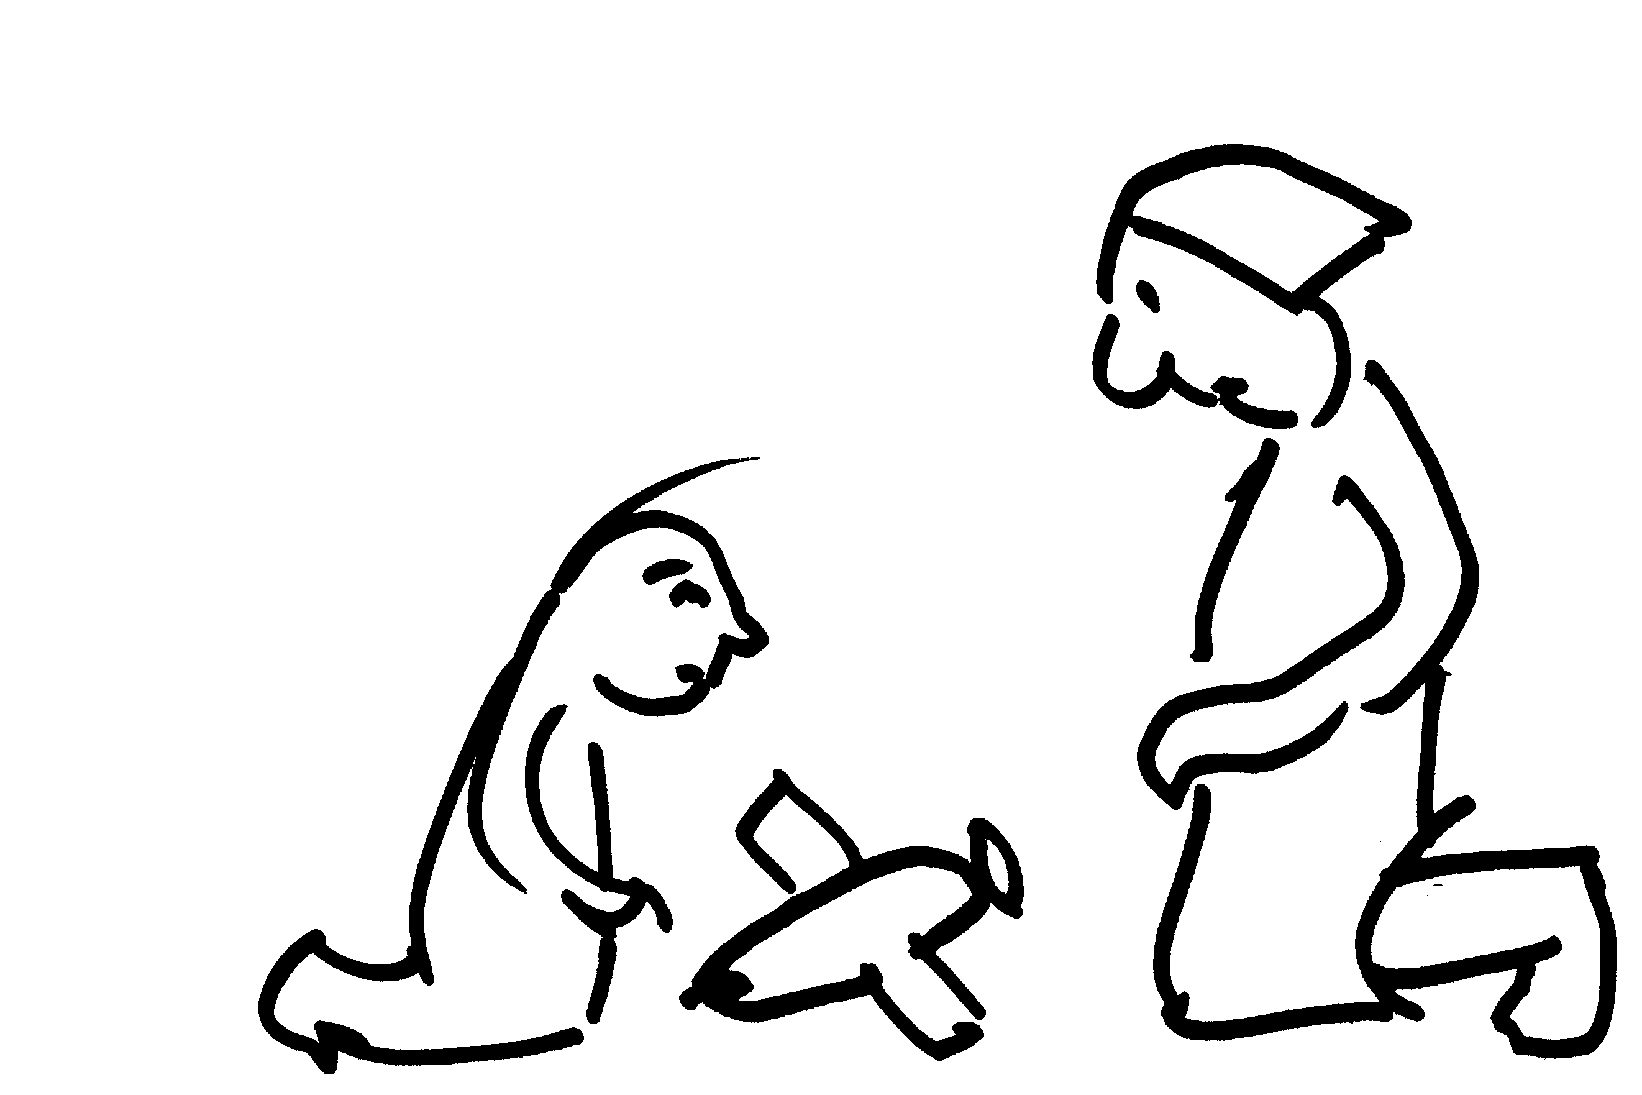
Subject’s Task:
Identify the “mystery word” represented by the beep.
watch clip #1
Guess word.
watch clip #2
Guess word again.
watch clip #3
Guess word again.
watch clip #4
Guess word again.
watch clip #5
Guess word again.
watch clip #6
Guess word again.
Final Guess
On to Next Mystery Word

Slide 18
Percent Correct Identification in English
Snedeker, Gleitman, and Brent (1999)
35%
30%
Noun
Verb
Nouns seem to be easier…why might that be?
25%
20%
Percentage of Correct Identification
15%
10%
5%
0%
English

Slide 19
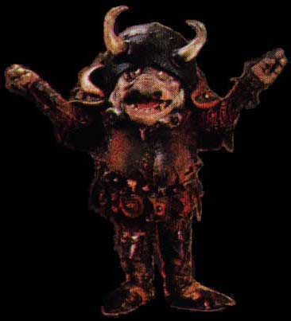
Learning Verb Meaning
Example of linguistic variation in verb meaning:
English:
The goblin fell into the river and then floated down it.
Spanish equivalent:
The goblin entered the river falling and then went down it floating.
Notes:
19

Slide 20
Learning Verb Meaning
Example of linguistic variation in verb meaning:
English:
The goblin fell into the river and then floated down it.
Go + Fall
In
Go + Float
Down
Go + In
Fall
Go
Down
Float
Spanish equivalent:
The goblin entered the river falling and then went down it floating.
Notes:
20

Slide 21
Learning Verb Meaning
Example of linguistic variation in verb meaning:
English:
The goblin fell into the river and then floated down it.
Go + Fall
In
Go + Float
Down
Manner of Motion encoded in verb
Direction of Motion encoded in verb
Go + In
Fall
Go
Down
Float
Spanish equivalent:
The goblin entered the river falling and then went down it floating.
Notes:
21

Slide 22
Becoming aware of language-specific preferences for verb meaning
Maguire et al. 2010
English and Spanish 2-year-olds seem to show a default preference for encoding direction of motion in a verb (perhaps because path information is more salient).
English and Spanish 5-year-olds seem to show a preference for encoding manner of motion in a verb.
By adulthood, English speakers maintain their preference for encoding the manner of motion in a verb while Spanish speakers recover their initial preference for encoding direction of motion.

Slide 23
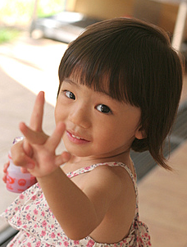
Also…
There is some crosslinguistic variation in the preference for nouns over verbs in the early lexicon.
Korean, Japanese, and Mandarin children show less of a noun bias (though there still is something of a noun bias). These languages have several ways of making verb information more salient to learners: verbs appearing sentence-final (very prominent for children), nouns optionally omitted
Notes:
23

Slide 24
How might verbs be learned?
Proposal for vocabulary development (Snedeker & Gleitman 2002):
1. Learn from Scenes
Child relies on situational context alone
Can learn only very concrete words: object labels

Slide 25
How might verbs be learned?
Proposal for vocabulary development (Snedeker & Gleitman 2002):
Learn from Scenes
Learn from Nouns
Object labels provide richer representation of linguistic context
– Utterance = set of known nouns
Child can learn concrete relational words like spatial prepositions (ex: “near”) and many verbs

Slide 26
How might verbs be learned?
Proposal for vocabulary development (Snedeker & Gleitman 2002):
Learn from Scenes
Learn from Nouns
Learn from Syntactic Frames
Learning relational words allows the child to learn the basic grammar of her language
Utterance is represented as a syntactic structure + known words
This representation allows the child to learn more abstract words

Slide 27
Snedeker & Gleitman (2002)
Targets
Videotaped interactions of 4 mother-child pairs
24 most common verbs chosen as targets
for each target 6 instances randomly selected
Subjects participated in one of 7 Information Conditions
Scenes
Nouns
Frames
Scenes + Nouns
Scenes + Frames
Nouns + Frames
Scenes + Nouns + Frames

Slide 28
Scenes Condition
Example “mystery verb”: “play”
beep
Guess Word.
Task: Subjects guess mystery verb from watching 6 instances of word use in video clips. The video clips are silent except beeps replace the moments the mystery word were uttered.
beep
Guess Word Again.
Etc….
Final Guess
On to Next Mystery Verb

Slide 29
Nouns Condition
Example “mystery verb”: “play”
1. elephant, piano
2. mommy
3. I, it, you
4. it, you
5. drums
6. music, you
Guess Word.
Guess Word Again.
Guess Word Again.
Task: Subjects shown the nouns co-occurring with the mystery verb in 6 sentences, the same sentences as those in the video clips with the beeps.
Guess Word Again.
Guess Word Again.
Final Guess
On to Next Mystery Verb

Slide 30
Frames Condition
Example “mystery verb”: “play”
1. Can kax SIRN the bussit?
2. Noggle SIRN?
3. Can po SIRN while lo nirp nu?
4. Lo are gonna SIRN nu?
5. SIRN the neps.
6. Lo SIRN tuggy wilm.
Guess Word.
Guess Word Again.
Guess Word Again.
Task: Subjects guess the mystery verb from the 6 sentence frames. The sentence frames are constructed by replacing words in the 6 utterances with nonsense words.
Guess Word Again.
Guess Word Again.
Final Guess
On to Next Mystery Verb

Slide 31
Correct Identification Varies with Information Condition
90%
80%
70%
60%
p < .05
(significant)
50%
% Correct on Final Trial
Frames
40%
30%
Nouns
Scenes
20%
10%
0%

Slide 32
Correct Identification Varies with Information Condition
90%
p < .05
Full Info
80%
70%
60%
p < .05
50%
% Correct on Final Trial
40%
Scenes+Nouns
30%
Scenes
20%
10%
0%

Slide 33
Correct Identification Varies with Information Condition
90%
p < .05
Full Info
80%
Nouns
+
Frames
Scenes
+
Frames
70%
60%
Scenes
+
Nouns
p < .05
50%
% Correct on Final Trial
Frames
40%
p < .05
30%
Nouns
Scenes
20%
10%
0%

Slide 34
Utility of syntactic frame knowledge: Scenes + Nouns equivalent to Syntactic Frames only
90%
p < .05
Full Info
80%
Nouns
+
Frames
Scenes
+
Frames
70%
60%
Scenes
+
Nouns
p < .05
50%
% Correct on Final Trial
Frames
40%
p < .05
30%
Nouns
Scenes
20%
10%
0%

Slide 35
Utility of additional knowledge with Frames: Scenes + Frames equivalent to Nouns + Frames, which is better than Frames alone
90%
p < .05
Full Info
80%
Nouns
+
Frames
Scenes
+
Frames
70%
60%
Scenes
+
Nouns
p < .05
50%
% Correct on Final Trial
Frames
40%
p < .05
30%
Nouns
Scenes
20%
10%
0%

Slide 36
Superiority of using all the available information: Scenes + Nouns + Frames is better than all other information type combinations
90%
p < .05
Full Info
80%
Nouns
+
Frames
Scenes
+
Frames
70%
60%
Scenes
+
Nouns
p < .05
50%
% Correct on Final Trial
Frames
40%
p < .05
30%
Nouns
Scenes
20%
10%
0%

Slide 37
So Snedeker & Gleitman (2002) have shown that maybe learning verbs isn’t so bad once you have some linguistic background (like knowing some nouns and some syntactic frames) and informative situational context (scenes)…
Now, back to learning nouns (a first step)…

Slide 38
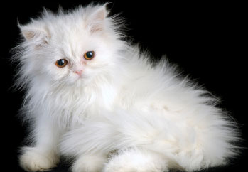
Common mistakes children make with meaning
Once children figure out that words are referential, they have to figure out what range of concepts words apply to. This isn’t so easy.
Underextension: using words in a narrower range.
Ex: Only siamese and Persian cats are cats.
kitty
Not kitty
Notes:
38

Slide 39
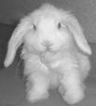
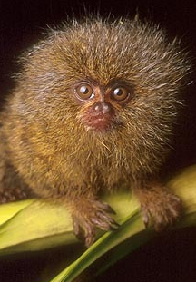
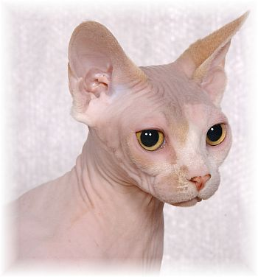
Common mistakes children make with meaning
Once children figure out that words are referential, they have to figure out what range of concepts words apply to. This isn’t so easy.
Overextension: using words in a wider range. (more common)
Ex: All fuzzy creatures are cats.
kitty
Not kitty
Notes:
39

Slide 40
Causes of extension errors
Underextension: perhaps child is conservatively extending hypothesis about what word refers to; correctable from experience with word’s usage by adults.
Overextension: Likely to simply be because child doesn’t know appropriate word and uses one that’s known. Overextensions tend to have some aspect of meaning in common, though. Corrected as children learn appropriate words for meanings they want to express.
Notes:
40

Slide 41
Some more overextension examples
Ball = ball, balloon, marble, apple, egg, wool pom-pom, spherical water tank
common feature = “round-ish shape”
Cat = cat, cat’s usual location on top of tv when absent
common feature = “associated with kitty”
Notes:
41

Slide 42
Some more overextension examples
Ball = ball, balloon, marble, apple, egg, wool pom-pom, spherical water tank
common feature = “round-ish shape”
Cat = cat, cat’s usual location on top of tv when absent
common feature = “associated with kitty”
Moon = moon, half-moon-shaped lemon slice, circular chrome dial on dishwasher, ball of spinach, wall hanging with pink and purple circles, half a Cheerio, hangnail
common feature = “crescent or round-ish shape” + a memory retrieval error?
Notes:
42

Slide 43
A Little Later Lexical Development
Notes:
43

Slide 44
The difference after 50 words
Up to 50 words: about 8-11 words added every month, adding words is a slow process
After 50 words: about 22-37 words added every month, words often added after a single exposure
Called the “word spurt”, “word explosion”, “naming explosion”.
Occurs for most (but not all) children around 18 months.
Notes:
44

Slide 45
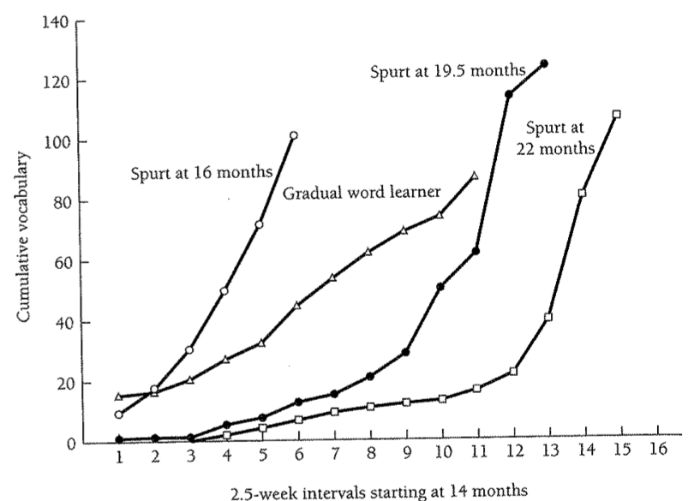
Does every child have a word spurt?
Some seem to
(13 of 18)
Goldfield & Reznick (1990)
Notes:
45

Slide 46
Does every child have a word spurt?
Others don’t
(5 of 18)
Goldfield & Reznick (1990)
Notes:
46

Slide 47
Word Comprehension
The word spurt refers to words children actually produce. However, another way to test children’s developing lexicons is via their comprehension of words.
Production usually lags behind comprehension.
Ex: At 16 months, children typically produce less than 50 words, but parents report they comprehend between 92 and 321 words.
Production vocabularies are different from comprehension vocabularies. (This may be because communication works just fine with a minimal verb vocabulary. Ex: go is very versatile. Go + night-night, go + car, go + park, etc.)
Notes:
47

Slide 48
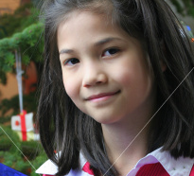
How learning works: Links between phonology and word-learning
phonological memory = ability to remember a sequence of unfamiliar sounds
Children’s phonological memory has been linked to their vocabulary size from 22 months up to 9 years old. (This makes sense since the ability to remember the forms of newly encountered words would be vital if a child wants to learn the mapping between sound and meaning.)
Notes:
48

Slide 49
How learning works: Links between motherese and word-learning
Ma, Golinkoff, Houston, & Hirsh-Pasek (2011) found that 21-month-olds learn better from child-directed speech (as compared to regular adult-directed speech).
What this means: Remember that motherese has exaggerated prosody, and when learning novel words early on in lexical development, children rely more on prosodic cues. Also, the exaggerated prosody may get children’s attention more.

Slide 50
How learning works: Links between social cues and word-learning
Brooks & Meltzoff 2008: 10- and 11-month-old infants who follow the gaze of their caretakers and pointed themselves when learning new words had faster vocabulary growth.
What this means: Very early word learning may be greatly facilitated by these kind of social cues in a communicative context.

Slide 51
Recap: Children’s Lexical Development
Children must figure out the lexicon of their language, including the correspondence between sounds and meaning
Children typically acquire their first 50 words over a series of months, and then increase their rate of lexical acquisition suddenly (word spurt)
Learning word meanings isn’t easy:
- some kinds of words may be more difficult to learn than others (nouns vs. verbs)
- often, children make mistakes by either assigning a narrower or wider meaning to a word than adults do. Eventually, through experience with the language, they home in on the correct meaning.
Notes:
51

Slide 52
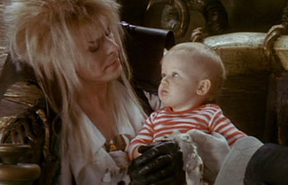
Questions?
You should be able to do up through question 8 on HW2, and up through question 16 on the lexical development review questions.
Notes:
52

