Slide 1
Psych 56L/ Ling 51: Acquisition of Language
Lecture 13
Development of Morphology & Syntax II
Notes:
1

Slide 2
Announcements
HW 2 should be graded by Thursday 2/28/13
HW 3 is due 3/12/13 - be working on it
Be working on the review questions for morphology and syntax
Notes:
2

Slide 3
From One Word to Many
Notes:
3

Slide 4
Beyond Single Word Speech
Unanalyzed combinations: most children have transitional forms that combine multiple words, but which the child doesn’t realize are multiple words
Ex: “Iwant” (I want), “Idunno” (I don’t know)
Notes:
4

Slide 5
Productive Word Combination
Productive: being able to use known vocabulary in different combinations
sit
cookie
daddy
juice
mommy
little
sleep
wet
more
hot
two
blue
Notes:
5

Slide 6
Productive Word Combination
Productive: being able to use known vocabulary in different combinations
sit
cookie
daddy
juice
mommy
little
daddy
cookie
sleep
wet
“daddy’s cookie”
more
hot
two
blue
Notes:
6

Slide 7
Productive Word Combination
Productive: being able to use known vocabulary in different combinations
sit
cookie
daddy
juice
mommy
little
cookie
daddy
sleep
wet
“cookie to daddy”
more
hot
two
blue
Notes:
7

Slide 8
Productive Word Combination
Productive: being able to use known vocabulary in different combinations
sit
cookie
daddy
juice
mommy
little
more
cookie
sleep
wet
“more cookies”
more
hot
two
blue
Notes:
8

Slide 9
Productive Word Combination
Productive: being able to use known vocabulary in different combinations
sit
cookie
daddy
juice
mommy
little
more
juice
sleep
wet
“more juice”
more
hot
two
blue
Notes:
9

Slide 10
Productive Word Combination
Productive: being able to use known vocabulary in different combinations
sit
cookie
daddy
juice
mommy
little
two
cookie
sleep
wet
“two cookies”
more
hot
two
blue
Notes:
10

Slide 11
Productive Word Combination
Productive: being able to use known vocabulary in different combinations
sit
cookie
daddy
juice
mommy
little
mommy
wet
sleep
wet
“mommy’s wet”
more
hot
two
blue
Notes:
11

Slide 12
Productive Word Combination
Productive: being able to use known vocabulary in different combinations
sit
cookie
daddy
juice
mommy
little
daddy
wet
sleep
wet
“daddy’s wet”
more
hot
two
blue
Notes:
12

Slide 13
Productive Word Combination
Productive: being able to use known vocabulary in different combinations
sit
cookie
daddy
juice
mommy
little
daddy
sit
sleep
wet
“daddy’s sitting”
more
hot
two
blue
Notes:
13

Slide 14
Beyond Two Words
Even when children produce multiword utterances, they still produce single word utterances.
Point: children’s development measured by the maximum number of words they produce in a given utterance.
When children start to put 3 words together, many of these utterances are combinations of the relational meanings expressed in the two word stage.
“I watching cars” = “I watching” + “watching cars”
“Put it table” = “Put it” + “it table”
Notes:
14

Slide 15
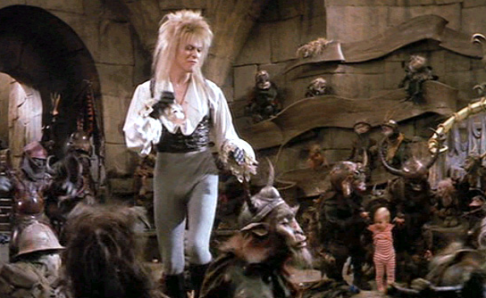
Beyond Two Words
Early sentences tend to be imperatives (commands), as well as affirmative, declarative statements. Questions and negations come later.
Imperative:
“Dance with them!”
Affirmative, declarative:
“I dance with them.”
Question: “Can I dance with them?”
Negation: “I don’t dance with them.”
Notes:
15

Slide 16
Development of Sentence Forms
Not all sentence forms are created equal - some are harder to get the hang of than others.
Negation: requires use of negative word and auxiliary verb
Stage 1: external negative marker
No wipe finger.
No the sun shining.
No mitten.
Wear mitten no.
Notes:
16

Slide 17
Development of Sentence Forms
Not all sentence forms are created equal - some are harder to get the hang of than others.
Negation: requires use of negative word and auxiliary verb
Stage 2: internal negative marker
I can’t see you.
I don’t like you.
I no want envelope.
Notes:
17

Slide 18
Development of Sentence Forms
Not all sentence forms are created equal - some are harder to get the hang of than others.
Negation: requires use of negative word and auxiliary verb
Stage 3: auxiliary constructions
I didn’t did it.
Donna won’t let go.
No, it isn’t.
Notes:
18

Slide 19
Development of Sentence Forms
Not all sentence forms are created equal - some are harder to get the hang of than others.
Questions: yes/no questions vs. wh-questions
Yes/No: Questions that can be answered with yes/no.
Usually require permutation of main verb and auxiliary verb, or insertion of dummy “do” in English.
Can we dance with all the goblins? (from “We can dance…”)
We can dance with all the goblins
Notes:
19

Slide 20
Development of Sentence Forms
Not all sentence forms are created equal - some are harder to get the hang of than others.
Questions: yes/no questions vs. wh-questions
Yes/No: Questions that can be answered with yes/no.
Usually require permutation of main verb and auxiliary verb, or insertion of dummy “do” in English.
Did we dance with all the goblins? (from “We did dance…”)
We did dance with all the goblins.
We danced with all the goblins.
Notes:
20

Slide 21
Development of Sentence Forms
Not all sentence forms are created equal - some are harder to get the hang of than others.
Questions: yes/no questions vs. wh-questions
Wh-Questions: Questions that begin with “wh” words.
Require permutation of auxiliary verbs and use of “wh” word.
Who can we dance with? (from “We can dance with…”)
We can dance with who
We can dance with all the goblins
Notes:
21

Slide 22
Development of Sentence Forms
Not all sentence forms are created equal - some are harder to get the hang of than others.
Questions: yes/no questions vs. wh-questions
Stage 1: external question marker
Y/N
I ride train?
Sit chair?
Wh
What cowboy doing?
What a bandaid is?
Notes:
22

Slide 23
Development of Sentence Forms
Not all sentence forms are created equal - some are harder to get the hang of than others.
Questions: yes/no questions vs. wh-questions
Stage 2: auxiliaries without inversion in wh-questions,
even while yes/no questions show inversion
Y/N
Does the kitty stand up?
Did I caught it?
Wh
Where the other Joe will drive?
Why kitty can’t stand up?
Notes:
23

Slide 24
Development of Sentence Forms
Not all sentence forms are created equal - some are harder to get the hang of than others.
Questions: yes/no questions vs. wh-questions
Stage 3: auxiliaries with inversion in wh-questions
Y/N
(N/A)
Wh
What did you doed?
What does whiskey taste like?
Notes:
24

Slide 25
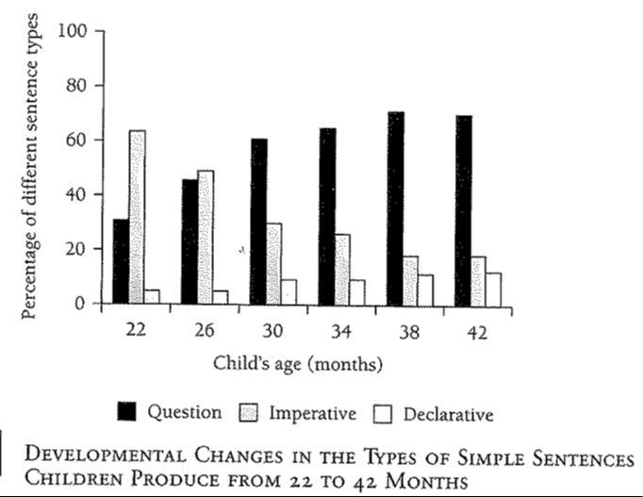
Beyond Two Words
Notes:
25

Slide 26
Beyond Two Words
Imperatives dominate early on, then taper off.
Notes:
26

Slide 27
Beyond Two Words
Declaratives always a fairly large proportion
Notes:
27

Slide 28
Beyond Two Words
Questions always a fairly small proportion
Notes:
28

Slide 29
Telegraphic Speech
Typical grammatical categories included in children’s multiword speech: nouns, verbs, adjectives
Typical categories missing: determiners (the, a), prepositions (to, by, from), auxiliary verbs (am, are, was), bound morphemes (-s plural marker)
Basic division of meaning:
more contentful vs. more grammatical
You can communicate quite well without the more “grammatical” categories.
Notes:
29

Slide 30
Telegraphic Speech Examples
Intended:
“I have to go to the castle to rescue my baby brother!”
Telegraphic:
“I go castle rescue baby brother!
Intended:
“The air is sweet and fragrant – and none may pass without my permission!”
Telegraphic:
“Air sweet fragrant – none pass without permission!”

Slide 31
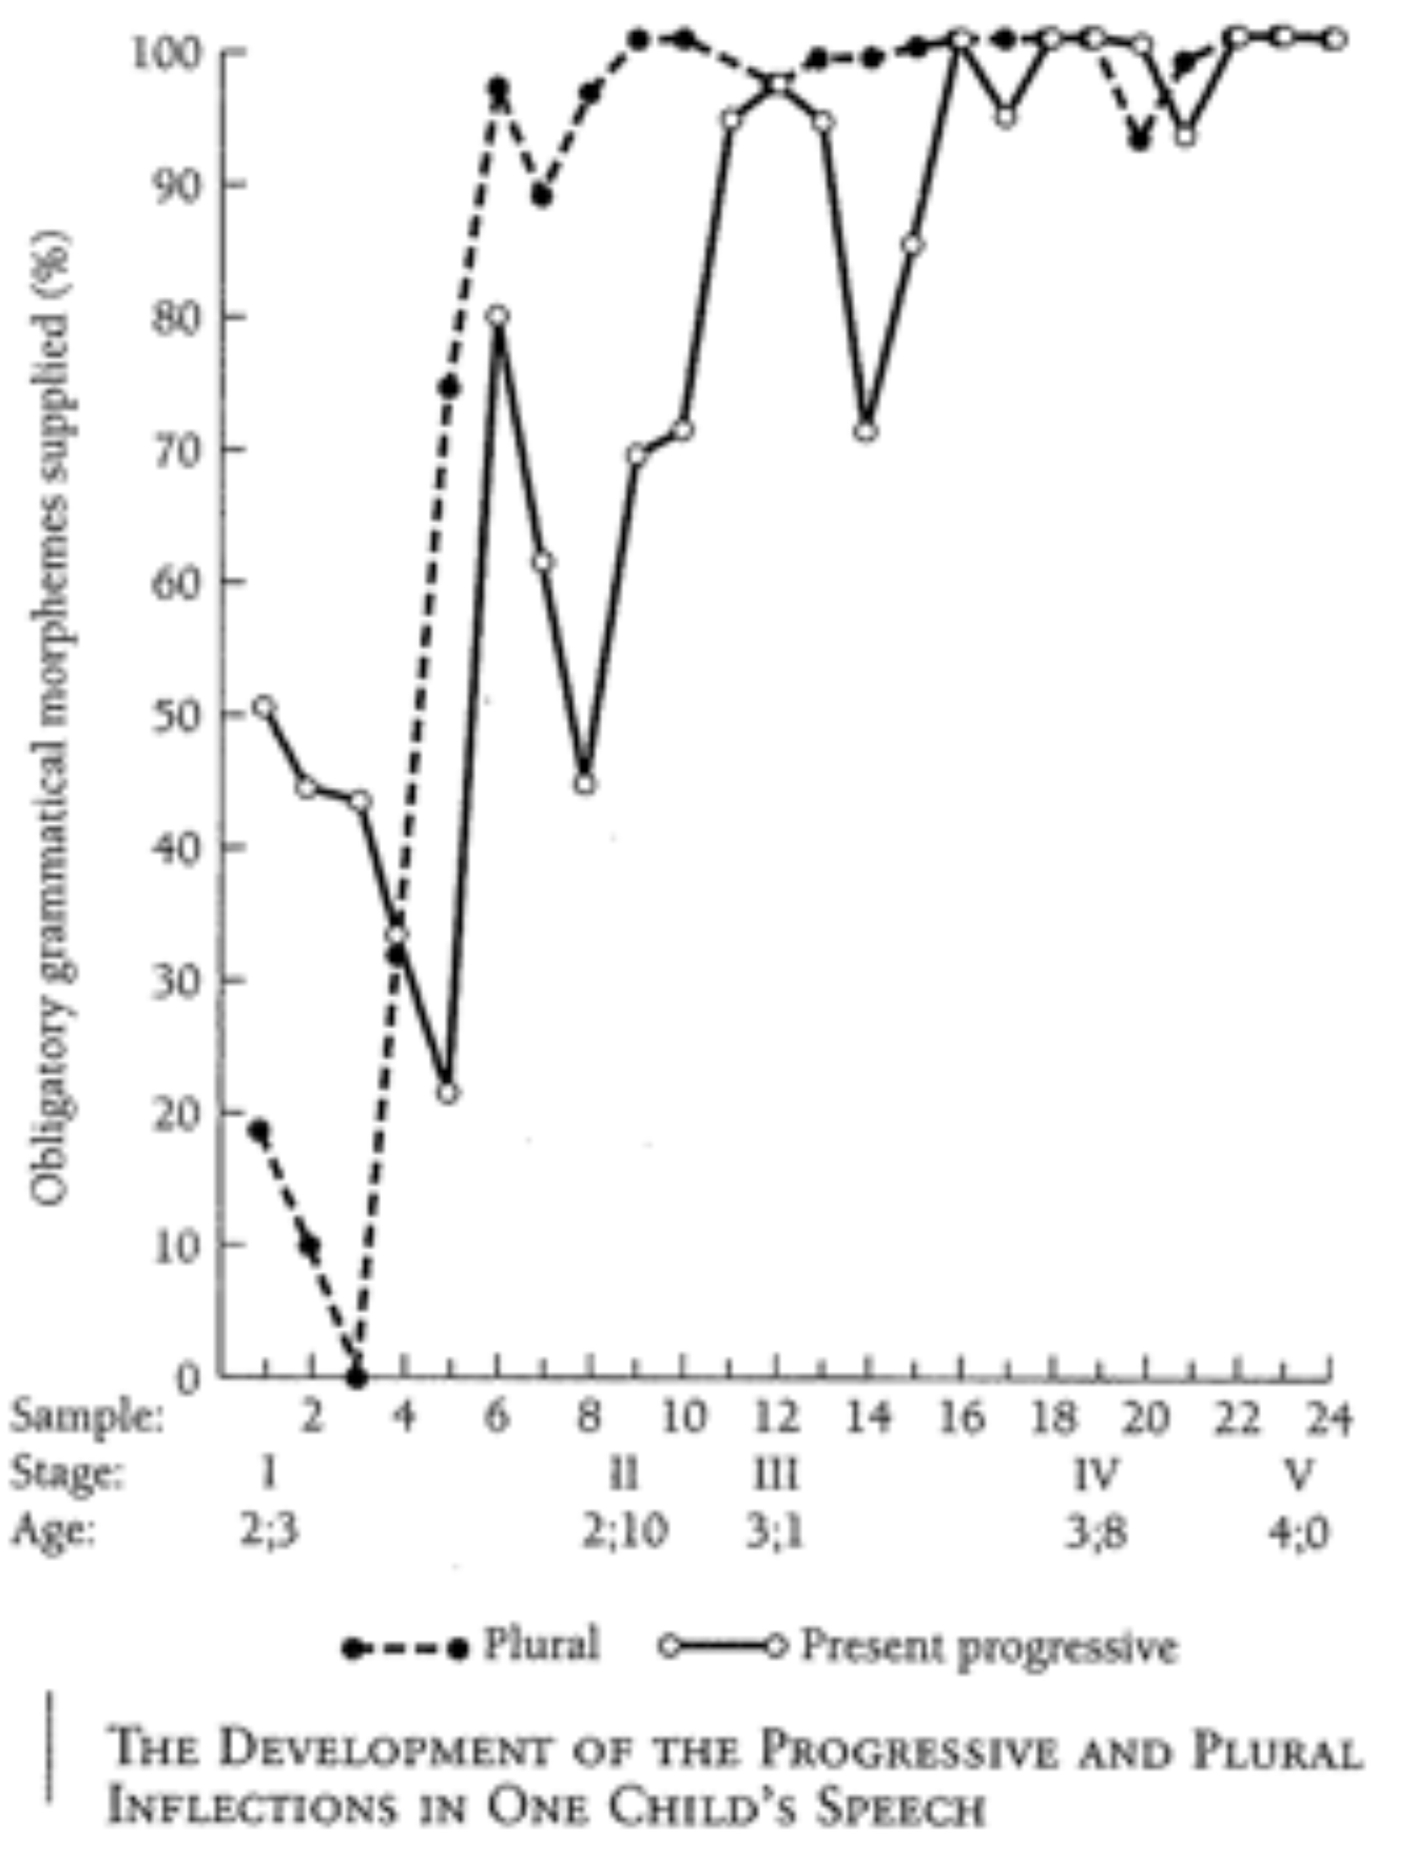
Morphological Development
Between 2 and 3 years old, children begin adding in the more “grammatical” categories - in particular the bound morphemes.
Usage of bound morpheme (either -ing progressive or -s plural) when required
Notes:
31

Slide 32
Morphological Development
Between 2 and 3 years old, children begin adding in the more “grammatical” categories - in particular the bound morphemes.
Usage of bound morpheme (either -ing progressive or -s plural) when required
Development is gradual (though may have spurt-like parts), and there are large ranges - not all bound morphemes come in at the same time
Notes:
32

Slide 33
Morphological Development
The order of acquisition for bound morphemes in English does appear to be similar across different children, however (even if their rates of development are quite different).
Brown (1973): three children (Adam, Eve, Sarah)
(1) present progressive: laughing /ɪŋ/
(2) plural: cats /s/, dogs /z/, glasses /əz/
(3) possessive: cat’s /s/, dog’s /z/, glass’s /əz/
(4) regular past tense: touched /t/, hugged /d/, wanted /əd/
(5) 3rd person singular: laughs /s/, hugs /z/, touches /əz/
(6) contracted be: The cat’s going to /s/, he’s going to /z/
(7) contracted auxiliary verb: he’d like to /d/, he’ll have to /l/
Note: Chan & Lignos (2011) describe a learning strategy that could cause English children to produce this order, based on how hard or easy it is to recognize that a derived form like “hugs” is related to a base form like “hug”.
Notes:
33

Slide 34
Morphological Development
The order of acquisition for bound morphemes in English does appear to be similar across different children, however (even if their rates of development are quite different).
But what about development cross-linguistically? Remember, English is fairly impoverished morphologically when compared to languages like Hungarian.
English: “the goblin” = always the same form
Hungarian: “the goblin” may have up to 16 different forms, depending on what “the goblin” ’s role in the sentence is

Slide 35
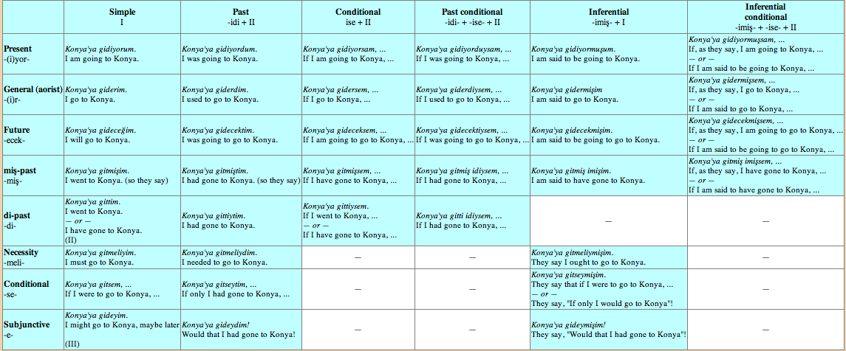
Forms of “I go” in Turkish:
gidiyorum, gidiyordum, gidiyorsam, gidiyorduysam, gidiyormuʂum, gidiyormuʂsam, giderim, giderdim, gidersem, giderdiysem, gidermiʂim, gidermiʂsem, gidecegim, gidecektim, gideceksem, gidecektiysem, gidecekmiʂim, gidecekmiʂsem, gitmiʂim, gitmiʂtim, gitmiʂsem, …
(http://cromwell-intl.com/turkish/verbs.html)

Slide 36
Morphological Development
Note: Morphologically rich languages are not necessarily more difficult for children to learn. Regular/predictable systems are easier for children to learn than languages that have multiple exceptions (like English often does).
Regularity vs. exceptions in English (ex: past tense):
We laughed.
We hugged.
We danced.
* We singed. (We sang.)
* We runned. (We ran.)
Notes:
36

Slide 37
Morphological Development
Note: Morphologically rich languages are not necessarily more difficult for children to learn. Regular/predictable systems are easier for children to learn than languages that have multiple exceptions (like English often does).
Regular morphologically rich language: Turkish
Inflected forms seem no harder for Turkish children to acquire. In fact, they often produce inflected forms (equivalent to English “laughed”) before they even combine words in multiple word utterances.
Notes:
37

Slide 38
Morphological Development
Other factors that help make morphology easier to learn:
- high frequency (more frequent morphemes are easier)
- regularity in form (morpheme is always the same)
- fixed position relative to the stem (ex: morpheme always attaches to the end of the word)
- morpheme is easy to recognize as separate from the stem (ex: laugh + ing)
- rhythm of language makes morpheme perceptually salient (ex: receives stress)
Notes:
38

Slide 39
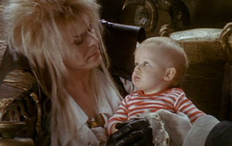
Development of Comprehension
Notes:
39

Slide 40
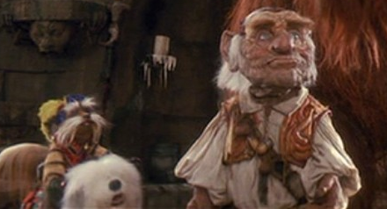
Getting to Children’s Knowledge
Clever comprehension strategies children use:
Use the order of words to predict who did what to whom.
Works really well for active sentences:
“The knight bumped the dwarf.”
Actual event: knight-bumps-dwarf
[Matches word order]
…but not so well for passives:
“The knight was bumped by the dwarf.”
Actual event: dwarf-bumps-knight
[Does not match word order]
knight
dwarf
Notes:
40

Slide 41
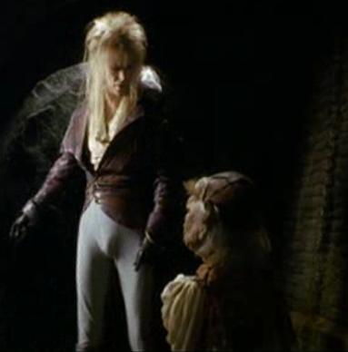
Getting to Children’s Knowledge
Clever comprehension strategies children use:
Use the order of words to predict who did what to whom.
Works really well for sentences where order-of-mention is the order of action:
“Jareth threw off his disguise before Hoggle cowered.”
Actual event: Jareth-throw-disguise, then Hoggle-cower. [Matches word order.]
…but not so well for ones where it’s not:
“Hoggle cowered after Jareth threw off his disguise.”
Actual event: Jareth-throw-disguise, then Hoggle-cower. [Does not match word order]
Jareth
Hoggle
Notes:
41

Slide 42
Getting to Children’s Knowledge
Clever comprehension strategies children use:
Use world knowledge to figure out likely sequence of events.
Jareth
Works really well for normal sentences (in a world where Jareth is often doing the intimidating and Hoggle is often doing the cowering):
“Jareth intimidated Hoggle.”
…but not so well for ones where the events are not predictable from world knowledge:
“Hoggle intimidated Jareth.”
Hoggle
Notes:
42

Slide 43
Getting Around the Clever Strategies
Using indirect methods like the preferential looking paradigm, we can test children’s comprehension of multiword combinations even when they can only produce one word utterances themselves
Hirsh-Pasek & Golinkoff (1991): 13- to 15-month-olds can comprehend improbable sentences with relational properties like
“She’s kissing the keys.”
Hirsh-Pasek & Golinkoff (1991): 16- to 18-month-olds can tell the difference between complex questions like
“Where is Cookie Monster washing Big Bird?” and
“Where is Big Bird washing Cookie Monster?”
Children understand more about structural relationships than they let on with their production!
Notes:
43

Slide 44
Getting Around the Clever Strategies
Just because children don’t use grammatical morphemes in their own speech doesn’t mean they don’t understand that adults use them and they should use them, too.
Shipley, Smith, & Gleitman (1969): children who are telegraphic speakers prefer to respond to full commands like “Throw me the ball” over their own telegraphic versions (“Throw ball”)
Gerken & McIntosh (1993): children are particular about which grammatical morphemes occur where - they can tell the difference between “Find the dog for me” and “Find was dog for me”
Notes:
44

Slide 45
General Points
Sequence of grammatical development that occurs in comprehension is like the sequence in production, but it occurs earlier.
Grammatical competence seems to be achieved fairly early. However grammatical rules are acquired, they must be acquired quickly. This places constraints on what kind of developmental theory can be proposed, because it must account for this speedy acquisition trajectory.
Notes:
45

Slide 46
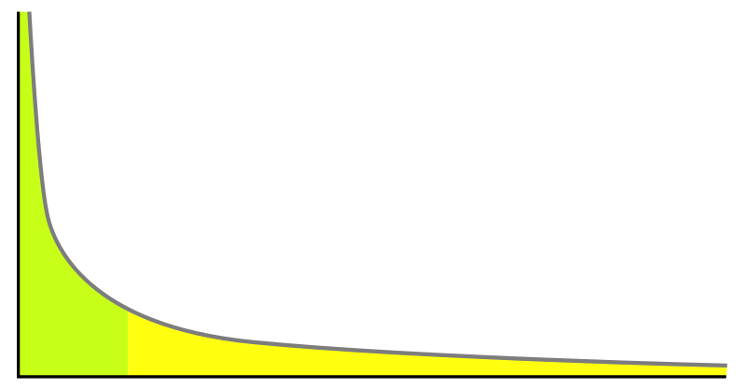
A related point: Data distributions
Why is the speeding acquisition trajectory surprising?
Language has a Zipfian distribution: relatively few items are used very frequently while most items occur rarely, with many occurring only once in even large data samples.
word frequency
words

Slide 47
A related point: Data distributions
Why is the speeding acquisition trajectory surprising?
“To attain full linguistic competence, the child learner must overcome the Zipfian distribution and draw generalizations about language on the basis of few and narrow types of linguistic expressions.” – Yang 2010
Basic point: The distribution of natural language data really makes the child’s job hard, since the child must extract patterns and build a system despite not encountering most of the grammatical forms in the language very often.

Slide 48
Another example of grammatical competence
Comprehension of complex sentences
(from J. de Villiers 1995)
“Once there was a boy who loved climbing trees in the forest. One afternoon he slipped and fell to the ground. He picked himself up and went home. That night when he had a bath, he saw a big bruise on his arm. He said to his Dad, “I must have hurt myself when I fell this afternoon.”
Notes:
48

Slide 49
Another example of grammatical competence
Comprehension of complex sentences
(from J. de Villiers 1995)
“Once there was a boy who loved climbing trees in the forest. One afternoon he slipped and fell to the ground. He picked himself up and went home. That night when he had a bath, he saw a big bruise on his arm. He said to his Dad, “I must have hurt myself when I fell this afternoon.”
When did the boy say he fell?
Notes:
49

Slide 50
Another example of grammatical competence
Comprehension of complex sentences
(from J. de Villiers 1995)
“Once there was a boy who loved climbing trees in the forest. One afternoon he slipped and fell to the ground. He picked himself up and went home. That night when he had a bath, he saw a big bruise on his arm. He said to his Dad, “I must have hurt myself when I fell this afternoon.”
When did the boy say he fell? Ambiguous!
When did the boy say he fell? In the afternoon.
When did the boy say he fell? At night.
Notes:
50

Slide 51
Another example of grammatical competence
Comprehension of complex sentences
(from J. de Villiers 1995)
“Once there was a boy who loved climbing trees in the forest. One afternoon he slipped and fell to the ground. He picked himself up and went home. That night when he had a bath, he saw a big bruise on his arm. He said to his Dad, “I must have hurt myself when I fell this afternoon.”
When did the boy say how he fell?
Notes:
51

Slide 52
Another example of grammatical competence
Comprehension of complex sentences
(from J. de Villiers 1995)
“Once there was a boy who loved climbing trees in the forest. One afternoon he slipped and fell to the ground. He picked himself up and went home. That night when he had a bath, he saw a big bruise on his arm. He said to his Dad, “I must have hurt myself when I fell this afternoon.”
When did the boy say how he fell? Unambiguous
When did the boy say how he fell? In the afternoon.
When did the boy say how he fell? At night.
Notes:
52

Slide 53
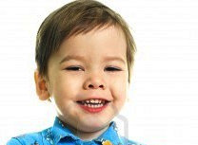
Another example of grammatical competence
Comprehension of complex sentences
(from J. de Villiers 1995)
“Once there was a boy who loved climbing trees in the forest. One afternoon he slipped and fell to the ground. He picked himself up and went home. That night when he had a bath, he saw a big bruise on his arm. He said to his Dad, “I must have hurt myself when I fell this afternoon.”
Children as young as 3 years old have these adult interpretations!
Notes:
53

Slide 54
Morphology & Syntax Development: Recap
Children progress from single word utterances to multiword utterances, learning to combine items in their lexicon in a productive manner to express the meanings they want.
Children’s developmental patterns tend to follow predictable paths, demonstrating their gradual acquisition of more grammatical knowledge.
Children seem to have acquired a very complex system of grammar at a very young age, though it is not necessarily the complete adult system.
Notes:
54

Slide 55
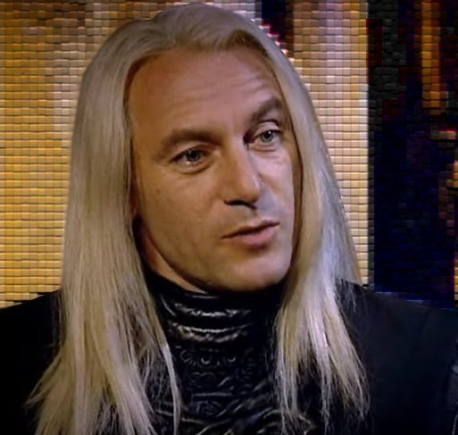
Questions?
You should be able to do up through question 10 on the review questions, and up through question 4 on HW3.
Notes:
55

