Slide 1
Psych 56L/ Ling 51:
Acquisition of Language
Lecture 15
Language & Cognition
Notes:
1

Slide 2
Announcements
Be working on HW3
Review questions available for language and cognition
Please fill out course evaluations for this class
Remember to look at extra credit options (especially the first one, which is a webgame)
Notes:
2

Slide 3

Sapir Whorf Hypothesis
The structure of one’s language influences the manner in which one perceives and understands the world.
“Don’t you see that the whole aim of Newspeak is to narrow the range of thought? In the end, we shall make thought crime literally impossible, because there will be no words in which to express it…” - George Orwell, 1984
Notes:
3

Slide 4

“Neo”-Whorfian Question
Language as a Toolkit: Does language augment our capacity for reasoning and representation?
Also sometimes referred to as “language as augmenter”
(Wolff & Holmes 2010)
Notes:
4

Slide 5



What the language toolkit can do
Language is a symbolic system that can help with cognitive off-loading.

Slide 6
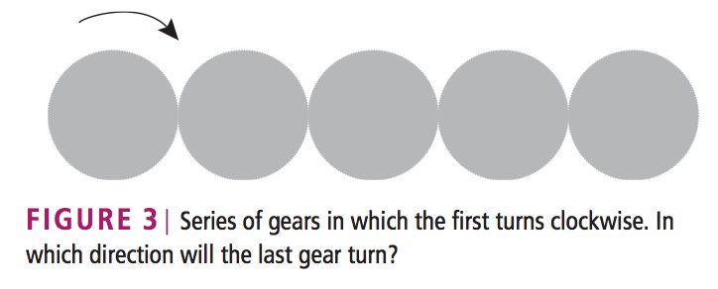
Cognitive Off-Loading example
(from Wolff & Holmes 2010)
“This problem could be solved by mental simulation; that is, by imagining the first gear turning to the right, then the second gear turning to the left, and so on. Alternatively, people might notice that each successive gear turns in the opposite direction from the previous one and generate the parity rule that ‘odd and even gears turn in different directions’. This rule, which may depend on linguistic coding, can then be applied more quickly than the laborious process of mentally rotating each gear.”

Slide 7
Language as a Toolkit
Today:
Navigation (combining core knowledge system information)
→ geometric + landmark or color information
Number (combining core knowledge system information)
→ small, exact numbers & large, approximate numbers
Next time:
Theory of Mind (realizing that someone can have a different point of view than you - when does this realization come, and how?)
Notes:
7

Slide 8
Navigation
Geometric
Object Landmark
Combination
“At the northeast corner”
“At the (blue) cylinder”
“Northeast of the (blue) cylinder”
*rats
*human infants
*adult humans
*rats
*human infants
*adult humans
*adult humans ONLY
Notes:
8

Slide 9
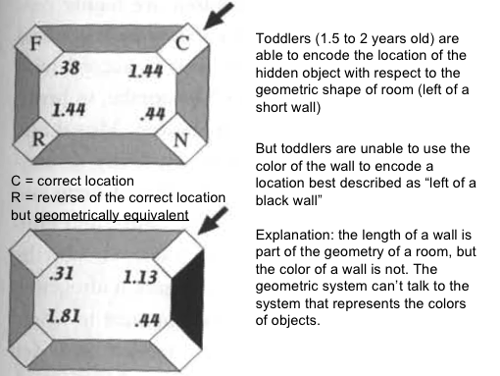
Navigation
Can find it here.
Can’t find it here by combining cues.
Notes:
9

Slide 10
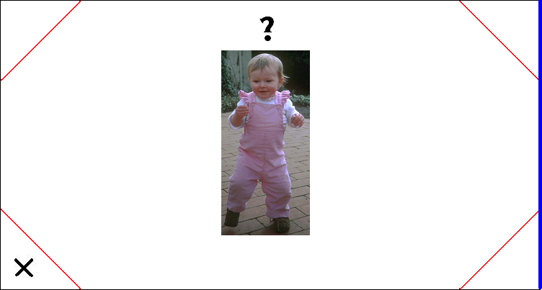
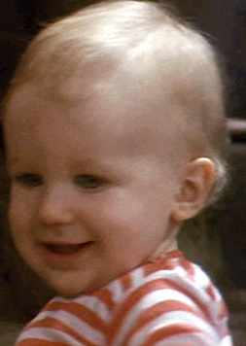
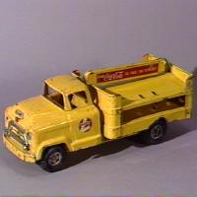

But can toddlers really not do it?
Maybe wall color just isn’t a very salient property for toddlers. How about trying more salient landmarks? (Hermer & Spelke 1996)
“Left of the truck”?
Notes:
10

Slide 11
But can toddlers really not do it?
Maybe wall color just isn’t a very salient property for toddlers. How about trying more salient landmarks? (Hermer & Spelke 1996)
No change in navigation behavior in toddlers even with more salient landmarks (toys like truck and teddy bear).
Notes:
11

Slide 12
So when does this ability develop?
Hermer-Vazquez, Moffet & Munkholm 2001: children with a high production of spatial language (like “left” and “right”) succeed. This usually happens somewhere between 4 and 5 years old.
Shusterman, Lee, & Spelke 2011: 4-year-old children can combine spatial and landmark cues when specifically told a landmark will be useful for navigation. (Ex: “The black wall can help you get the sticker.”)
Hyde, Winkler-Rhoades, Lee, Izard, Shapiro, & Spelke 2011: a 13-year-old deaf child, deprived of most linguistic input after late infancy, performs like toddlers do (very poor when cues must be combined to solve navigation).
Notes:
12

Slide 13

So when does this ability develop?
Implication: Language use seems integral in solving this task that requires representing information from different domains (geometry & color). Children can be prompted through language to pay attention to it, but without language, it seems difficult for humans to solve these kind of tasks.

Slide 14
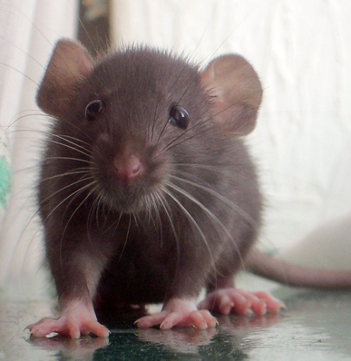
So when does this ability develop?
However… rats (who don’t have spatial language) can be trained to do the same thing, though only after hundreds of trials. Language is useful (speeds things up), but not necessary?

Slide 15
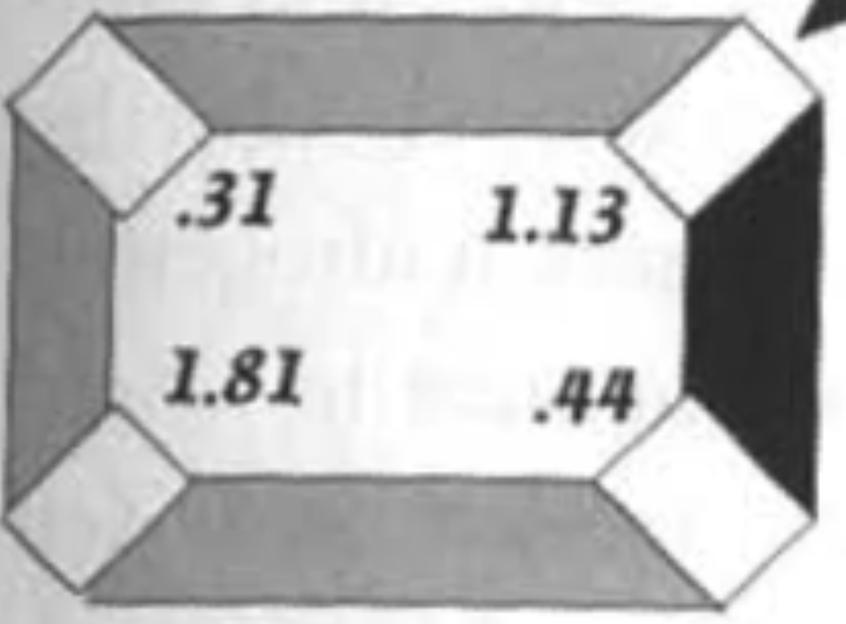
Is language really responsible?
Hermer-Vazquez, Spelke & Katnelson 1999
Testing adults, who were asked to verbally shadow as they performed the task. Verbal shadowing (language as meddler: Wolff & Holmes (2010)) = repeating as fast as they could a passage recorded on tape. Interferes with linguistic combination abilities. [Class demo of verbal shadowing: repeat a passage while imagining that you’re giving precise directions from here to the student union.]
X
Notes:
15

Slide 16
Is language really responsible?
Hermer-Vazquez, Spelke & Katnelson 1999
Verbal-shadowing adults behaved just like toddlers! They searched equally the correct corner and the rotationally equivalent one, seemingly unable to combine the information from geometry and color.
X
Notes:
16

Slide 17
Is language really responsible?
Hermer-Vazquez, Spelke & Katnelson 1999
Experiments with adults who were doing nonverbal shadowing (repeating a rhythm by clapping) did not show this result, despite the fact that the nonverbal shadowing (rhythm shadowing in this case) is as cognitively taxing as verbal shadowing. [Class demo of rhythm shadowing: repeat the clapping pattern while imagining that you’re giving precise directions from here to the student center.]
X
Notes:
17

Slide 18
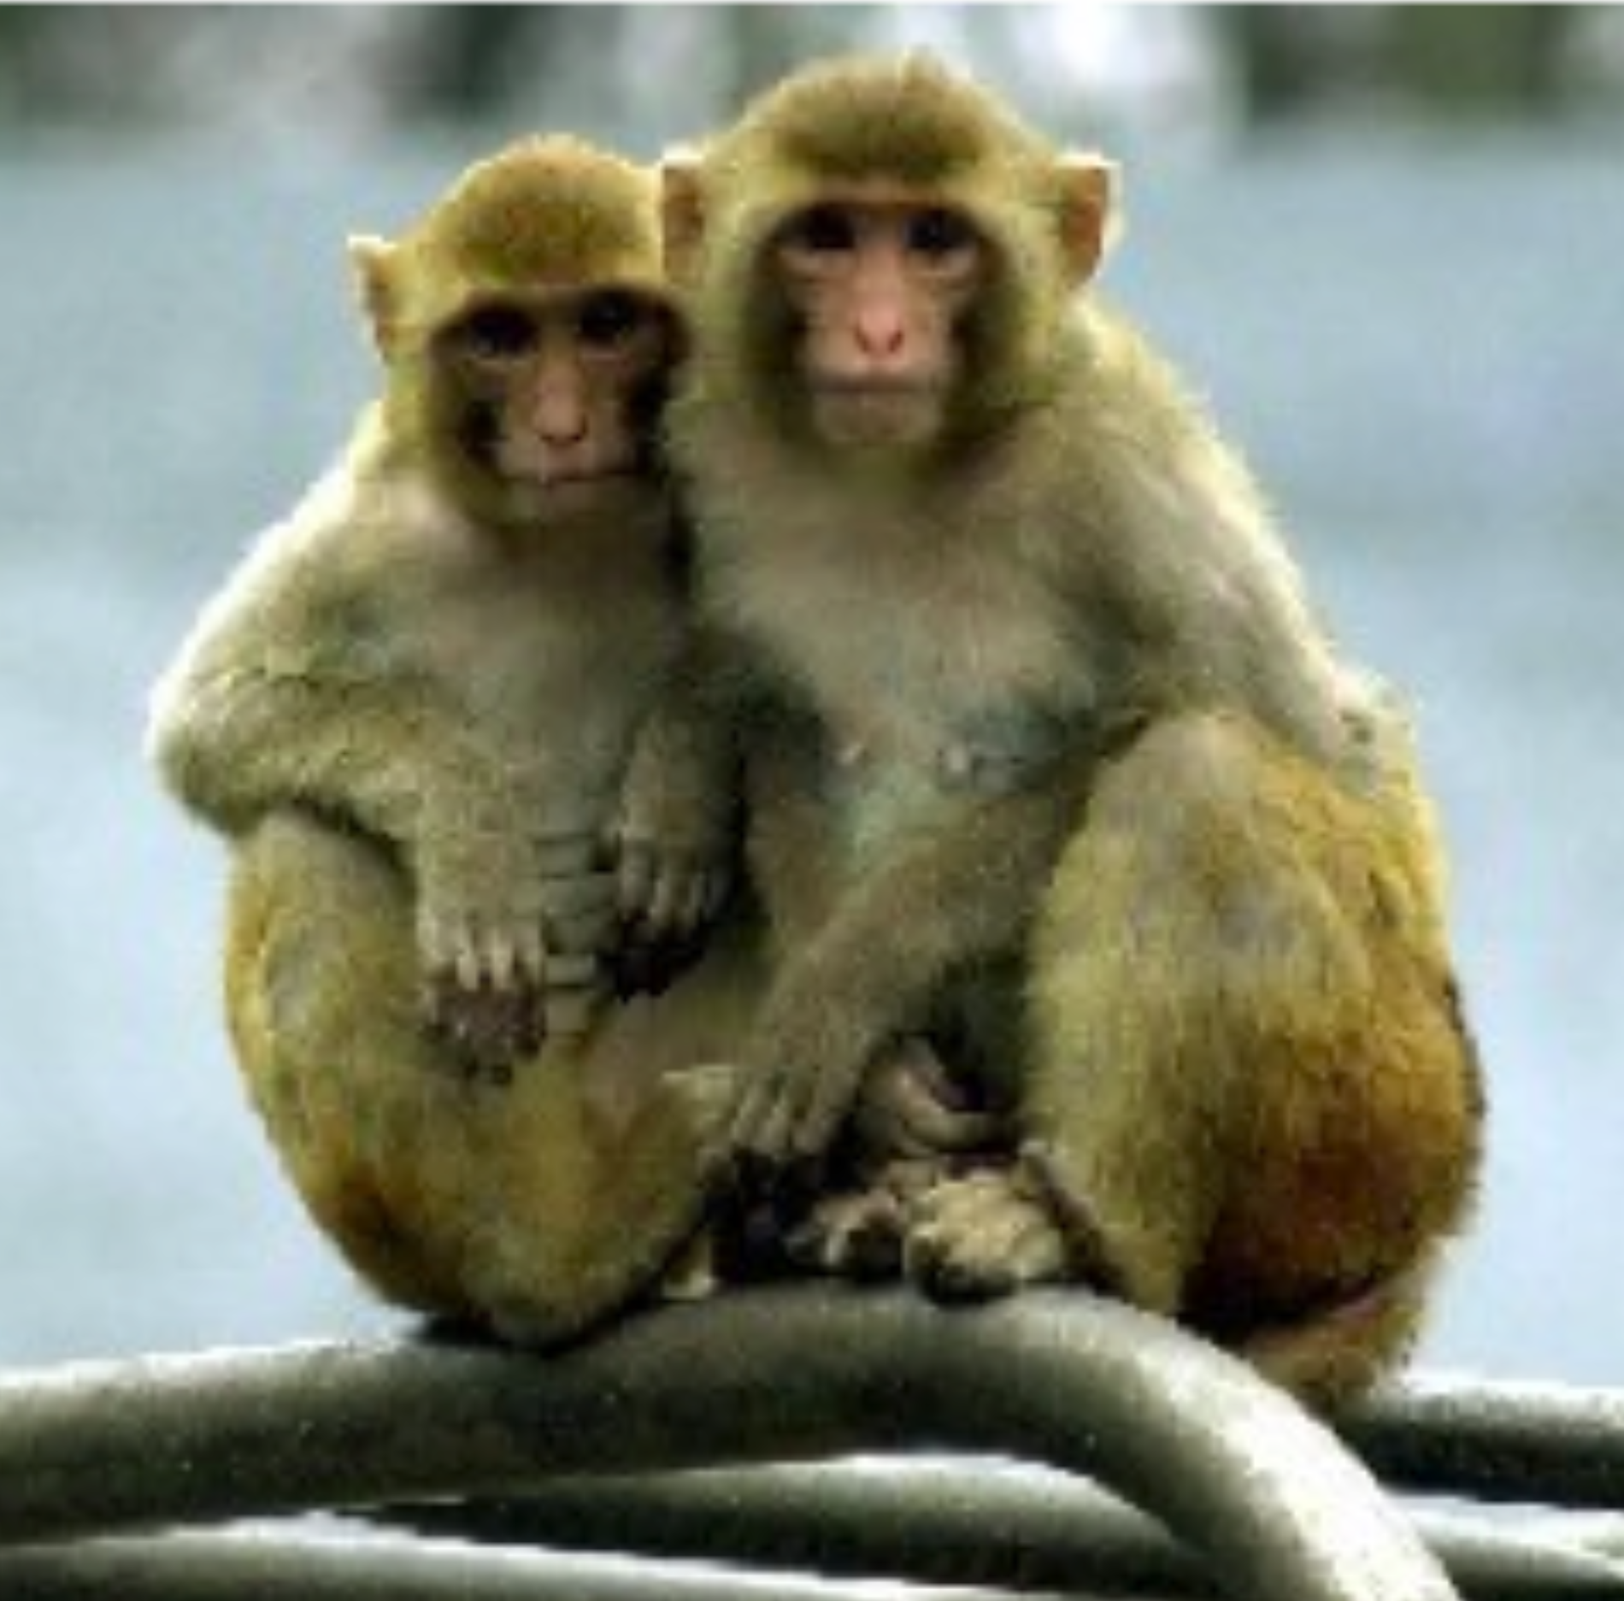
Is language really necessary?
Gouteux, Thinus-Blanc, & Vauclair 2001: testing Rhesus monkeys (who do not have spatial language)
Tested 3 monkeys on location “left of wall opposite the blue wall”.
~50 trials each.
Two monkeys: ~85% correct
Other monkey: ~70% correct
Pretty good for no spatial language!
X
Notes:
18

Slide 19
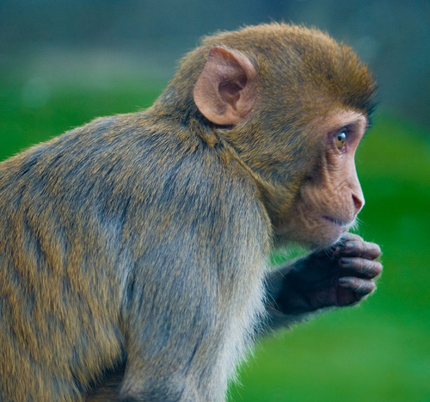
So language does seem to play a very important role in the ability to combine information from different core knowledge systems. (Perhaps not absolutely necessary, but extraordinarily helpful - kind of like motherese for language development.)
Or maybe rhesus monkeys are just clever enough to do this without the spatial language that humans seem to rely on. Maybe humans rely on language because they have it as a tool at their disposal…
Is language really necessary?
Notes:
19

Slide 20
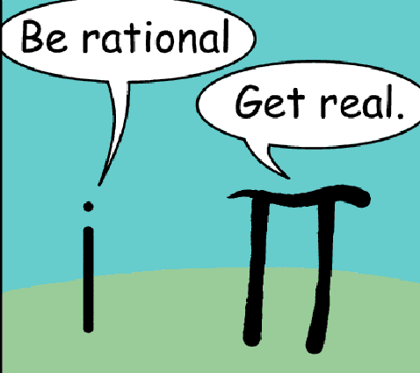
Number
Core number systems shared by humans and other animals:
System for representing approximate numerical magnitudes (large, approximate number sense)
System for representing persistent, numerically distinct individuals (small, exact number sense)
Notes:
20

Slide 21
Decide Fast:
How Many?
Notes:
21

Slide 22

Notes:
22

Slide 23
Notes:
23

Slide 24
Notes:
24

Slide 25
Notes:
25

Slide 26
Notes:
26

Slide 27
Decide Fast:
Which side has more?
Notes:
27

Slide 28
Notes:
28

Slide 29
Notes:
29

Slide 30
Notes:
30

Slide 31
Notes:
31

Slide 32
How We Deal With Number
Amount Being Represented | How Represented
Very small numbers | “Subitizing”- up to 4; can tell what set looks like at a glance
Large approximate numerosities | System for representing approximate numerical magnitudes (adults at a glance can tell apart groups with a ratio of about 1.1 to 1 [Weber’s Law])
Large exact numerosities | Combo of 2 above systems plus language
Notes:
32

Slide 33
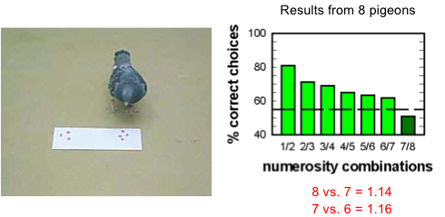
A number sense in general isn’t special
Prelinguistic infants have a system for approximating numerical magnitudes (Dehaene 1997, Gallistel & Gelman 2000), but so do pigeons, rats, fish, and other primates.

Slide 34
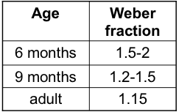
Weber Fraction Limit
for telling apart large numerosities
Everyone can do:
12 vs. 6 = 2.0
32 vs 16 = 2.0
100 vs 50 = 2.0
6 month olds struggle:
12 vs. 8 = 1.5
9 month olds struggle:
12 vs. 10 = 1.2
Adults struggle:
12 vs. 11 = 1.09

Slide 35
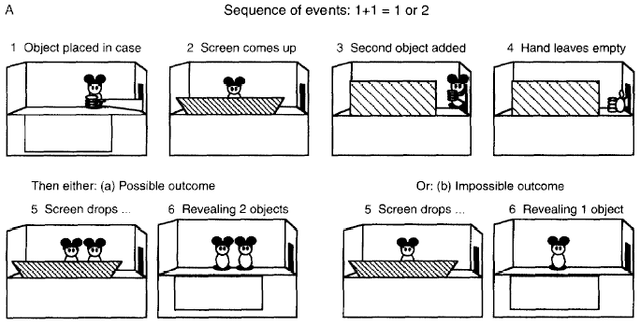
What about small numbers?
Wynn 1998:
Testing infant knowledge using a preferential looking paradigm. Infants are surprised by the “impossible” outcome, which means they can do addition on very small numerosities precisely.

Slide 36
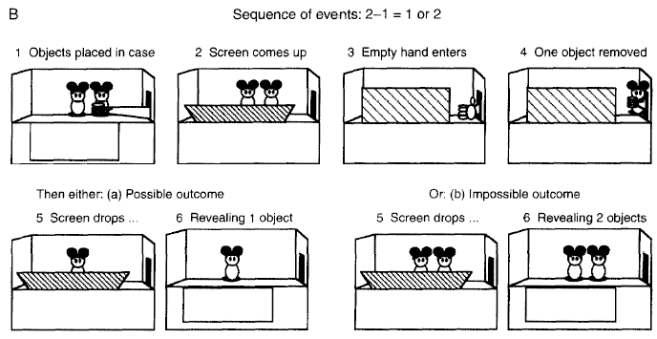
What about small numbers?
Wynn 1998:
Testing infant knowledge using a preferential looking paradigm. Infants are surprised by the “impossible” outcome, which means they can do subtraction on very small numerosities precisely.

Slide 37
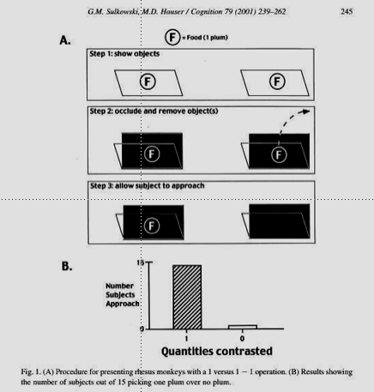
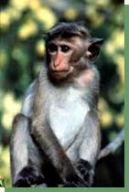
What about small numbers?
Sulkowski & Hauser 2001: Monkeys can, too
Rhesus monkeys shown to spontaneously represent the numbers 1-3
Test monkeys by using a procedure predicated on monkeys going to where they think food is

Slide 38
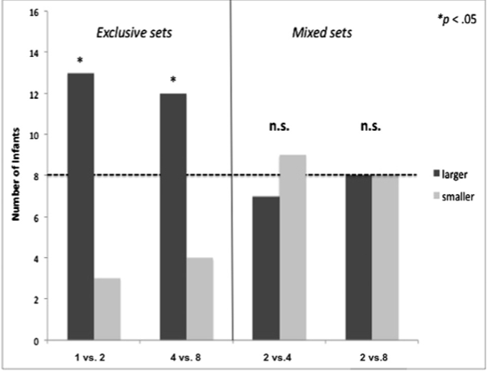
What about small vs. approximate numbers?
vanMarle 2012: 10- to 12-month-old infants have trouble doing comparisons across these two systems
“Infants choosing between sets that were either exclusively small (1 vs. 2) or exclusively large (4 vs. 8) chose the larger amount significantly more often than chance. Infants choosing between ‘‘mixed’’ sets, where one quantity was small and one was large, performed at chance. n.s., nonsignificant.”
1 vs 2
4 vs 8
2 vs 4
2 vs 8

Slide 39
What human language does…
Many languages have an exact number system that provides names for exact quantities of any size
1, 2, 3, 4, 5…….578, 579, 580, 581, 582…
This bridges the “gap” between the two core systems.
Supporting evidence from Dehaene, Spelke, Pinel, Stanescu, and Tsivkin 1999: fMRI study showed that the exact number task recruited neural networks typically associated with language processing.
Notes:
39

Slide 40
What human language does…
Many languages have an exact number system that provides names for exact quantities of any size
1, 2, 3, 4, 5…….578, 579, 580, 581, 582…
This bridges the “gap” between the two core systems.
Another test of this: Look at the numerical cognition of people whose languages don’t have an exact number system.

Slide 41
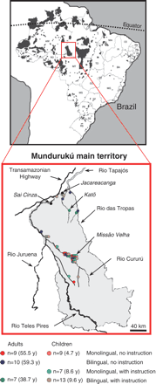
Languages without Exact Number Systems
Pica, Lemer, Izard & Dehaene 2004: Munduruku speakers in Brazil who only have exact numbers for 1-5.
Notes:
41

Slide 42
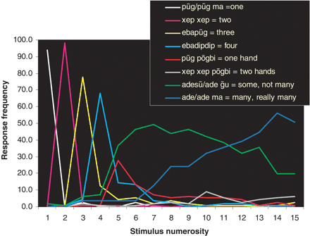
Munduruku responses when asked “how many” and shown a particular number of items
Numerosities bigger than five are “some” or “many”.

Slide 43
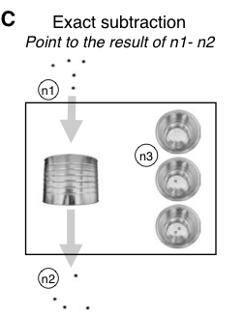
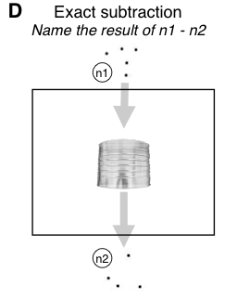
Munduruku responses to exact arithmetic
Note: Even though some quantities are outside the language’s number words (bigger than 5), the answer is within the number words (5 or less).

Slide 44
Munduruku responses to exact arithmetic
Results: Munduruku do much worse than speakers who have an exact number system (though still better than chance).

Slide 45
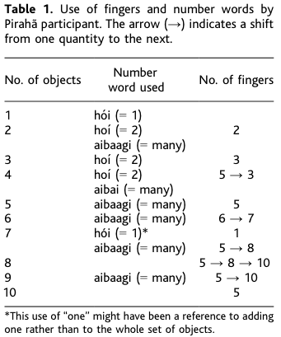
Languages without Exact Number Systems
Gordon 2004: Pirahã speakers in Brazil who only have words for “one/two” and “many”.

Slide 46
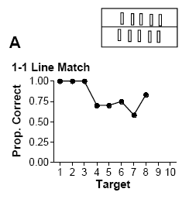
Languages without Exact Number Systems
Gordon 2004: Pirahã speakers in Brazil who only have words for “one/two” and “many”.
Exact arithmetic on larger numbers that are both outside the small, exact system and outside the language is very, very hard to do.
Shown batteries on one side of the line, and asked to line up batteries to match on the other side.

Slide 47
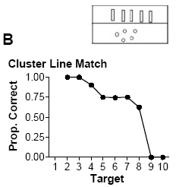
Languages without Exact Number Systems
Gordon 2004: Pirahã speakers in Brazil who only have words for “one/two” and “many”.
Exact arithmetic on larger numbers that are both outside the small, exact system and outside the language is very, very hard to do.
Shown cluster of nuts on one side of the line, and asked to line up batteries to match on the other side.

Slide 48
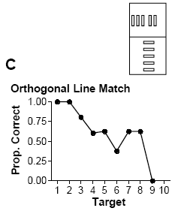
Languages without Exact Number Systems
Gordon 2004: Pirahã speakers in Brazil who only have words for “one/two” and “many”.
Exact arithmetic on larger numbers that are both outside the small, exact system and outside the language is very, very hard to do.
Shown vertical line of batteries on one side, and asked to line up batteries to match on the other side.

Slide 49
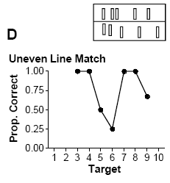
Languages without Exact Number Systems
Gordon 2004: Pirahã speakers in Brazil who only have words for “one/two” and “many”.
Exact arithmetic on larger numbers that are both outside the small, exact system and outside the language is very, very hard to do.
Shown uneven line of batteries on one side, and asked to line up number of batteries to match on the other side.

Slide 50
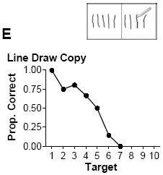
Languages without Exact Number Systems
Gordon 2004: Pirahã speakers in Brazil who only have words for “one/two” and “many”.
Exact arithmetic on larger numbers that are both outside the small, exact system and outside the language is very, very hard to do.
Shown lines on one side, and asked to copy number of lines to match on the other side.

Slide 51
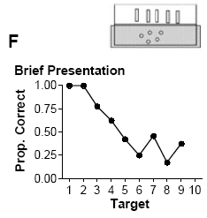
Languages without Exact Number Systems
Gordon 2004: Pirahã speakers in Brazil who only have words for “one/two” and “many”.
Exact arithmetic on larger numbers that are both outside the small, exact system and outside the language is very, very hard to do.
Shown cluster of nuts on one side for one second, and then asked to match number of batteries to that amount from memory.

Slide 52
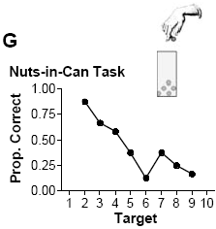
Languages without Exact Number Systems
Gordon 2004: Pirahã speakers in Brazil who only have words for “one/two” and “many”.
Exact arithmetic on larger numbers that are both outside the small, exact system and outside the language is very, very hard to do.
Shown cluster of nuts, and then nuts are placed in a can. One nut is withdrawn at a time, and participant asked after each one if the can is empty yet.

Slide 53
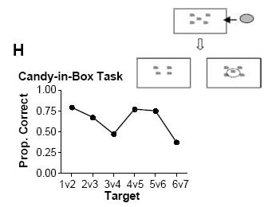
Languages without Exact Number Systems
Gordon 2004: Pirahã speakers in Brazil who only have words for “one/two” and “many”.
Exact arithmetic on larger numbers that are both outside the small, exact system and outside the language is very, very hard to do.
Candy put in a box with a given number of fish drawn on the top of the box. The box is then hidden. The box is then brought out again along with another box with either one more or one fewer fish painted on the box. Participants asked to identify which box contains the candy.

Slide 54
Gelman & Gallistel 2004:
“Language and the Origin of Numerical Concepts”
“Reports of subjects who appear indifferent to exact numerical quality even for small numbers, and who also do not count verbally, add weight to the idea that learning a communicable number notation with exact numerical reference may play a role in the emergence of a fully formed conception of number.”
  No language for large exact numbers =
  no representation for large exact numbers
Notes:
54

Slide 55
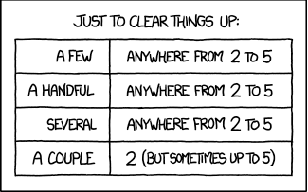
Languages without Exact Number Systems
http://xkcd.com/1070/
  Note: English has imprecise words for numbers, too – but we also have exact words for numbers.

Slide 56
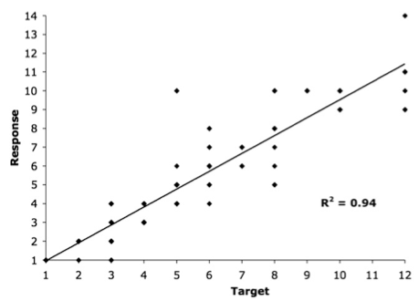
Another example: deaf people who have not had access to a language (spoken or signed)
Spaepen, Coppola, Spelke, Carey, & Goldin-Meadow 2011
Test population: Home-signers from Nicaragua
Spontaneous communication about number: The number of fingers the home-signers extended (y axis) as a function of the number of objects actually shown in a story they were retelling (x axis).
Home-signers seem able to track approximate numerosity.

Slide 57
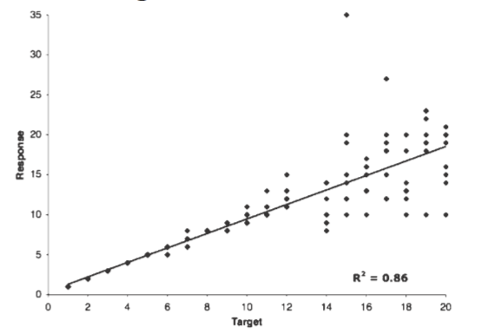
Another example: deaf people who have not had access to a language (spoken or signed)
Spaepen, Coppola, Spelke, Carey, & Goldin-Meadow 2011
Test population: Home-signers from Nicaragua
Asked to relate exactly how many objects were shown.
Home-signers have major difficulty once numbers go much above four.

Slide 58
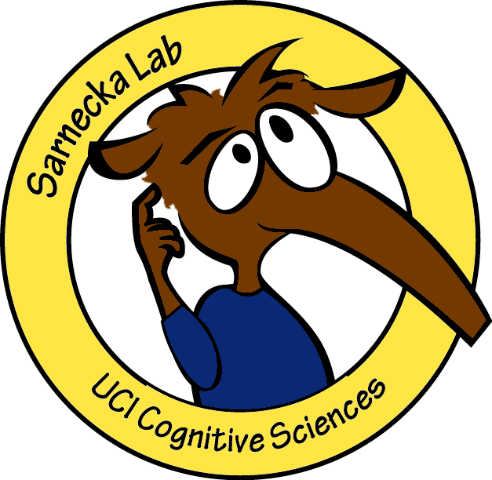

Children’s numerical cognition
English children must learn number words, and it can take them a surprisingly long time to do it.
Even if children can recite a list of counting numbers (“one, two, three, four, five, …”), they may not necessarily understand that “three” refers to the quantity three. Moreover, even if they recite the list when seeming to count objects, they do not realize that the last number they say is the right answer.
Investigator: “How many are there?”
Child: “One, two, three, four, five. There are three!”
Barbara Sarnecka

Slide 59
Children’s numerical cognition
The process of connecting number words to quantity seems to occur in stages:
Pre-number-knowers: no number word knowledge
One-knowers: “one”, but no other numbers
Two-knowers: “one”, “two”, but no others
Three-knowers: “one”, “two”, “three”, but no others
Cardinal-principle-knowers: children realize the connection between the counting list and quantity (cardinal principle of counting) – the last number you say is in the list is the quantity (denotes the cardinality of the set)
Barbara Sarnecka

Slide 60
Children’s numerical cognition
Negen & Sarnecka (2010): Tested children’s non-verbal numerical cognition when they did not necessarily know the exact meaning of number words.
“Now we’re going to play a copying game. I will give something to the anteater…(experimenter puts some items from a bowl onto his plate, and slides it to his stuffed animal)…and you give something to the bunny. You copy me and make your plate look just like mine.”
“Now we’re going to play a remembering game. I will give something to the bunny…(experimenter demonstrates)…and you try to remember what I gave the bunny. (Experimenter returns items to the bowl.) You give the bunny something and try to make yours just like mine was.”

Slide 61
Children’s numerical cognition
Negen & Sarnecka (2010): Tested children’s non-verbal numerical cognition when they did not necessarily know the exact meaning of number words.
Results: Children who know more number words did a better job at replicating and remembering the number of items. Surprisingly, performance improved for all number sizes, even the ones children didn’t necessarily have words for yet.
Example: Child knows “one” and “two”, but improves at replicating/remembering not only one and two, but also three, four, and five objects.
Language for numbers helps improve non-verbal comprehension and memory for numbers - helps highlight the salient concept of quantity.

Slide 62
Language & Cognition: Recap
Whorfianism is the belief that language influences (or determines) someone’s experiences in the world. Neo-Whorfianism is a variant that believes language augments thought, so we can think more complex thoughts.
In both navigation and number, we have seen evidence for cases where language seems to enable more complex thought - or at least to enable it to happen more easily.
Notes:
62

Slide 63
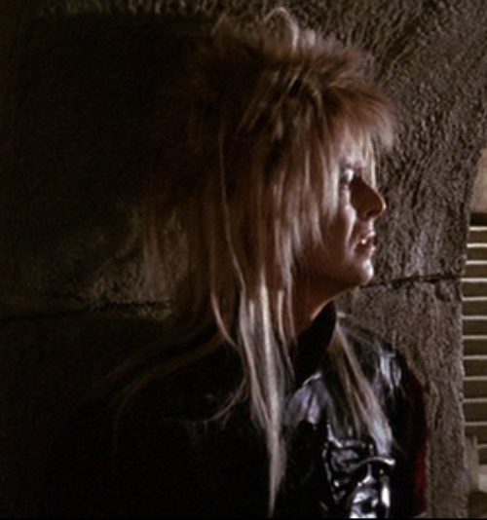
Questions?
You should be able to answer up through question 15 on the language & cognition review questions, and up through question 8 on HW3.
Notes:
63

