Slide 1
Psych 56L/ Ling 51:
Acquisition of Language
Lecture 16
Language & Cognition
Notes:
1

Slide 2
Announcements
Review questions available for language and cognition
Be working on HW3 [due 3/12/13]
Remember to do the extra credit
Please fill out course evaluations for this class
Notes:
2

Slide 3

“Neo”-Whorfian Question
Language as a Toolkit: Does language augment our capacity for reasoning and representation (and thereby determine our perception of the world)?
Also sometimes referred to as “language as augmenter”
(Wolff & Holmes 2010)
Notes:
3

Slide 4


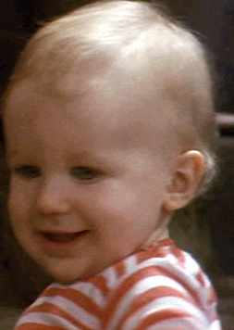
Theory of Mind
Notes:
4

Slide 5
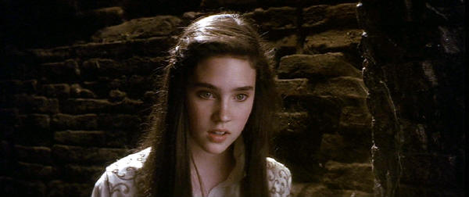
sentential complement
Sarah thought that Hoggle had betrayed her.
The embedded sentence (also called a sentential complement here) encodes the contents of Sarah’s mind.
The ‘truth value’ of the embedded sentence cannot be evaluated with respect to this world. It must be evaluated with respect to Sarah’s mental world (what Sarah thinks).
What if a child didn’t know this?
Notes:
5

Slide 6
What you need to know to evaluate the truth value of these statements
Syntactic Knowledge: you know that some verbs (think, believe, say, …)
can take sentential complements
Social Cognitive Knowledge: you know that other people can have a false belief
Bridge: you know that there is a connection between this syntactic form and the expression of potentially false beliefs
Which comes first, social or syntactic knowledge?
Usual Pattern: Social/Conceptual ---> Linguistic
Whorfian: Linguistic ---> Social/Conceptual
Notes:
6

Slide 7
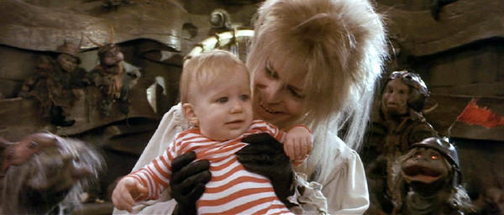
A little problem…
How do you measure children’s understanding that other people can have false beliefs?
(abstracted away from their linguistic ability to represent false beliefs)
Notes:
7

Slide 8
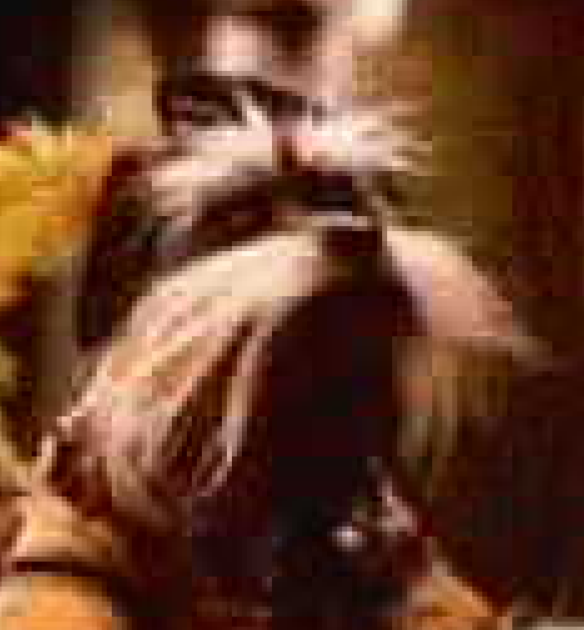
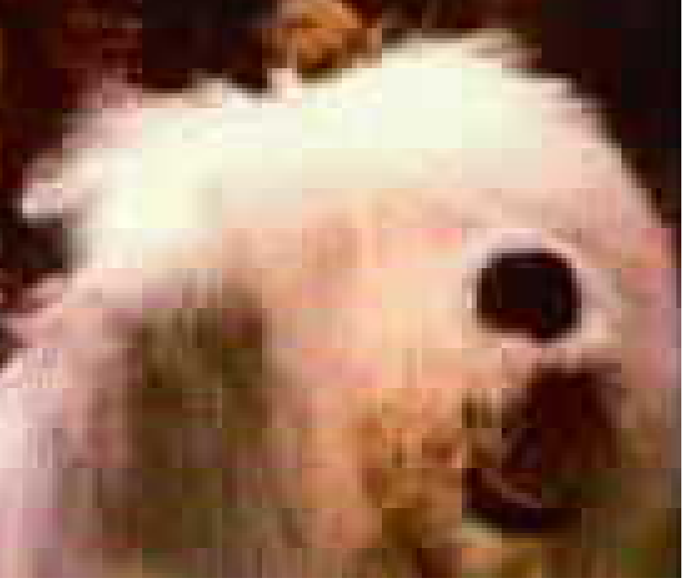
False Belief Task (Unseen displacement)
The child is introduced to two puppets, Sir Didymus and Ambrosius.
Sir Didymus
Ambrosius
Notes:
8

Slide 9
False Belief Task (Unseen displacement)
While playing, Sir Didymus puts a marble into a bin and then goes outside (the puppet disappears under the table, for example).
marble
bin
Notes:
9

Slide 10
False Belief Task (Unseen displacement)
While playing, Sir Didymus puts a marble into a bin and then goes outside (the puppet disappears under the table, for example).
Notes:
10

Slide 11
False Belief Task (Unseen displacement)
When Sir Didymus is not around, naughty Ambrosius changes the location of the marble. He takes it out of the bin and puts it in a different bin.
Notes:
11

Slide 12
False Belief Task (Unseen displacement)
Some time later Sir Didymus comes back and wants to play with his marble. Children are then asked the critical question: Where will Sir Didymus look for his marble?
Notes:
12

Slide 13
False Belief Task (Unseen displacement)
Some time later Sir Didymus comes back and wants to play with his marble. Children are then asked the critical question: Where will Sir Didymus look for his marble?
3-year olds & autistic children
4 to 5-year olds
Correct
Incorrect
Notes:
13

Slide 14
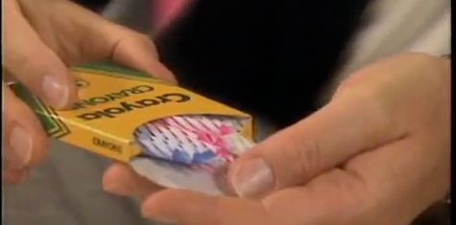
False Belief Task (Unexpected Contents)
http://www.youtube.com/watch?v=8hLubgpY2_w

Slide 15
If we’re looking for a language connection…
At what age do children start talking about thoughts/beliefs? At what age do children first begin to use sentential complements?
2-year-olds talk a lot!
  ... about what they did, what they want
  ... about what others do
  ... possibly about what others say
  – not about what others think
Notes:
15

Slide 16
If we’re looking for a language connection…
At what age do children start talking about thoughts/beliefs? At what age do children first begin to use sentential complements?
Children’s comprehension of sentential complements
“Sir Didymus said he bought peaches. But look! He really bought oranges. What did Sir Didymus say he bought?”
3-year-olds: oranges (reality, not mental state)
4-year-olds: peaches (key into “say that”)
Notes:
16

Slide 17
If we’re looking for a language connection…
At what age do children start talking about thoughts/beliefs? At what age do children first begin to use sentential complements?
At around four years of age, children understand that mental verbs can take a whole sentence as their object (a complement)
Sir Didymus thought that the shampoo was the toothpaste.
And the embedded sentence can be FALSE from the child’s Point of View, but TRUE for Sir Didymus.
Once the child has this capacity, he can represent two worlds: his own, and someone else’s mental world.
This usually coincides with children’s production of mental state verbs.
Notes:
17

Slide 18
Testing typically developing children
De Villiers & Pyers 2002: Measures of comprehension and production of sentential complements far more correlated with children’s performance on false belief tasks than any other linguistic measure.
Causation? “In every case, children who passed false beliefs gave us evidence that they had productive command of complementation.”
Learning Trajectory: Easier to observe what people say than what they think. Can get more helpful data with communication verbs that take sentential complements (like say), and then extend that by analogy to mental verbs like think.
Notes:
18

Slide 19
How exactly do children learn that connection?
One idea
Difficult to observe: someone else’s thoughts
Easier to observe: what people say
  “She said that she ate the peach.”
Children will sometimes hear sentences like this in a context where there is overt evidence to suggest that the embedded proposition is false.
Children can use evidence from verbs like say to generalize to verbs like think and believe

Slide 20
How exactly do children learn that connection?
One idea
Syntactic Knowledge: you know that some verbs can take sentential complements
Bridge: you know from hearing communication verbs and from observing the world while hearing them that there is a connection between this syntactic form and the expression of potentially false propositions.
Having learned this connection from communication verbs, you then generalize that since mental verbs also take sentential complements, their sentential complements must also potentially be false.
Social Cognitive Result: Therefore you can contemplate other (mental) worlds.

Slide 21
Testing the connection in other ways and in other populations
What if you train children on communication verbs that take sentential complements? Do they improve on false belief tasks?
What if you make children use mental state verbs that take sentential complements? Do they improve on false belief tasks?
Test development in deaf children who are language-delayed vs. not
Test other primates (who are non-verbal)
Notes:
21

Slide 22
Training children on communication verbs
Hale & Tager-Flusberg 2003: Children who were trained on sentential complements (“say that…”) did well on both sentential complement tests and false belief tasks. However, children trained only on false belief tasks also did well on false belief tasks.
Familiar implication: Sentential complements not required, just extraordinarily helpful.
Notes:
22

Slide 23
Making children use mental state verbs
Ornaghi, Brockmeier, & Grazzani Gavazzi 2011: During a 2-month period of intervention, children were read stories enriched with mental lexicon items. After listening to a story, the experimental group took part in language games and conversations aimed at stimulating children to use mental terms. Four-year-olds improved on false-belief understanding - even though they hadn’t been trained on false belief tasks. However, the control group also improved (just not as much).
Familiar Implication: Mental state verbs can be helpful for thinking about false beliefs, but they’re not necessarily required.

Slide 24
Testing deaf children
(delayed vs. non-delayed language)
de Villiers & de Villiers 2003: Oral deaf children (who are language-delayed) with normal IQ and active social intelligence are significantly delayed in false belief tasks. Performance on both verbal and non-verbal false belief tasks are delayed to the same degree. Best predicted by sentential complement production with verbs of communication or mental state, not just by general language ability.
Implication: Language (specifically sentential complements) required for success on false belief tasks. (Maybe no one trained them explicitly on false belief tasks?)
Notes:
24

Slide 25
Testing deaf children
(delayed vs. non-delayed language)
Pyers & Senghas 2009: Tested two groups of learners of Nicaraguan Sign Language (NSL).
Group 1 (older): Learned an early form of NSL
Group 2 (younger): Learned a later form of NSL
Main difference: Group 2 knew many more signs for mental state verbs like think and know than Group 1
Results: Group 2 did much better on false belief tasks than Group 1, despite being younger.
Implication: Language (specifically mental state verbs that take sentential complements) required for success on false belief tasks. (Maybe no one trained them explicitly on false belief tasks?)

Slide 26
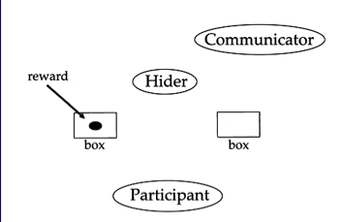
Testing other primates (who are non-verbal)
Call & Tomasello 1999: Used the same test for both children and great apes (though the great apes needed many more trials)
Main Test:
Communicator watches the Hider hide a reward in one of two containers and then leaves the room. The Hider switches the containers. The communicator returns and indicates which container has the reward. Participants are asked to locate the reward.

Slide 27
Testing other primates (who are non-verbal)
Call & Tomasello 1999: Made sure to check competency in skills needed to successfully perform the task (other than understanding of false belief)
Understanding of Indication Behind barrier, Communicator watches Hider place reward in bucket. Communicator indicates bucket to participants.
(Do you understand that the Communicator picks out the location of the reward?)

Slide 28
Testing other primates (who are non-verbal)
Call & Tomasello 1999: Made sure to check competency in skills needed to successfully perform the task (other than understanding of false belief)
Visible Displacement Communicator indicates reward’s location. Hider opens the container and moves the reward.
(Do you understand that the reward moves?)

Slide 29
Testing other primates (who are non-verbal)
Call & Tomasello 1999: Made sure to check competency in skills needed to successfully perform the task (other than understanding of false belief)
Invisible Displacement
Same as visible but containers are switched and participants do not see the object
(Do you understand that the containers can switch places, and that means what’s in them switches places, too?)

Slide 30
Testing other primates (who are non-verbal)
Call & Tomasello 1999: Made sure to check competency in skills needed to successfully perform the task (other than understanding of false belief)
Ignoring Communicator
Hider hides reward. Communicator leaves. Hider switches buckets. Communicator returns and indicates bucket with reward (the wrong container)
(Do you understand the communicator can be ignored, because he may not be right?)

Slide 31
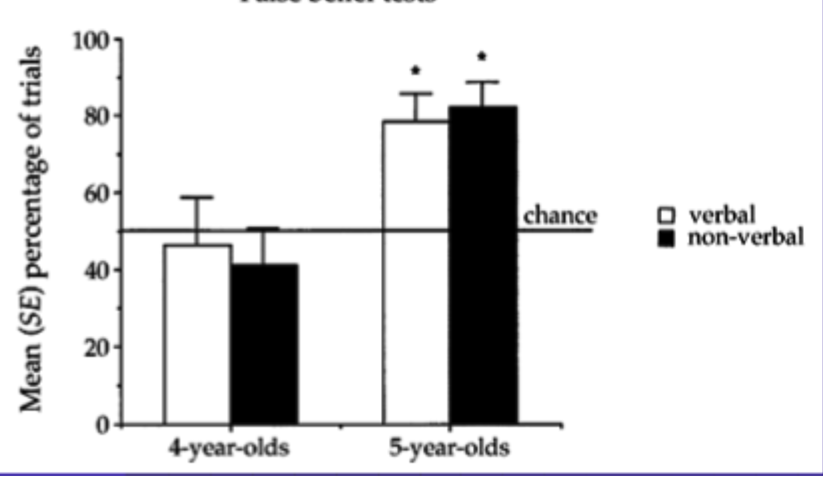
Testing other primates (who are non-verbal)
Call & Tomasello 1999: Children do the same on the standard verbal task and this non-verbal equivalent. (Though it takes a five-year-old to pass.)

Slide 32
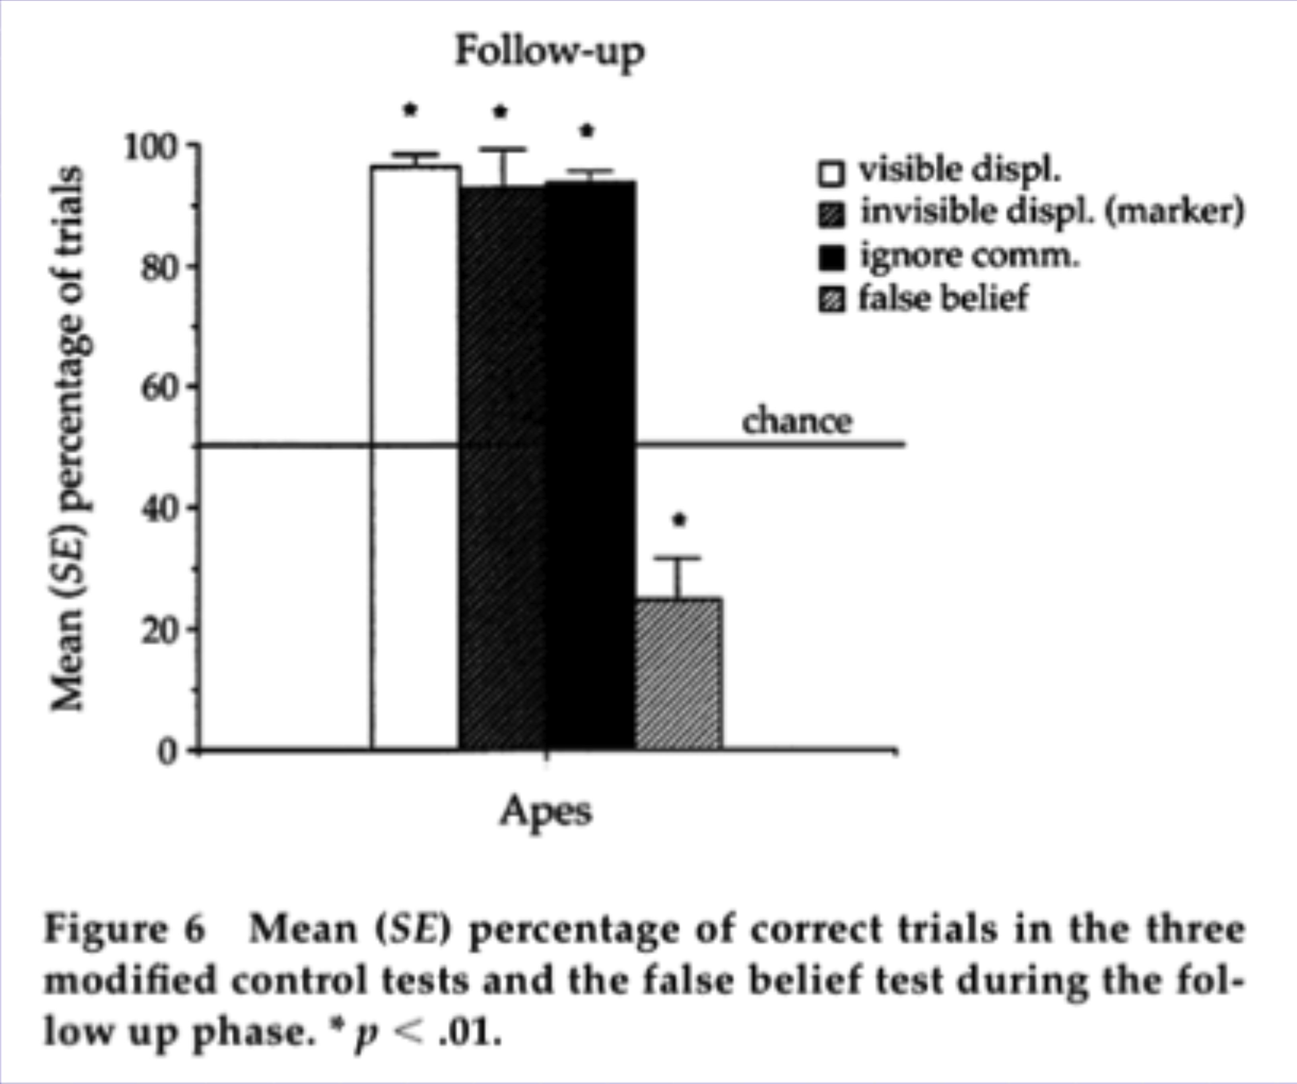
Testing other primates (who are non-verbal)
Call & Tomasello 1999: Great apes fail spectacularly, even though they pass all the preliminary control tasks.
Implication: Having language (or a language-enabled brain) seems necessary. (Though maybe no one trained the apes on false belief tasks?)

Slide 33
Theory of Mind: Link to Language is…?
Additional evidence from Baillargeon, Scott, & He 2010:
2-year-olds can pass a false belief task when they are tested indirectly. How do we test them indirectly? We can gauge their spontaneous responses (as assessed by looking time) to events they are shown. Baillargeon et al. 2010 argue that this is an easier task than requiring the children to answer a question directly using language.
Familiar implication: Language is extraordinarily helpful but not explicitly required.
Notes:
33

Slide 34
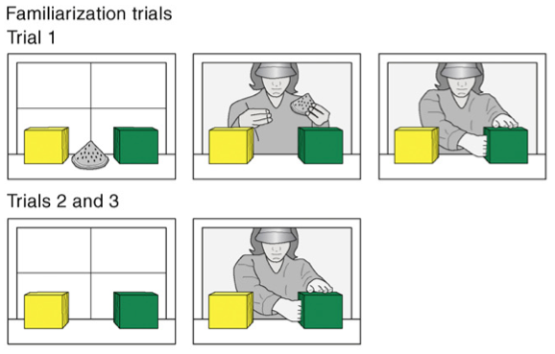
Baillargeon, Scott, & He 2010
Familiarization:
In trial 1, a toy stood between a yellow and a green box; a female agent entered the apparatus, played with the toy briefly, hid it inside the green box, and then paused, with her hand inside the green box, until the trial ended. In trials 2 and 3, the agent reached inside the green box, as though to grasp her toy, and then paused.

Slide 35
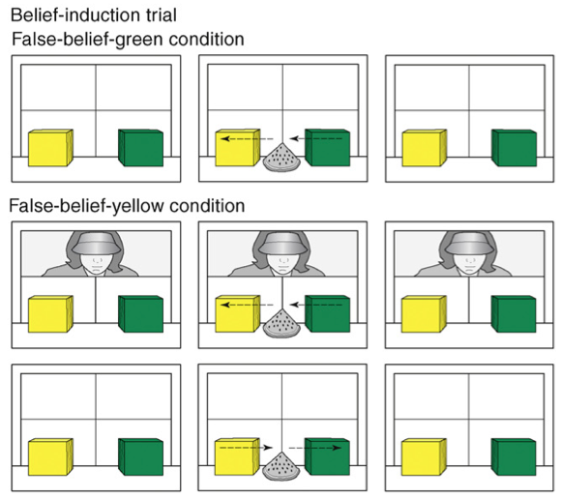
Baillargeon, Scott, & He 2010
Belief Induction:
In the belief-induction trial, the toy either moved from the green to the yellow box in the agent’s absence (false-belief-green condition) or moved to the yellow box in the agent’s presence but then returned to the green box after she left (false-belief-yellow condition).

Slide 36
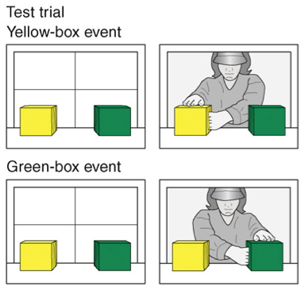
Baillargeon, Scott, & He 2010
Testing:
In the test trial, the agent returned, reached inside either the yellow box (yellow-box event) or the green box (green-box event), and then paused.
In each condition, the infants expected the agent to reach where she falsely believed the toy to be hidden, and they looked reliably longer when she reached to the other location instead.

Slide 37
Theory of Mind: Link to Language is…?
Language is useful for cognitive off-loading? Perhaps when children are tested directly on false belief tasks (that is, required to show their knowledge with language), having mental state verbs in their linguistic repertoire allows them to easily encode what’s going on. Then, it’s easier to do the task, which requires more mental work than tasks where children are tested indirectly.
But the jury is still out…(remember that the great apes were tested without language, as were the four- and five-year-olds in the Call & Tomasello 1999 study).

Slide 38

Language & Cognition: Recap
Neo-whorfianism is a variant of Whorfianism that believes language augments thought, so we can think more complex thoughts.
For theory of mind, we have seen evidence for cases where language seems to enable more complex thought - or at least to enable it to happen more easily.
It seems like language is like a hammer – it’s a really good tool (and probably better than a shoe) for getting the (cognitive) job done. But that doesn’t necessarily mean the job can’t get done without it.
Notes:
38

Slide 39

Questions?
You should be able to answer all the questions on the language & cognition review questions, and all the questions on HW3.
Notes:
39

