Slide 1
Psych 56L/ Ling 51:
Acquisition of Language
Lecture 9
Lexical Development I
Notes:
1

Slide 2
Announcements
Midterm grades available on EEE
Review questions for lexical development available
HW2 due 2/21/13
Notes:
2

Slide 3
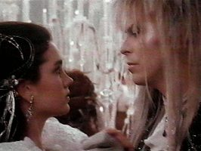
Lexical Knowledge in Adults
Notes:
3

Slide 4
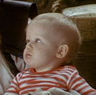
We know a lot of words
Average English-speaking college student knows ~150,000
Average first grader knows ~14,000 (and has only been alive ~2000 days) - that’s 7 new words a day, assuming that the child learns right from the first day s/he is born!
Notes:
4

Slide 5
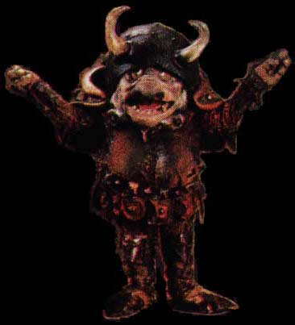
What we know
Mental dictionary of words = lexicon
Each entry for a word contains a lot of information, including what the word sounds like, how to use the word in combination with other words, what the word means, what other words that word is related to…
/ɡɑblɪn/
goblin
creature
the goblin is…, some goblins are…
Notes:
5

Slide 6
So what exactly is a word, anyway?
A word (or morpheme) is an arbitrary symbol that stands for something in the real world (even if it’s only a concept in someone else’s mind): goblin, silliness, labyrinth
Some concepts/meanings are more abstract:
“doing something in the past”, “continuing to do something”
(ex: -ed in English, kissed) (ex: -ing in English, was kissing)
Notes:
6

Slide 7
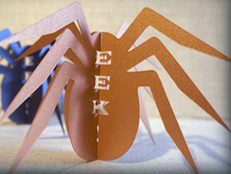
So what exactly is a word, anyway?
Important: words refer to things (referential). Not enough to simply have associations of sound with something (ex: saying “Eeek!” every time you see a spider)
Some greetings and social routines (“Hi!” “See ya!”) might be considered non-referential language.

Slide 8
More about word meaning
(one major part of the lexicon)

Slide 9
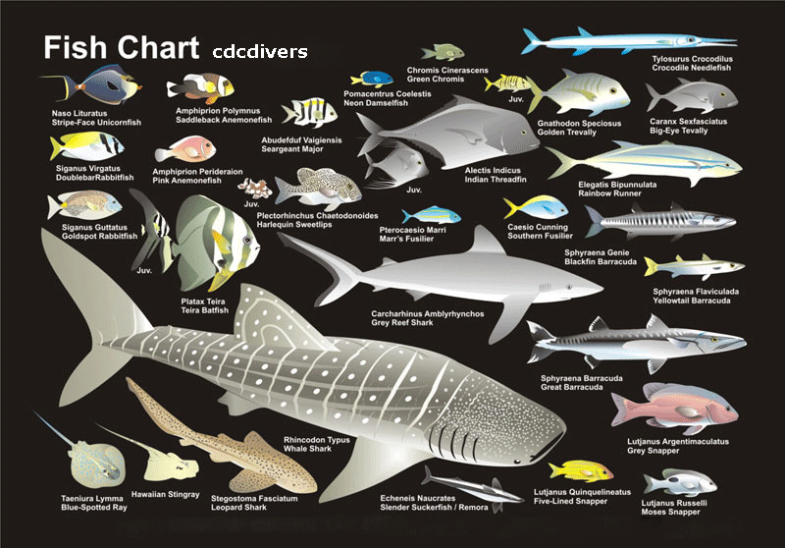
Hypothesis 1:
Meaning as reference
Meaning = Reference
The meaning of a word (or phrase) is whatever it refers to in the world
  George Washington =
  a particular person
  Fish = a kind of animal
  Red = property of
  objects

Slide 10
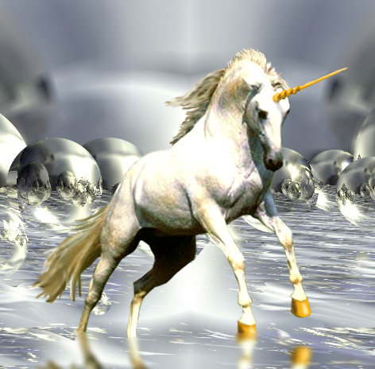
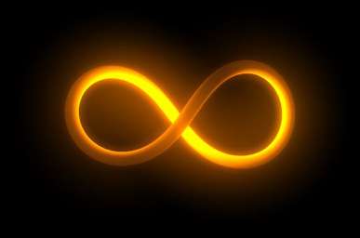
Hypothesis 1:
Meaning as reference
Problems?
Words can label non-existing real world referents
  The Crown Prince of Massachusetts
  unicorn
Words can refer to abstract referents
  Infinity
  Inevitability

Slide 11
Hypothesis 1:
Meaning as reference
Problems?
Same referent, different meaning
  Morning star (the last visible star in the eastern sky as dawn breaks)
  Evening star (the first star visible in the western sky as sun sets)
  Creatures with a heart
  Creatures with a kidney
Learning: Many non-encountered instances - how do we learn to extend meaning to include referents we haven’t seen before?
  Fish?

Slide 12
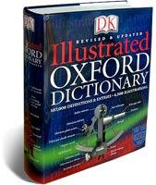
Hypothesis 2:
Meaning as definition
The Classical Theory
Word meanings are a set of properties that are necessary and sufficient for membership in the category.
  Meanings are analyzable into bundles of semantic primitives (features).
  Triangle: a closed, three sided figure, whose angles add up to 180 degrees.

Slide 13
Hypothesis 2:
Meaning as definition
Word meanings are a set of properties that are necessary and sufficient for membership in the category.
Fish
[aquatic]
[water-breathing]
[cold-blooded]
[animal]
[chambered heart]

Slide 14
Hypothesis 2:
Meaning as definition
How do we come up with the right set of properties?
Bachelor
  # My husband is a bachelor.
    Bachelor → UNMARRIED
  # I met a two-year-old bachelor.
    Bachelor → ADULT
  # My sister is a bachelor.
    Bachelor → MALE
  # My dog Rex is a bachelor.
    Bachelor → HUMAN
[UNMARRIED]
[ADULT]
[MALE]
[HUMAN]

Slide 15
Hypothesis 2:
Meaning as definition
How do we create new meanings?
Compositional semantics.
Noun Phrase
red triangles
3-sided
closed
figure
red
[red]
[3-sided]
[closed]
[figure]
red
triangle
[red]
[3-sided]
[closed]
[figure]

Slide 16
Hypothesis 2:
Meaning as definition
Composition doesn’t always seem to work, though…
Are small elephants really in the set of small things to begin with?
?
Noun Phrase
small things
elephants
Union of Features
[small?]
[mammal]
[has trunk]
Modifier
Head Noun
Ex: “small”
Ex: “elephant”
[small]
[mammal]
[has trunk]
Ex: “small elephant”

Slide 17
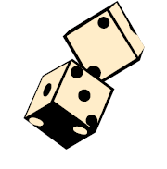
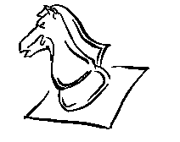

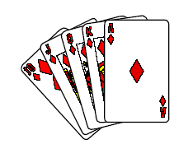

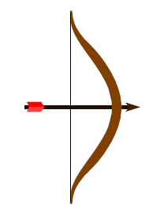


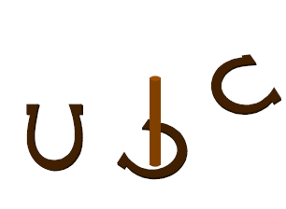
Hypothesis 2:
Meaning as definition
Also, necessary and sufficient features aren’t always so easy to come up with.
What is a game?
(Wittgenstein, 1953)
Is it always amusing?
Is skill required?
Is it always competition?
Must luck play a role?

Slide 18
Hypothesis 2:
Meaning as definition
Also, necessary and sufficient features aren’t always so easy to come up with.
Bachelor (revisited)
[UNMARRIED]
[ADULT]
[MALE]
[HUMAN]
Alfred is an unmarried adult male, but he has been living with his girl-friend for the last 23 yrs. Their relationship is happy. Is Alfred a bachelor?

Slide 19
Hypothesis 2:
Meaning as definition
Also, necessary and sufficient features aren’t always so easy to come up with.
Bachelor (revisited)
[UNMARRIED]
[ADULT]
[MALE]
[HUMAN]
Bernard is an unmarried adult male, and he does not have a partner. Bernard is a monk living in a monastery. Is Bernard a bachelor?

Slide 20
Hypothesis 2:
Meaning as definition
Also, necessary and sufficient features aren’t always so easy to come up with.
Bachelor (revisited)
[UNMARRIED]
[ADULT]
[MALE]
[HUMAN]
Charles is a married adult male, but he has not seen his wife for many years. Charles is earnestly dating, hoping to find a new partner. Is Charles a bachelor?

Slide 21
Hypothesis 2:
Meaning as definition
Also, necessary and sufficient features aren’t always so easy to come up with.
Bachelor (revisited)
[UNMARRIED]
[ADULT]
[MALE]
[HUMAN]
Donald is a married adult male, but he lives in a culture that encourages men to take two wives. Donald is earnestly dating, hoping to find a new partner. Is Donald a bachelor?

Slide 22
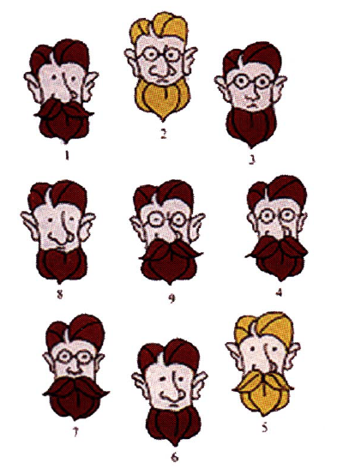
Hypothesis 3:
Meaning as graded membership to a category
Prototype Theory

Slide 23
Hypothesis 3:
Meaning as graded membership to a category
Prototype Theory
Categories have graded membership: Some members of a category are reliably rated as “better” members than others
Please rate the following in the category BIRD
Ostrich vs. Robin vs. Bat
1 2 3 4 5 6 7
Good
member
Bad
member

Slide 24
Hypothesis 3:
Meaning as graded membership to a category
Prototype Theory
Categories have graded membership: Some members of a category are reliably rated as “better” members than others
Robin: 1.1
Eagle: 1.2
Wren: 1.4
Ostrich: 3.3
Chicken: 3.8
Bat: 5.8

Slide 25
Hypothesis 3:
Meaning as graded membership to a category
Prototype Theory
Family Resemblance Structure
Smith Family
Degree of Category Membership (“Smithness”) depends on
  the number of features and
  how central they are to “Smithness”

Slide 26
Hypothesis 3:
Meaning as graded membership to a category
Prototype Theory
Family Resemblance Structure
Smith Family
Smith Features
  Beard 8/8 = 1
  Brown hair 6/8 = .75
  Big nose 6/8 = .75
  Big ears 6/8 = .75
  Mustache 4/8 = .5
(non-Smith features:
No beard = 0/8, blonde hair = 2/8, small nose = 2/8, small ears = 2/8, no mustache = 4/8)

Slide 27
Hypothesis 3:
Meaning as graded membership to a category
Prototype Theory
Family Resemblance Structure
Smith Family
Middle Smith has all features – calculate his score, based on other 8
  beard 1 * 1.0 +
  brown hair 1 *.75 +
  big nose 1 * .75 +
  big ears 1 * .75 +
  mustache 1* .5
---------------------------
  Total 3.75

Slide 28
Hypothesis 3:
Meaning as graded membership to a category
Prototype Theory
Family Resemblance Structure
Smith Family
Smith #3 has a few features
  beard 1* 1.0 +
  brown hair 1* .75 +
  small nose 1 * .25 +
  big ears 1 * .75 +
  no mustache 1 * .5
--------------------------
  Total 3.25
  poorer instance than middle Smith

Slide 29
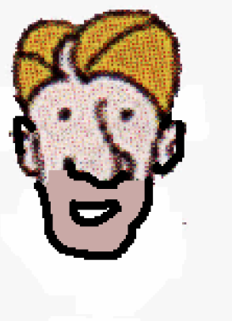
Hypothesis 3:
Meaning as graded membership to a category
Prototype Theory
Family Resemblance Structure
Item with too few features is not a member of the category
  no beard 1 * 0 +
  blonde hair 1 * .25 +
  big nose 1 * .75 +
  small ears 1 * .25 +
  no mustache 1 * .5
-----------------------
  Total 1.75
          not a Smith

Slide 30
Hypothesis 3:
Meaning as graded membership to a category
Prototype Theory
Family Resemblance Structure: One Formalization
Features have associated probability
These probabilities may be thought of as weights on the features for membership/identification purposes
Category membership is based on a weighted sum of the features.

Slide 31
An important issue:
Words ≠ Concepts

Slide 32

Words ≠ Concepts
Words and concepts do not map one-to-one.
Lexical gaps: concepts that have no words associated with them
“couch hole” = gap between couch cushions child has to be careful to avoid when walking across the couch
????
Notes:
32

Slide 33
Words ≠ Concepts
Words and concepts do not map one-to-one.
Lexical gaps: concepts that have no words associated with them
“couch hole” = gap between couch cushions child has to be careful to avoid when walking across the couch
“couch hole”
Notes:
33

Slide 34
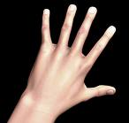
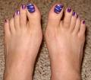
Words ≠ Concepts
Words and concepts do not map one-to-one.
Words pick out some, but not all, conceptually available distinctions
Ex:
vs.
Notes:
34

Slide 35
Words ≠ Concepts
Words and concepts do not map one-to-one.
Words pick out some, but not all, conceptually available distinctions
Ex:
vs.
English
fingers
toes
Notes:
35

Slide 36
Words ≠ Concepts
Words and concepts do not map one-to-one.
Words pick out some, but not all, conceptually available distinctions
Ex:
vs.
English
fingers
toes
Spanish
dedos
Notes:
36

Slide 37
Words ≠ Concepts
Words and concepts do not map one-to-one.
Words pick out some, but not all, conceptually available distinctions
Ex:
vs.
English
fingers
toes
digits
Spanish
dedos
Notes:
37

Slide 38
Words ≠ Concepts
Words and concepts do not map one-to-one.
Words pick out some, but not all, conceptually available distinctions
Ex:
vs.
Limb is foot
Concepts
Attached to end of limb
Limb is hand
Notes:
38

Slide 39
Words ≠ Concepts
Words and concepts do not map one-to-one.
Words pick out some, but not all, conceptually available distinctions
Ex:
vs.
toes
Limb is foot
English
Attached to end of limb
Limb is hand
fingers
Notes:
39

Slide 40
Words ≠ Concepts
Words and concepts do not map one-to-one.
Words pick out some, but not all, conceptually available distinctions
Ex:
vs.
Limb is foot
English
Attached to end of limb
Limb is hand
digits
Notes:
40

Slide 41
Words ≠ Concepts
Words and concepts do not map one-to-one.
Words pick out some, but not all, conceptually available distinctions
Ex:
vs.
Limb is foot
Spanish
Attached to end of limb
Limb is hand
dedos
Notes:
41

Slide 42
What about more abstract concepts/meanings?
(which often may be associated
with units smaller than whole words)
[from Wagner 2010]

Slide 43
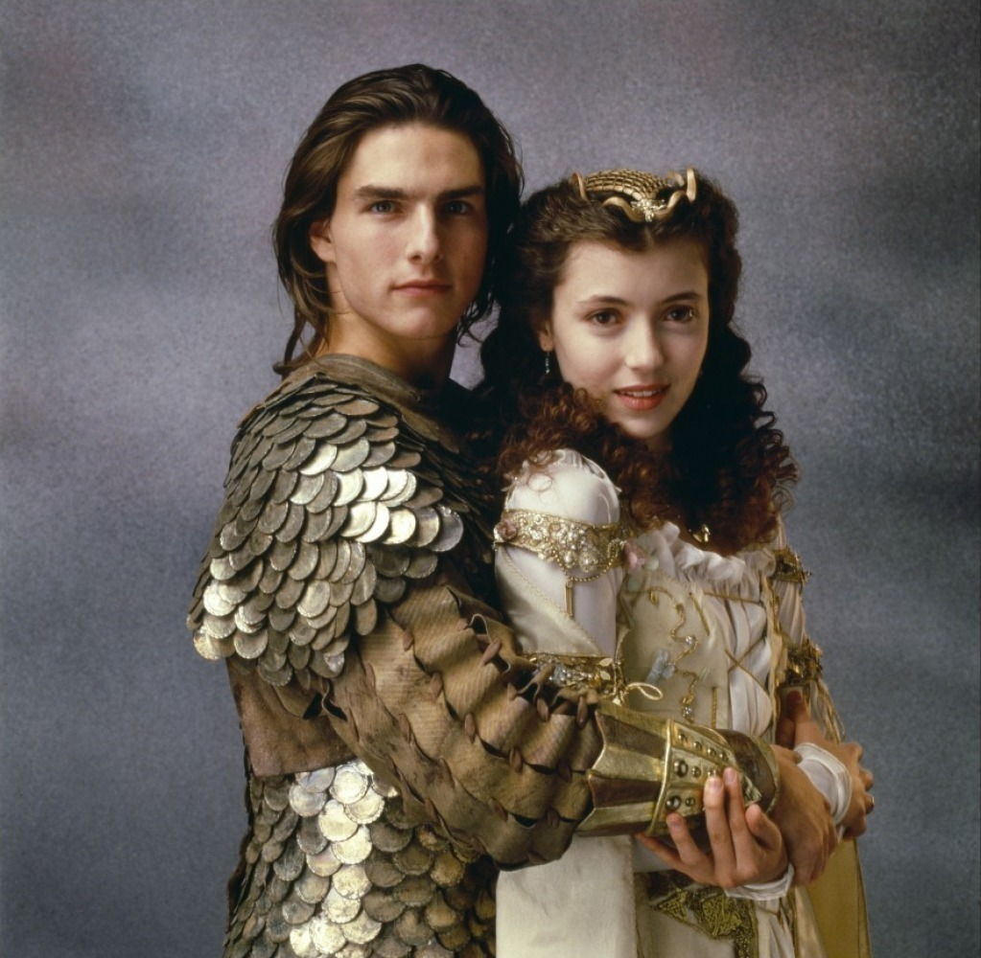
Concepts associated with events
Tense: Locates an event in time
past:
Jack hugged Lily. Jack did hug Lily.
Jack was hugging Lily. Jack had hugged Lily.
Jack has hugged Lily.
present:
Jack hugs Lily. Jack is hugging Lily.
future:
Jack will hug Lily. Jack will be hugging Lily.
Jack will have hugged Lily by tomorrow.

Slide 44
Concepts associated with events
Aspect: signals the viewer’s perspective
of the event
completed (“perfective”):
Jack hugged Lily. Jack did hug Lily.
Jack has hugged Lily. Jack had hugged Lily.
Jack will have hugged Lily by tomorrow.
incomplete (“imperfective”):
Jack was hugging Lily. Jack is hugging Lily.
Jack will be hugging Lily.

Slide 45

Concepts associated with events
All languages mark either tense or aspect or both, but there is wide variation in their precise expression.
Tense-only: modern Hebrew
Aspect-only: Mandarin
English: both

Slide 46
Concepts associated with events
Another difficulty: These kinds of meanings can be naturally related to each other, which means it can be difficult to realize they’re actually separate concepts
Class one: “the present moment”
present tense + imperfective aspect
(naturally incomplete because you’re watching it happen)
ex: Jack hugs Lily.
Class two: “the completed past”
past tense + perfective aspect
(naturally in the past because you know it finished)
ex: Jack hugged Lily.

Slide 47
Concepts associated with events
Some final thoughts:
Our subjective experience of time passing may help identify that tense is a relevant concept. There may be a more perceptually grounded way to identify something as definitively “present” vs. “past” vs. “future” than there is to identify something as definitively a “game” or a “fruit” or a “Smith”.
Our subjective experience of events happening may help identify that incomplete vs. complete is a relevant distinction. As with time, there may be a more perceptually grounded way to identify something as definitively “complete” vs. “incomplete”.

Slide 48
Recap: Children’s Lexical Development
Children must figure out the lexicon of their language, including the correspondence between sounds and meaning.
Referential meaning isn’t necessarily so easy to define. A current theory that shows promise is a probabilistic implementation of prototype theory.
Different components of meaning may overlap, such as with tense and aspect. This shows us that the meaning we have for a word can involve many different logically separate concepts, even if we aren’t explicitly aware of them.
Notes:
48

Slide 49
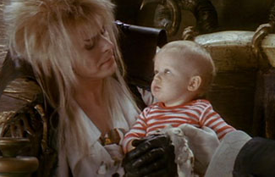
Questions?
You should be able to do up through question 7 on HW2 and up through question 7 on the lexical development review questions.
Notes:
49

