Slide 1
Psych 56L/ Ling 51: Acquisition of Language
2/5/2013
Midterm Review

Slide 2
Test Format
Multiple Choice:
Totally normal, choose from 4 options
True/False:
Also choose from 4 options
First: Choose True or False
Second: Choose the option with the correct reasoning

Slide 3
True/False Sample Question
1 + 2 = 3
True, and we can check because 3 – 2 = 1
True, any two odd and even numbers sum to 3
False, 1 + 2 = 4
False, 1 – 2 = 3

Slide 4
Viewpoints on Development
Domain-specific
Learned
Innate
Domain-general

Slide 5
Viewpoints on Development
Domain-specific
Generativist
Learned
Innate
Empiricist
Nativist
Constructionist
Domain-general

Slide 6
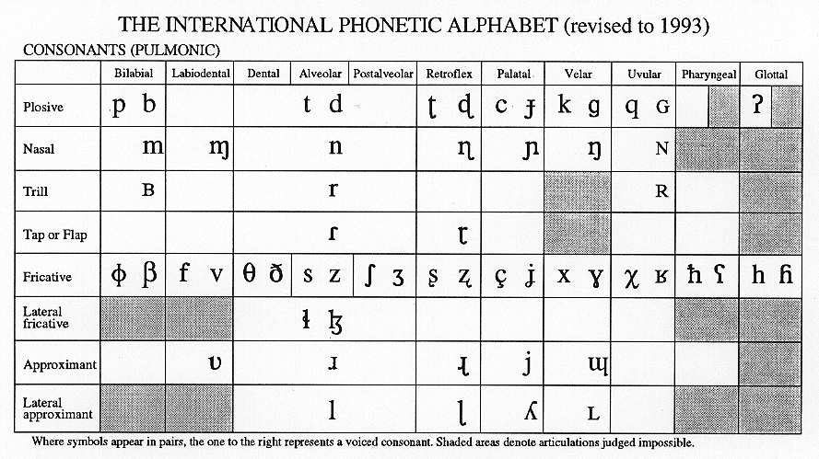
IPA: Consonants
ñ
tʃ dʒ
w

Slide 7
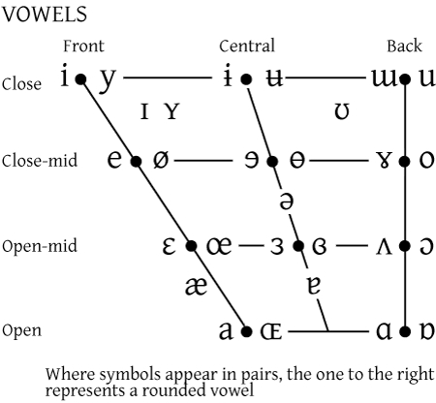
IPA: Vowels

Slide 8
Phonological Processes
Deletion Processes
Final consonant deletion /kӕt/ -> /kӕ/
Consonant cluster deletion /brӕt/ -> /bӕt/
Unstressed syllable deletion /bәnӕnә/ -> /nӕnә/

Slide 9
Phonological Processes
Substitution Processes
Stopping /ðæt/ -> /dæt/
Gliding /ræbɪt/ -> /wæbɪt/
Denasalization /spun/ -> /spud/
Fronting /ʃɪp/ -> /sɪp/
Assimilation /dagi/ -> /gagi/

Slide 10
Combining Processes
Processes can occur at the same time:
“giraffe” /dʒəræf/ -> /ræ/
/dʒəræf/ -> /ræf/ Unstressed Syllable Deletion
/ræf/ -> /ræ/ Final Consonant Deletion

Slide 11
Combining Processes
/faɪrtrʊk/ -> /tairpʊ/
/faɪrtrʊk/ -> /faɪrtʊk/ Consonant Cluster Deletion
2) /faɪrtʊk/ -> /faɪrtʊ/ Final Consonant Deletion
/faɪrtʊ/ -> /fairpʊ/ Fronting
/faɪrpʊ/ -> /paɪrpʊ/ Assimilation (Cons. Harmony)
(/f/ takes +stop,+bilabial from /p/)

Slide 12
Research Methods
Diary Study
Pro: Know when a child produces particular utterances
Con: Doesn’t say anything about “typical” children
MacArthur-Bates Communicative Development Inventory(MCDI)
Pro: Gives norms for when children know a word
Con: Says nothing about a particular child
Mean-Length Utterance (MLU)
Pro: Tells you how complex a child’s utterances are
Con: Doesn’t say anything about word-level knowledge

Slide 13
Research Methods
Computational Modeling
Pro: Can identify good learning strategies
Con: Says nothing about what children know
Peabody Picture Vocabulary Test (PPVT)
Pro: Know if a child understands a particular word
Con: Costly to administer

Slide 14
BLANK SLIDE
TEXT

Slide 15
Transitional Probability
TP(AB) = P(AB|A) = # of times you saw AB / # of times you saw A
ka/ko/si
ko/li/ja
ja/ko
li/je/vo
TP(ko/si) = # of times ko/si / # of times ko
TP(ja/vo) = # of times ja/vo / # of times ja

Slide 16
TP Minima
TP can be though of like a tide
Every time the TP is at “low tide” we put a boundary
0.7
0.65
0.55
0.5
0.45
0.4
0.35
0.3
0.3
0.2
0.15

Slide 17
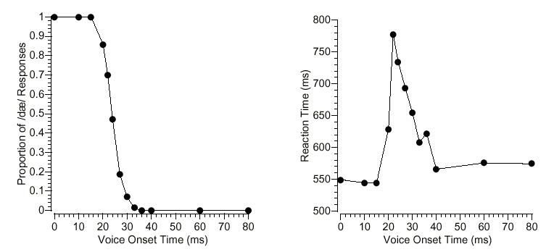
Sound Identification

Slide 18
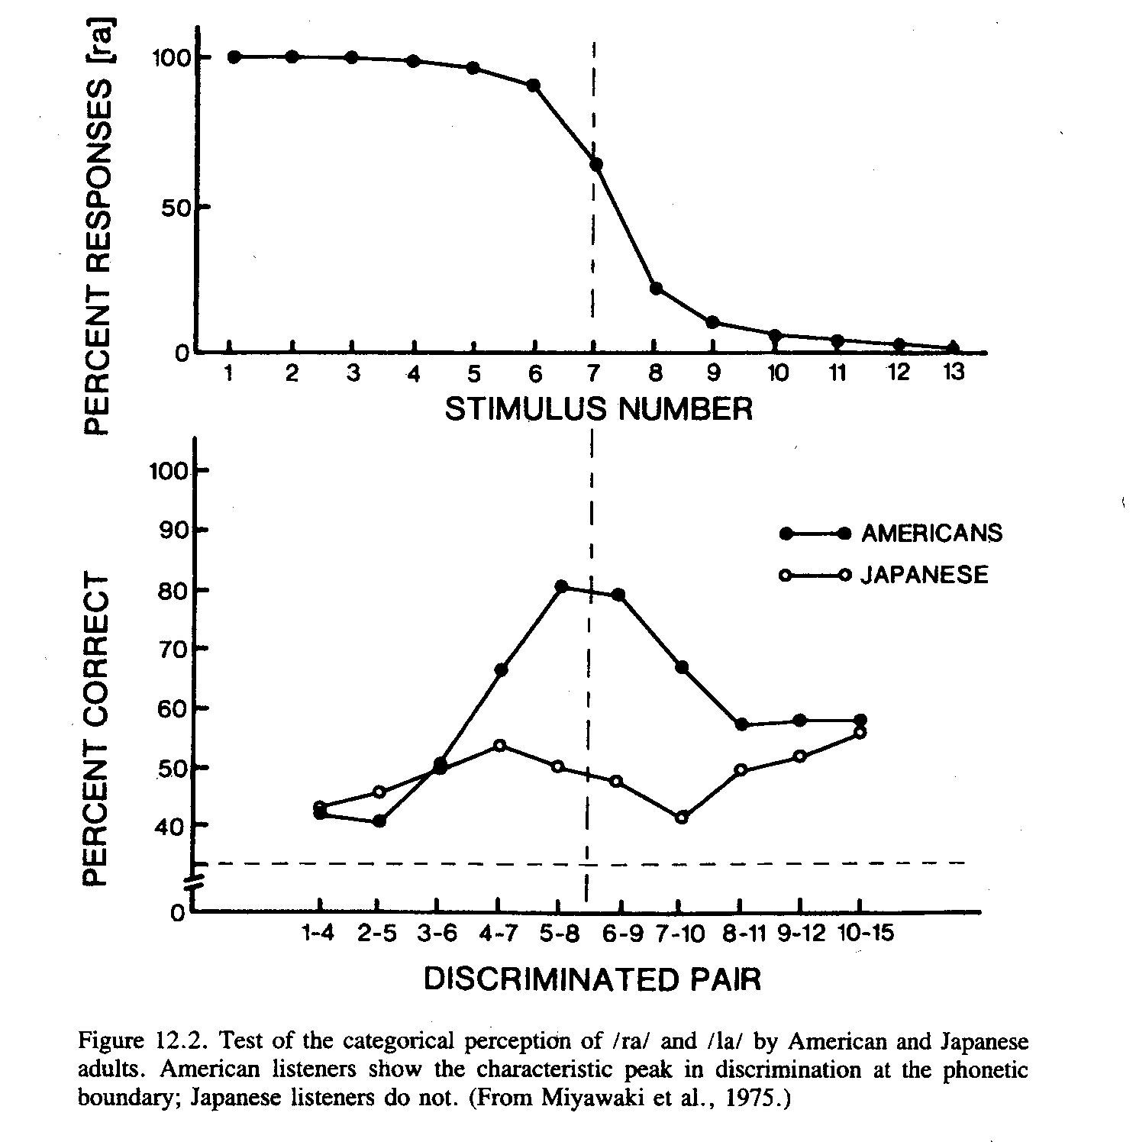
Sound Discrimination

