Slide 1
Discussion of Cieslak, McMahon, and Pang,
“Did I Make Myself Clear? The Fed and the Market
in the Post-2020 Framework Period”
Eric T. Swanson
University of California, Irvine
Review of the Federal Reserve’s Monetary Policy Framework
Brookings Institution
June 14, 2024

Slide 2
Summary of Paper
Thorough background on the 2020 FAIT framework
many examples, anecdotes
numerous quotes from FOMC members, news articles
Discussion of successes and failures of FAIT framework
anecdotal and informal, but insightful
High-frequency analysis of interest rate changes around macro announcements and FOMC announcements/communications
Textual analysis of newspaper articles using ChatGPT
Interest rate expectations vs. term premium responses

Slide 3
Summary of Paper’s Conclusions
The 2020 FAIT framework was a mistake
designed to handle one specific problem
difficult to communicate
increased market uncertainty
ended up constraining the FOMC
Classic “risk management” approach better
Fed should be more explicit about bands around π*
shouldn’t worry so much about small undershoots (or overshoots)
Fed should give “scenario analysis”
Fed should publish Tealbook forecast and/or SEP details
I agree
I agree
I agree
I agree
I disagree
I agree
I agree
I disagree

Slide 4
Comment 1: Point of Inflation Targeting was Clear Communication
One of the main points of inflation targeting was clear communication with financial markets and the public:
“Inflation targeting is characterized by two features: an explicit numerical target or target range for inflation and a high degree of transparency about forecasts and policy plans.” (Bernanke, 11/14/2007)
“Among other important features of inflation targeting are vigorous efforts to communicate with the public about the plans and objectives of the monetary authorities and… strengthen the central bank’s accountability for attaining those objectives.” (Bernanke, Laubach, Mishkin, and Posen, 1999, p. 4)
“The use of inflation targeting increases public understanding of monetary policy, improves policy-maker accountability …” (BLMP, p. 6)
“We see the inflation-targeting framework as serving two important functions: (1) improving communication between policy-makers and the public, and, not unrelatedly, (2) providing discipline and accountability in the making of monetary policy.” (BLMP, p. 23)
“By making explicit the central bank’s medium-term policy intentions, inflation targets improve planning in the private sector , enhance the public debate about the direction of monetary policy, and increase the accountability of the central bank.” (BLMP, p. 23)
“Why spend so much effort on clarity and communication? The efforts by the inflation-targeting central banks to improve transparency and communication have been crucial to the success of the targeting regimes.” (BLMP, p. 296)
“Increased transparency would also reduce the financial and economic uncertainty associated with the Fed’s current procedures by giving the markets more information about what future monetary policies are likely to be. That would reduce substantially the costs incurred by financial analysts trying to guess what the Federal Reserve will do next and would make it easier for businesses and consumers to plan for the future, thus promoting economic efficiency.” (BLMP, p. 311)

Slide 5
Comment 1: Point of Inflation Targeting was Clear Communication
One of the main points of inflation targeting was clear communication with financial markets and the public:
“Inflation targeting is characterized by two features: an explicit numerical target or target range for inflation and a high degree of transparency about forecasts and policy plans.” (Bernanke, 11/14/2007)
“Among other important features of inflation targeting are vigorous efforts to communicate with the public about the plans and objectives of the monetary authorities and… strengthen the central bank’s accountability for attaining those objectives.” (Bernanke, Laubach, Mishkin, and Posen, 1999, p. 4)
“The use of inflation targeting increases public understanding of monetary policy, improves policy-maker accountability …” (BLMP, p. 6)
“We see the inflation-targeting framework as serving two important functions: (1) improving communication between policy-makers and the public, and, not unrelatedly, (2) providing discipline and accountability in the making of monetary policy.” (BLMP, p. 23)
“By making explicit the central bank’s medium-term policy intentions, inflation targets improve planning in the private sector , enhance the public debate about the direction of monetary policy, and increase the accountability of the central bank.” (BLMP, p. 23)
“Why spend so much effort on clarity and communication? The efforts by the inflation-targeting central banks to improve transparency and communication have been crucial to the success of the targeting regimes.” (BLMP, p. 296)
“Increased transparency would also reduce the financial and economic uncertainty associated with the Fed’s current procedures by giving the markets more information about what future monetary policies are likely to be. That would reduce substantially the costs incurred by financial analysts trying to guess what the Federal Reserve will do next and would make it easier for businesses and consumers to plan for the future, thus promoting economic efficiency.” (BLMP, p. 311)

Slide 6
Comment 1: Point of Inflation Targeting was Clear Communication
In contrast, Cieslak, McMahon, and Pang provide extensive evidence that:
the 2020 FAIT framework was vague by design
policymakers themselves did not agree on details of the framework
markets and press sought more clarity and were rebuffed
term premia increased
FAIT seemed to create market uncertainty, confusion in 2021
The 2020 FAIT framework was a giant step backward in communication and accountability

Slide 7
Comment 2: Communication Problems
Sum of high-frequency market responses to:
FOMC Announcements
Chair Press Conferences
Table IV:
This should not happen
with good communication, these columns should be uncorrelated
instead, Fed Chair systematically contradicted the FOMC
Clear evidence of a communication problem
Related to the 2020 FAIT framework? Not clear.

Slide 8
Comment 2: Communication Problems
Figure 11:

Slide 9
Comment 2: Communication Problems
Swanson and Jayawickrema (2024):
2020-2023 press conferences were, ex post, a serious communications failure

Slide 10
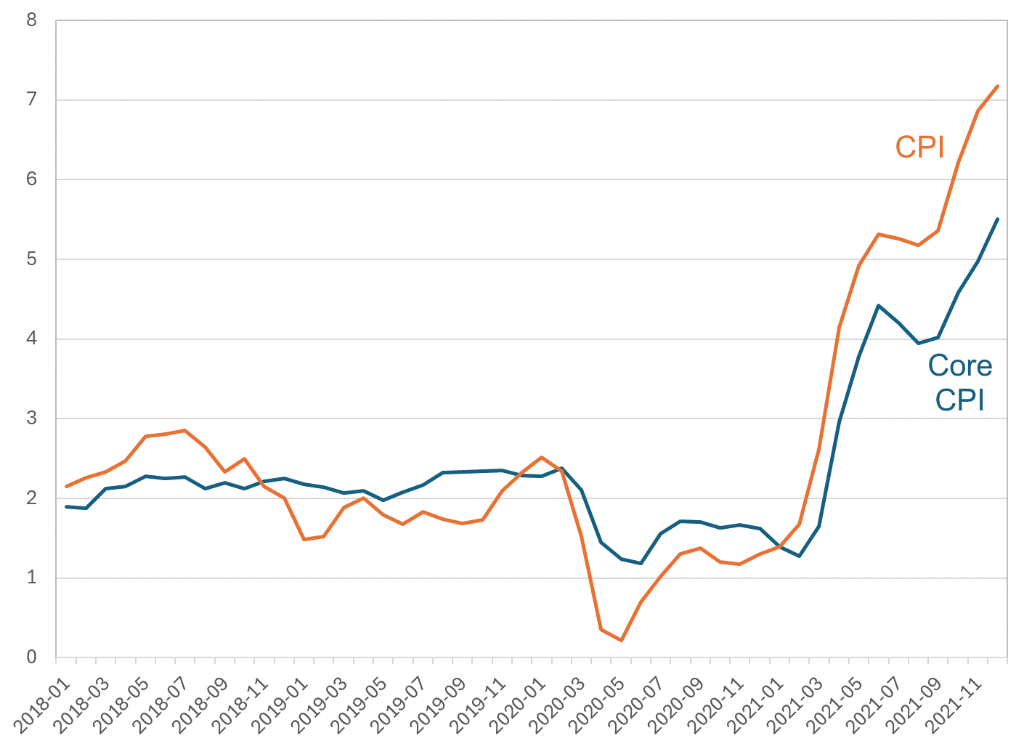
Comment 3: Fed Was Not Very Constrained by Its Fwd Guidance
Inflation in December 2021:
percent change from 12 months previous

Slide 11
Comment 3: Fed Was Not Very Constrained by Its Fwd Guidance
December 2021 Summary of Economic Projections:
This does not look like the FOMC was constrained. It looks like they thought inflation would be transitory.

Slide 12
Comment 3: Fed Was Not Very Constrained by Its Fwd Guidance
If the Fed had been constrained in December 2021:
SEP interest rate forecasts would have been hitting the constraint
instead, the FOMC soon set interest rates much higher
SEP inflation forecasts would have been very high
instead, they were very low
Instead, it looks like monetary policy in late 2021 & early 2022 was set based on a bad assumption that inflation would be transitory.

Slide 13
Comment 4: Fed Should Publish SEP after Every Meeting
Paper argues Fed should publish Tealbook, esp. staff forecast
puts political pressure on staff
creates significant risk of biasing staff forecast
e.g., there have been times when staff forecast changed dramatically
Instead, publish the SEP after every meeting:
SEP is a fantastic resource
e.g., June 12, 2024 FOMC release and it would be very helpful to have SEP for July 30-31 meeting
avoids political pressure on staff forecast
minimal additional work
Not necessary to connect dots to forecasts
SEP is extremely valuable as it is

Slide 14
Comment 5: Term Premium Fallacy
Changes in the term premium do not necessarily have the same effect on the economy as changes in expected path of short rates
Rudebusch, Sack, and Swanson (2007 FRBSL ER)
The term premium can change for many reasons. Different reasons imply different effects on the economy.
For example:
Suppose a long-term real bond has no risk premium while comparable nominal bond has an inflation risk premium
In equilibrium, firms & lenders are indifferent between the two rates
If inflation risk premium goes up, in equilibrium, firms & lenders are still indifferent between the two rates
Thus, higher term premium in this case does not imply lower investment

Slide 15
Summary
Paper is an outstanding summary of Fed’s post-2020 FAIT framework
well-written, thorough, informative, many good examples and quotes
Authors are fair but ultimately critical of FAIT
Suggest Fed should return to “risk management” oriented approach going forward
Some thoughts:
2020-2023 press conferences were a communications failure, not clearly related to FAIT
Question the Fed story that it was constrained in late 2021 & early 2022
Argue for publishing SEP every meeting rather than Tealbook forecasts
Effects of term premia are not necessarily the same as effects of changes in short rate expectations

