Slide 1

Discussion of Marek Jarocinski
“Estimating the Fed’s Unconventional Policy Shocks”
Eric T. Swanson
University of California, Irvine
International Banking, Economics, and Finance Session
Allied Social Science Association Meetings
January 7, 2023

Slide 2
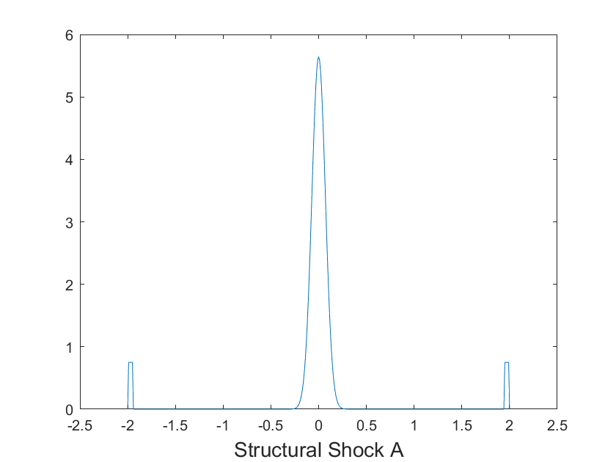

Structural Shocks Can Be Identified Using Fat Tails
Suppose (unobserved) structural shocks in the model have very fat tails:
Then large observations in the data are overwhelmingly likely to have come from either one shock or the other, not both
So the econometrician can basically observe the effects of the two structural shocks separately

Slide 3
Structural Shocks Can Be Identified Using Fat Tails

Slide 4
Financial Market Responses to FOMC Announcements are Fat-Tailed

Slide 5
Fat Tails in the Data Identify Four Types of Monetary Policy Shocks
surprise change in fed funds rate
surprise change in forward guidance
surprise change in long-term bond purchases
surprise change in Delphic forward guidance

Slide 6
Relation to Literature
Results in the paper agree very closely with previous identifications despite using a completely different approach:
Gurkaynak, Sack, and Swanson (2005):
  Forward guidance has no effect on current federal funds rate
Swanson (2021):
  Forward guidance and long-term bond purchases have no effect on current federal funds rate
  Long-term bond purchases have minimal effects before 2008
Lewis (2023):
  Structural shocks are heteroskedastic over the course of the afternoon of an FOMC announcement

Slide 7
Main Comment: Delphic Forward Guidance Interpretation
Stock market responses to FOMC announcements are very volatile, often difficult to explain
Jan. 3, 2001: large intermeeting surprise cut in fed funds rate by 50bp
̶ intermediate-maturity futures and Treasury yields rose because markets reduce probability of recession
̶ stock market has huge increase, much more than usual
Mar. 20, 2001: Fed cuts funds rate by 50bp, but markets had hoped for 75bp
̶ intermediate-maturity futures and Treasury yields fall because markets increase probability of recession
̶ stock market has huge decline, much more than usual
This paper (and Jarocinski-Karadi, 2020) calls both of these announcements “Delphic forward guidance”, but that interpretation does not seem to fit here and is inconsistent with market commentary at the time

Slide 8
FOMC Announcement of 3/20/2001

Slide 9
Main Comment: Delphic Forward Guidance Interpretation
Regular forward guidance:
Delphic forward guidance:
The decomposition of shocks into regular forward guidance vs. Delphic forward guidance just seems like a way for the model to “explain” volatile stock market movements
Note: excluding the stock market, three factors in Swanson (2021) explain 94% of variation in financial markets around FOMC announcements

Slide 10
Main Comment: Delphic Forward Guidance Interpretation
Consistent with this interpretation, Delphic forward guidance effects disappear 1-2 days later:
The effects of regular forward guidance are more persistent:

Slide 11
Summary
This is a great paper
The identification approach is clearly a good idea
Results are consistent with previous identifications using other methods
Main comment:
“Delphic forward guidance” shock interpretation is not very convincing
Delphic shocks just seem like a way for the model to “explain” the very volatile stock market reactions to Fed announcements
Delphic forward guidance shock effects die out in 1 day

