Slide 1
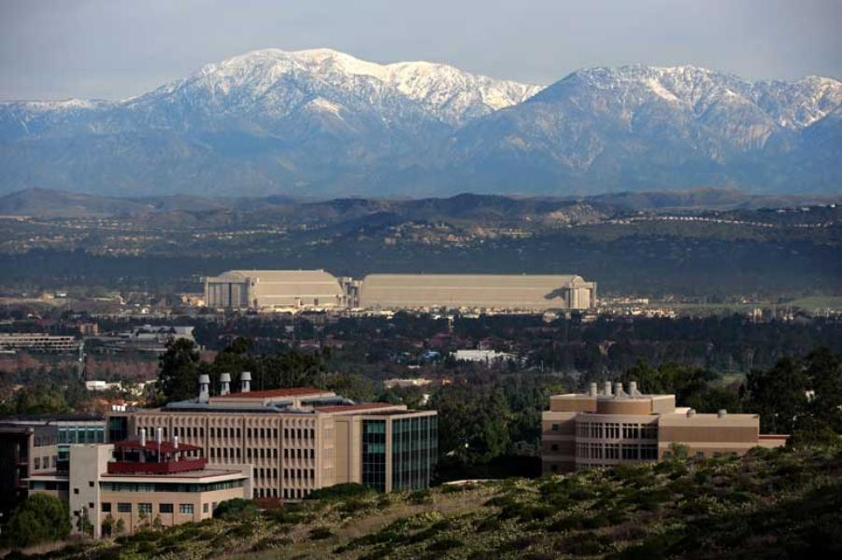
ChaMP Academic Panel:
Challenges in Monetary Policy Transmission
Eric T. Swanson
University of California, Irvine
ChaMP Conference
Banca d’Italia, Rome
July 7, 2026

Slide 2
1. Monetary Policy Transmission Heterogeneity in the U.S.
Some states (e.g., Texas, Oklahoma) are clearly differentially sensitive to oil shocks
  e.g., De Michelis, Ferreira, Iacoviello (2020 IJCB)
Evidence for monetary policy transmission heterogeneity is less clear, but:
Great Lakes states are more manufacturing-intensive, MP sensitive
  Carlino-DeFina (1998 REStat)
California is very mortgage-financing sensitive, would be more MP sensitive,
except that LTV ratios are also cyclical, so it’s complicated
  Beraja, Fuster, Hurst, Vavra (2018 QJE)
Low-income metro areas are more MP sensitive (consistent with more hand-to-mouth households)
  Herreno-Pedemonte (2026 REStat)

Slide 3
2. Post-2020 MP Transmission Changes
Debate about whether the Phillips Curve has steepened since 2020:
Phillips Curve slope increased:
  e.g., Hobijn, Miles, Royal, Zhang (2023 FRBChi Letter)
Phillips Curve slope didn’t change, but nonlinear:
  e.g., Benigno-Eggertsson (2024 AEAPP)
Inflation surge driven primarily by price shocks:
  e.g., Bernanke-Blanchard (2025 AEJMacro)
Evidence that firms adjusted prices more frequently:
  e.g., Montag-Villar (2025 FEDS)

Slide 4
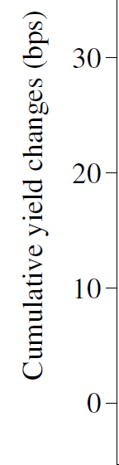
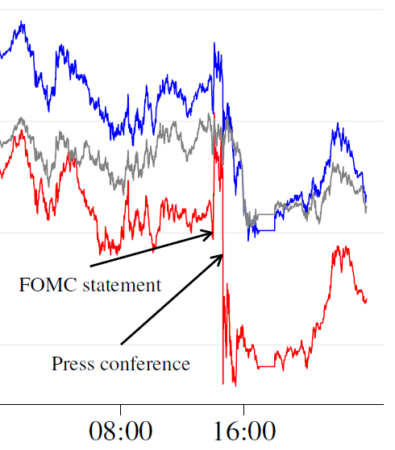
2. Post-2020 MP Transmission Changes: Communication Problems
Example: June 15, 2022:
10yr Treasury
30yr Treasury
2yr Treasury
source: Cieslak, McMahon, Pang (2025)

Slide 5
2. Post-2020 MP Transmission Changes: Communication Problems
Swanson and Jayawickrema (2025):
2020-2023 press conferences were, ex post, a serious communications failure

Slide 6
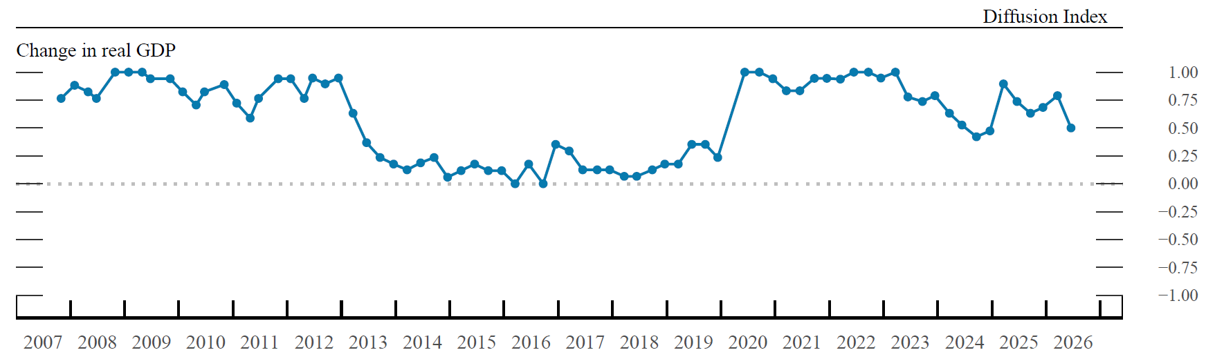
3. Is Uncertainty High? FOMC Perceptions of Uncertainty, 2007-26
higher than average
average uncertainty
lower than average
Lake Wobegon Effect: “All the children in Lake Wobegon are above average”
source: FOMC Summary of Economic Projections, June 2026

Slide 7
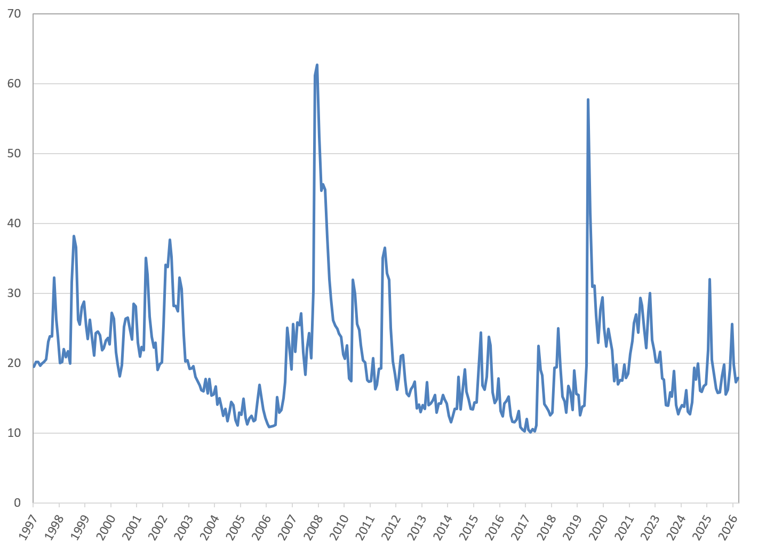
3. Is Uncertainty High? VIX, 1997-2026
Global Financial Crisis
East Asian Crisis
Covid
Russian Default/LTCM
European Sovereign Debt Crisis
Dot-com boom/bust
U.S. invades Iraq
Inflation, Interest Rate Hikes
U.S. Tariff Threats
Brexit
Hormuz
average, 1997-2025
current situation

