Slide 1
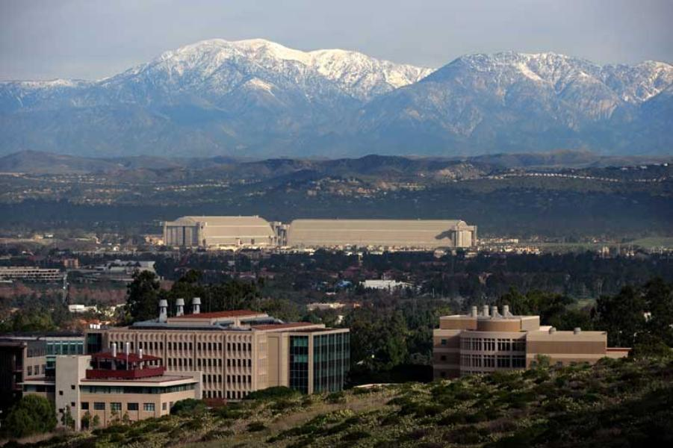
The Past, Present, and Future of the
“Fed Information Effect”
Eric T. Swanson
University of California, Irvine
Melbourne Macro Policy Meeting
October 31, 2025

Slide 2
The Fed Information Effect
The Past:
Sims and Zha (1994)
Christiano, Eichenbaum, and Evans (1996 REStat)
Romer and Romer (2000 AER)
Campbell, Evans, Fisher, and Justiniano (2012 BPEA)
Nakamura and Steinsson (2018 QJE)
Faust, Swanson, and Wright (2004 BEJMacro)
The Present:
Bauer and Swanson (2023 AER)
Jarocinski and Karadi (2020 AEJMacro)
The Future:
Golez and Matthies (2025 JFE)?
Gilchrist, Yang, and Zhao (2025)?
Swanson, Wang, and Wu (2025)
Jarocinski and Karadi (2025)
Boehm and Kroner (2024 NBERWP)
Alam (2023 SSRNWP)

Slide 3
The Fed Information Effect: The Past
The Past
Sims and Zha (1994)
Christiano, Eichenbaum, and Evans (1996 REStat)
Romer and Romer (2000 AER)
Campbell, Evans, Fisher, and Justiniano (2012 BPEA)
Nakamura and Steinsson (2018 QJE)
Faust, Swanson, and Wright (2004 BEJMacro)

Slide 4

The “Fed Information Effect"
t indexes FOMC announcements
BCrev_{t} is one-month change in Blue Chip forecast around FOMC announcement
mps_{t} is measure of FOMC announcement surprise in 30-minute window around announcement
Standard macro models, VARs predict θ < 0 (for GDP, inflation)
But empirical work sometimes estimates θ > 0

Slide 5
The “Fed Information Effect” Story
The Fed is a better forecaster than the private sector
When the Fed lowers interest rates, private sector infers that economy must be worse than they thought
So private sector lowers rather than raises GDP forecast
See: Romer and Romer (2000 AER), Campbell, Evans, Fisher, Justiniano (2012 BPEA), Nakamura and Steinsson (2018 QJE)
Note: the implied macro information content of Fed interest rate announcements is huge
information effect
interest rate effect

Slide 6
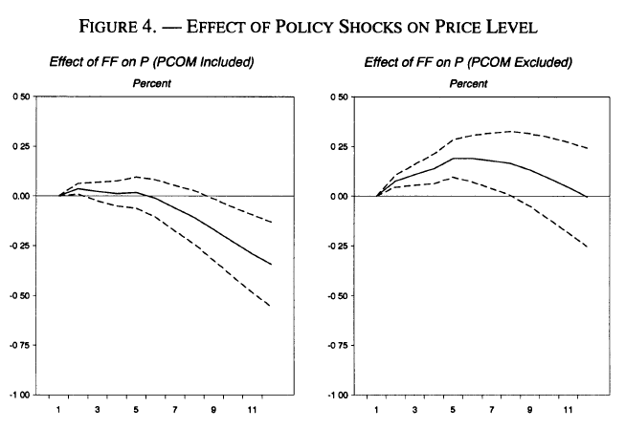
The “Price Puzzle”
Eichenbaum (1992 EER) and Sims (1992 EER) estimated that a monetary policy tightening caused prices to increase rather than decrease in a VAR
Sims and Zha (1994) and Christiano, Eichenbaum, and Evans (1996 REStat) argued an omitted variable (commodity prices) was driving the puzzle
Their story: an increase in commodity (esp. oil) prices was causing both the Fed to raise interest rates and inflation to increase

Slide 7
RR, CEFJ, and NS
Romer-Romer (2000 AER):
The Fed’s interest rate decisions reveal information about inflation to the private sector
Campbell-Evans-Fisher-Justiniano (2012 BPEA):
The Fed’s interest rate decisions reveal information about unemployment to the private sector
Nakamura-Steinsson (2018 QJE):
The Fed’s interest rate decisions reveal information about GDP to the private sector

Slide 8
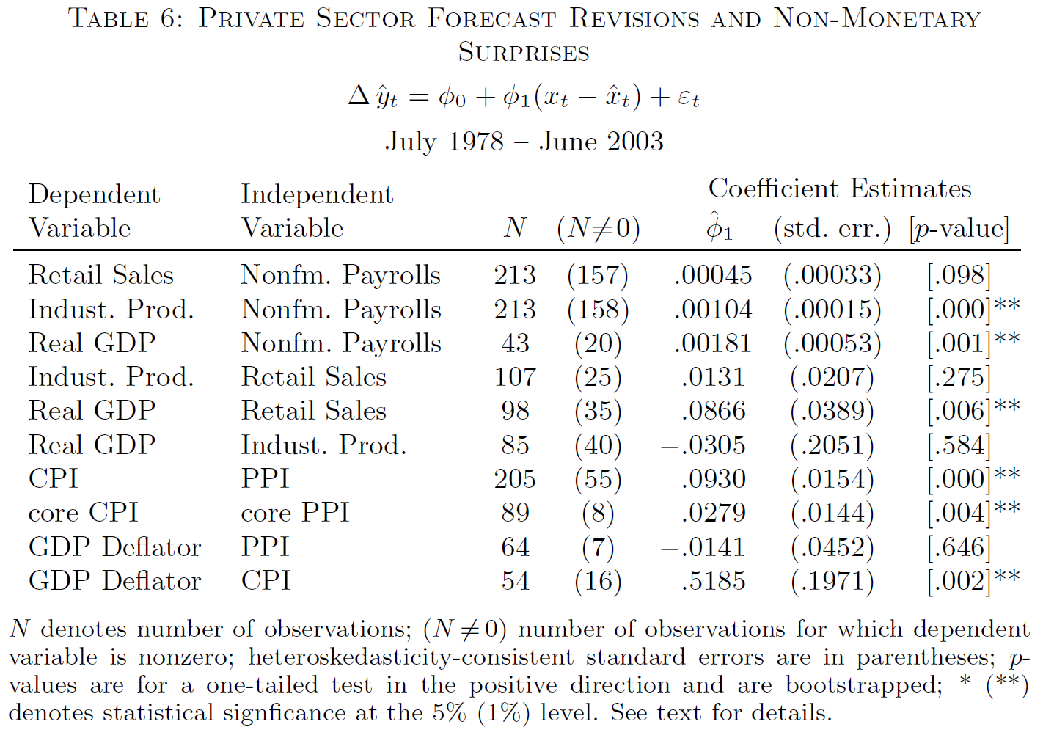
Faust, Swanson, and Wright (2004 BEJMacro)
Showed that private sector revises forecasts of upcoming data releases in response to major macroeconomic announcements:

Slide 9
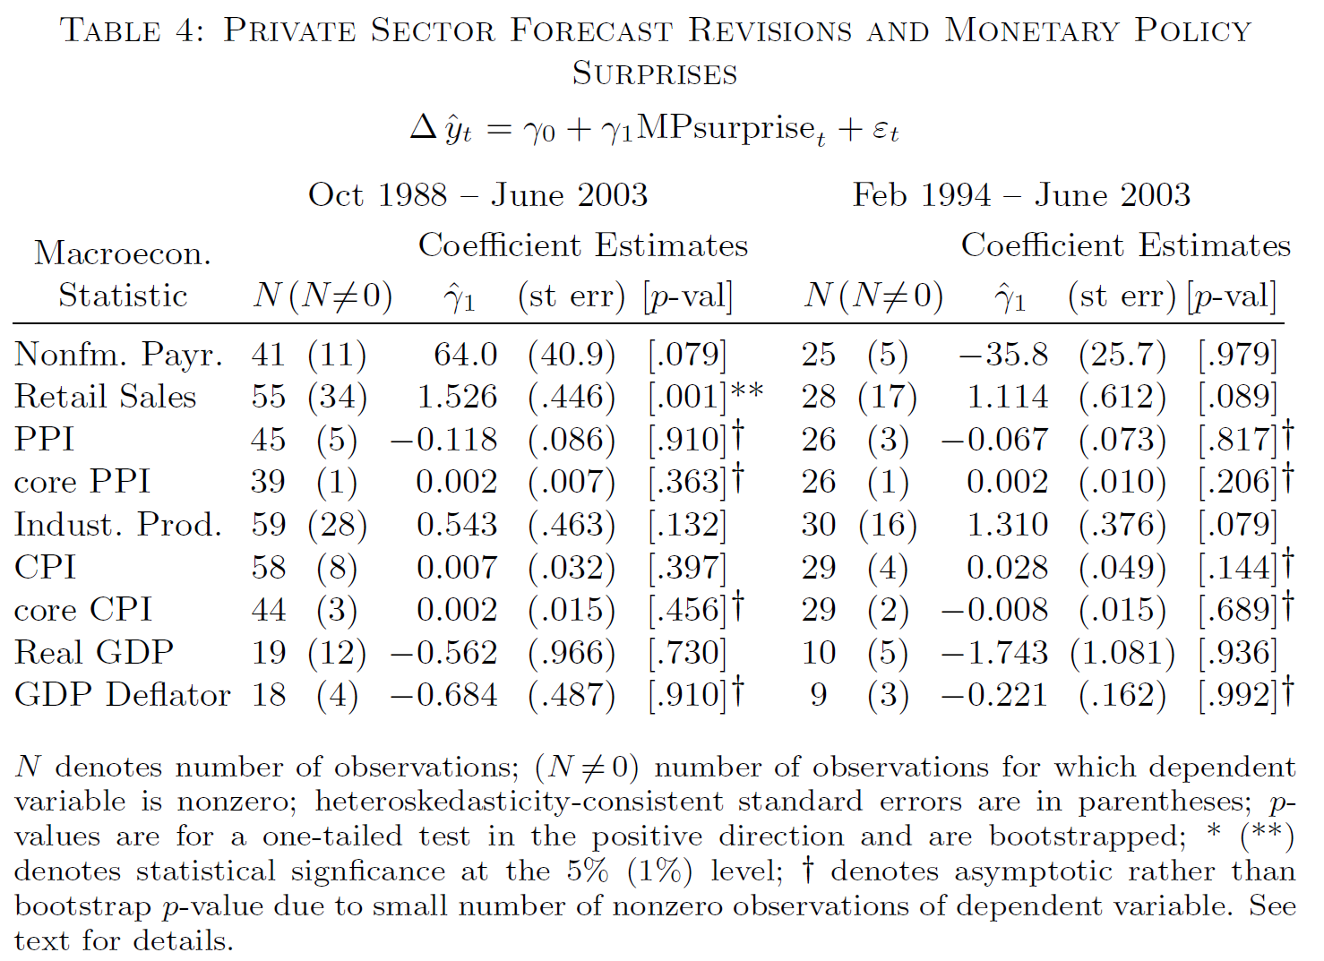
Faust, Swanson, and Wright (2004 BEJMacro)
But private sector does not revise those forecasts in response to FOMC announcements:

Slide 10
The Fed Information Effect: The Present
The Present
Bauer and Swanson (2023 AER)
Jarocinski and Karadi (2020 AEJMacro)

Slide 11
Bauer-Swanson (2023 AER): Background
Fed forecast is very similar to Blue Chip, other high-quality forecasters
Fed publishes its forecast 4 times per year in the Summary of Economic Projections (2 times per year in the Semiannual Report to Congress pre-2007)
Fed’s forecasts have not been particularly good:
e.g., Fed’s inflation forecast in 2021-2022
When financial press reports on FOMC decisions, articles emphasize interest rates, not revealed information about macro variables

Slide 12
Bauer-Swanson (2023 AER): Replication
Replicate RR, CEFJ, and NS findings, but:
Using Romer-Romer sample and methods, cannot replicate CEFJ or NS finding
Using CEFJ sample and methods, cannot replicate RR or NS finding
Using NS sample and methods, cannot replicate RR or CEFJ finding
Summary:
The “Fed Information Effect” literature is not unified
Instead, it is fragmented, unable to confirm each other’s results, lacks robustness

Slide 13
Bauer-Swanson (2023 AER): Forecast Comparison
Compare Fed Greenbook and Blue Chip forecasts, show they are very similar*
Note: Fed forecasts are 8 times per year, Blue Chip is once per month, so timing does not line up
When researchers claim the Fed forecast is better, it is almost always
due to a timing issue: e.g., comparing Fed forecast to most recent Blue Chip forecast (which is stale)
Bauer-Swanson compare Fed forecast to closest Blue Chip forecast; half the time Fed forecast comes first and half the time Blue Chip is first
*See also Faust, Swanson, and Wright (2004 BEJMacro), Gamber and Smith (2009 JMacro), Paul (2020 REStat), Hoesch, Rossi, and Sekhposian (2023 AEJMacro)

Slide 14
Bauer-Swanson (2023 AER): Forecaster Survey
There are only 52 forecasters in the Blue Chip survey
We tracked down the contact information for the chief economist for each forecasting team, asked them:
Do you revise any of your macroeconomic forecasts (GDP, unemployment, or inflation) in response to the FOMC’s federal funds rate decision? If yes, please briefly explain which forecasts you revise and which direction you revise those forecasts (i.e., do you revise them up or down if the decision is more hawkish/dovish than expected).
Do you revise any of your macroeconomic forecasts in response to the FOMC statement? If yes, please briefly explain which forecasts you revise, and which direction you revise those forecasts (i.e., do you revise them up or down if the statement is more hawkish/dovish than expected).
Do you revise any of your macroeconomic forecasts in response to the dot plot released by the FOMC in the Summary of Economic Projections (SEP)? If yes, please briefly explain which forecasts you revise and which direction you revise those forecasts (i.e., do you revise them up or down if the dot plot is more hawkish/dovish than expected)
Do you revise any of your macroeconomic forecasts in response to SEP forecasts of GDP, unemployment, and inflation in the Summary of Economic Projections? If yes, please briefly explain which FOMC forecasts matter for you, which forecasts you revise, and which direction you revise those forecasts.

Slide 15
Bauer-Swanson (2023 AER): Forecaster Survey
There are only 52 forecasters in the Blue Chip survey
We tracked down the contact information for the chief economist for each forecasting team, asked them:
Do you revise any of your macroeconomic forecasts (GDP, unemployment, or inflation) in response to the FOMC’s federal funds rate decision? If yes, please briefly explain which forecasts you revise and which direction you revise those forecasts (i.e., do you revise them up or down if the decision is more hawkish/dovish than expected).
Do you revise any of your macroeconomic forecasts in response to the FOMC statement? If yes, please briefly explain which forecasts you revise, and which direction you revise those forecasts (i.e., do you revise them up or down if the statement is more hawkish/dovish than expected).
Do you revise any of your macroeconomic forecasts in response to the dot plot released by the FOMC in the Summary of Economic Projections (SEP)? If yes, please briefly explain which forecasts you revise and which direction you revise those forecasts (i.e., do you revise them up or down if the dot plot is more hawkish/dovish than expected)
Do you revise any of your macroeconomic forecasts in response to SEP forecasts of GDP, unemployment, and inflation in the Summary of Economic Projections? If yes, please briefly explain which FOMC forecasts matter for you, which forecasts you revise, and which direction you revise those forecasts.

Slide 16
Bauer-Swanson (2023 AER): Forecaster Survey
Zero forecasters say that they revise their forecast in the “Fed Information Effect” direction
Of the forecasters who do revise their forecasts, vast majority revise in the standard direction, consistent with macro models, VARs

Slide 17
Bauer-Swanson (2023 AER): Forecaster Survey
If there was a Fed Information Effect, we ought to see it here

Slide 18
Bauer-Swanson (2023 AER): Forecaster Survey
Some quotes:
“I trust my outlook more than the Fed’s. . . Their forecasting ability is pretty poor.”
“My view is that the Fed does not have superior information. . . The FOMC forecast tends to be off by a lot.”
“We tend to find that the Fed has no better information advantage over economists like myself… In fact, what we have found many times is Fed forecasts (per the SEP) tend to be somewhat stale.”
“I would be responding to the change in the policy outlook, not to the possibility that the Fed ‘knew’ something that I did not.”
“In the end, we are likely to get more information from speeches and press conferences than we are from the statement, the decision, or the dots. So by the time we get those things, it tends to be relatively ‘old news’, if you will.”

Slide 19
Bauer-Swanson (2023 AER): Omitted Variables
Between the Blue Chip Survey each month and FOMC announcement, significant economic news is often released
Old economic news can also be relevant if some Blue Chip forecasters are sluggish in updating their forecast
Economic news is an omitted variable in Fed Information Effect regressions

Slide 20
Bauer-Swanson (2023 AER): Omitted Variables
Including the omitted news variable on the right-hand side:
Greatly increases regression R², from about .01 to .42
Reduces standard errors of θ estimates
Increases statistical significance of θ
Reverses the sign of θ to the standard direction, consistent with macro models and VARs
Summary: Including omitted economic and financial news variables eliminates the “Fed Information Effect” puzzle

Slide 21
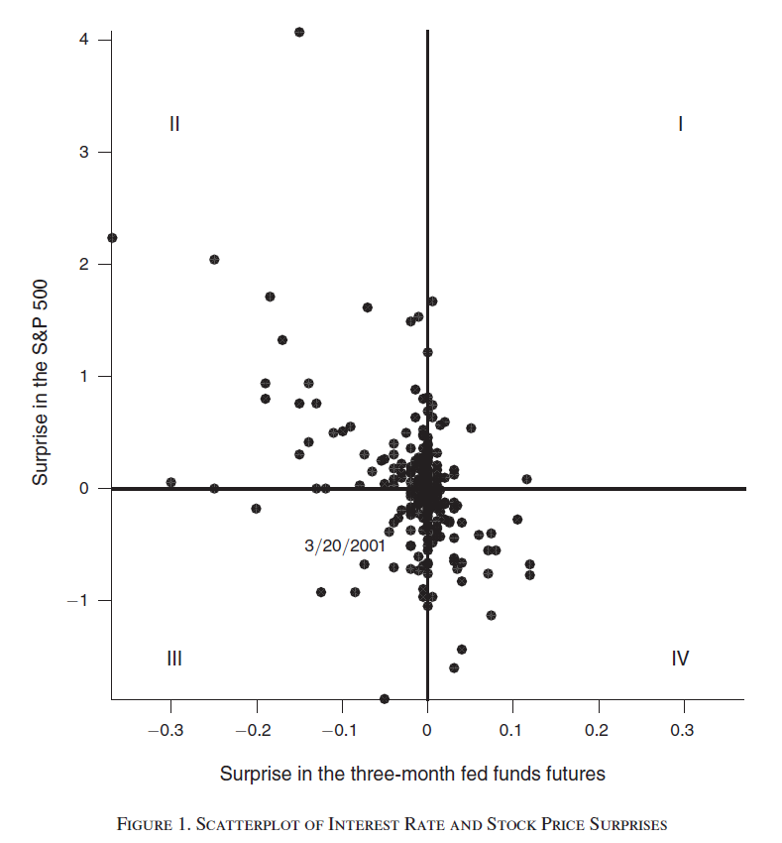
Jarocinski-Karadi (2020 AEJMacro)
Argue that there is a Fed Information Effect, but only sometimes
According to their Figure 1, standard interest rate channel of monetary policy usually dominates
This story is very different from Romer-Romer, CEFJ, NS
Bauer-Swanson evidence does not contradict this “occasional information shock” story

Slide 22
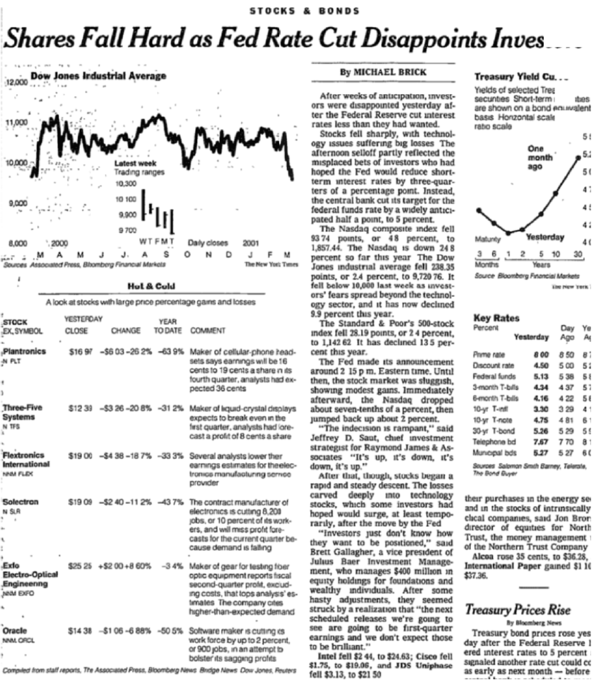
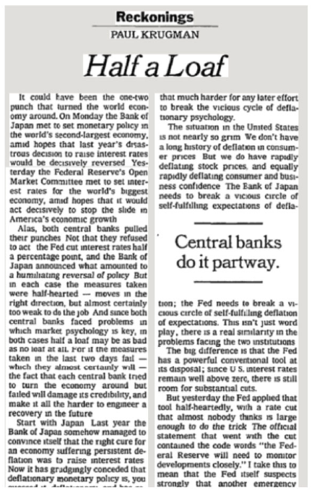
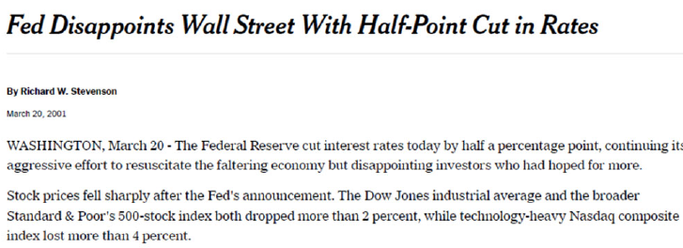
Jarocinski-Karadi (2020 AEJMacro): March 20, 2001
Nevertheless, my experience at the Fed suggests the Fed does not have an informational advantage
Instead, there is probably something else going on (e.g., on 3/20/2001):

Slide 23
The Fed Information Effect: The Future
The Future
Golez and Matthies (2025 JFE)?
Gilchrist, Yang, and Zhao (2025)?
Swanson, Wang, and Wu (2025)
Jarocinski and Karadi (2025)
Boehm and Kroner (2024 NBERWP)
Alam (2023 SSRNWP)

Slide 24
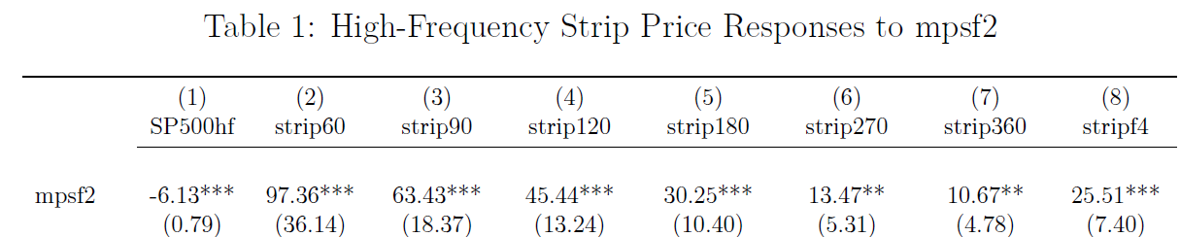
Dividend Strips
Golez and Matthies (2025 JFE) and Gilchrist, Yang, and Zhao (2025):
although stocks respond very negatively to FOMC announcements
near-term dividend STRIPs respond positively
Note: this is not the Jarocinski-Karadi (2020) story; it is always present
Also: the effect is driven by the nearest-maturity STRIP (60 days!)
Moreover, dividend futures do not show this effect

Slide 25
Dividend Futures vs. STRIPs
Dividend futures:
Settle based on cumulative actual dividends paid by index (S&P 500) constituents from issue date to maturity
Dividend STRIPs:
Synthetic security constructed by going long spot S&P 500 and short 60-day-ahead S&P 500 index future
This synthetic security earns the dividends paid over the next 60 days, but has no risk from index fluctuations
However, Boguth, Carlson, Fisher, Simutin (2023 RF):
Going long-short two very similar securities greatly amplifies (levers) the idiosyncratic noise/frictions in each
This idiosyncratic noise/friction seems to be related to short-term int. rates

Slide 26
Swanson, Wang, and Wu (2025)
Kalshi is a U.S. CFTC-licensed prediction market where participants can buy and sell binary futures contracts based on very wide range of events (including major macro data releases):
e.g., “Will the October unemployment rate release be 4.3% or more?”, “4.4% or more?”, “4.5% or more?”, etc.
In contrast to other prediction markets, CFTC license makes Kalshi much larger and more liquid:
participants can take positions up to $7 million in each contract
investment banks can and do act as market makers
U.S. investors can participate (unlike Polymarket)
contracts trade every day, track Blue Chip, SPF closely
caveat: data only available since mid-2021 (short sample)

Slide 27
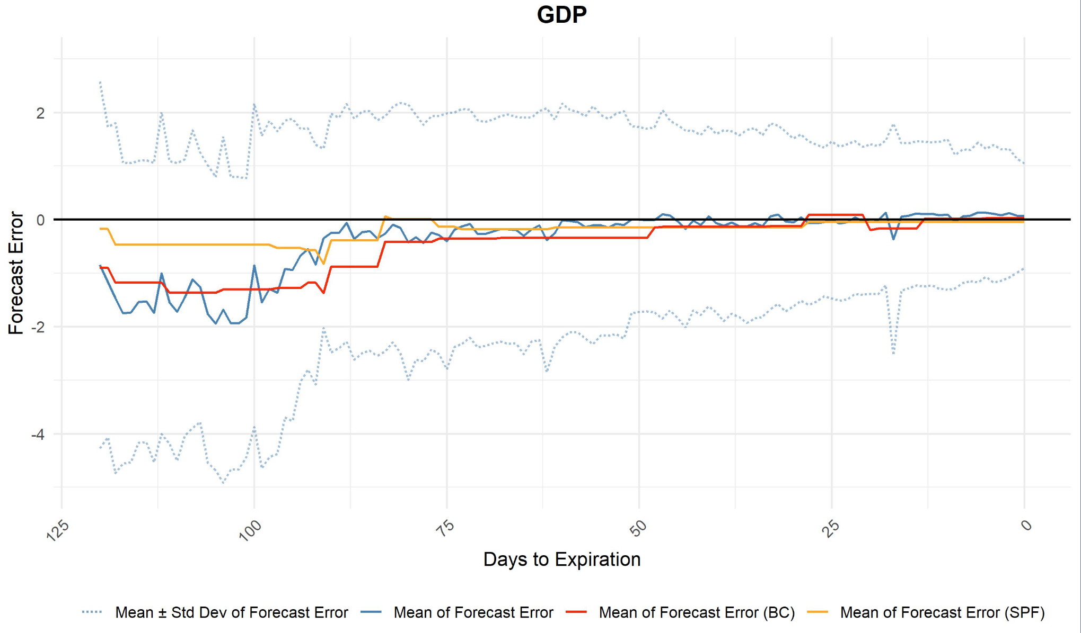
Swanson, Wang, and Wu (2025)

Slide 28
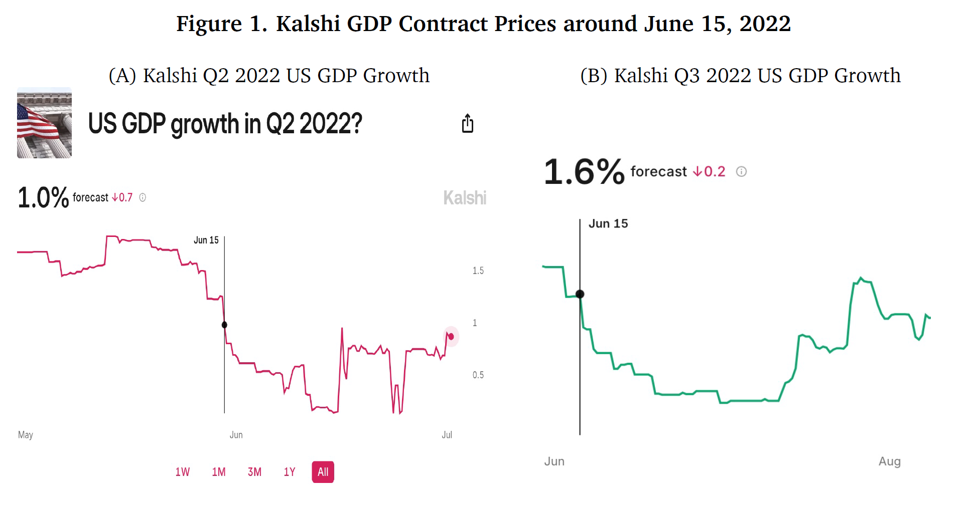
Swanson, Wang, and Wu (2025)

Slide 29
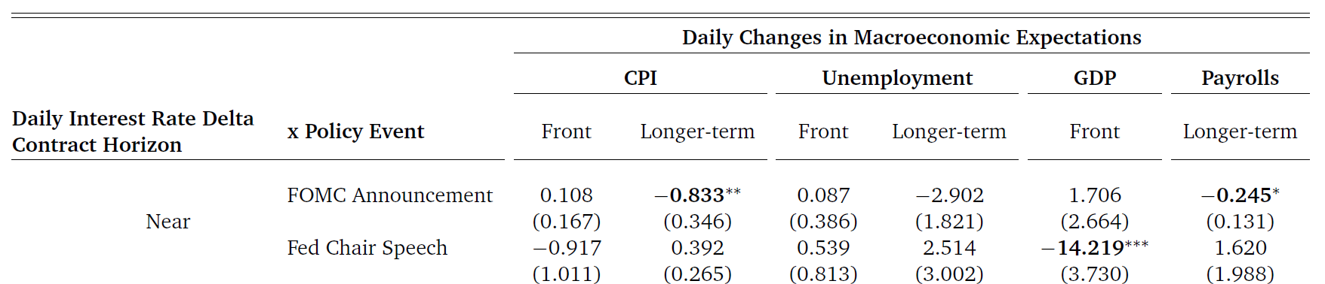
Swanson, Wang, and Wu (2025)
On days of FOMC announcements and Fed Chair speeches, how do Kalshi macro forecasts respond?
CPI, GDP, Nonfarm Payrolls forecasts all respond negatively to tightening surprises—i.e., no evidence of a strong, systematic “information effect”

Slide 30
Jarocinski-Karadi (2025)
Jarocinski and Karadi (2025) decompose FOMC announcement surprises into:
“pure” monetary policy shock
“Fed response to news” shock (as in Bauer-Swanson 2023AER, NBERMA)
“Fed information” shock (that moves stock prices in puzzling direction)
They find evidence for all three components in the data, and GDP tends to rise after a positive “information” shock
Note: As in their previous work, the “information shock” is only occasional

Slide 31
Boehm-Kroner (2024 NBERWP)
Boehm and Kroner:
control for essentially all yield curve movements around FOMC announcements
find that residual stock price movements are correlated with many other market responses (exchange rates, VIX, foreign stock prices)
acts like a “risk appetite shock”
Boehm-Kroner call it the “Fed non-yield shock”
I suspect that the Boehm-Kroner “non-yield shock” and Jarocinski-Karadi “information shock” are essentially the same
Open question: what’s driving this shock exactly?

Slide 32
Alam (2023 SSRNWP)
Alam finds that FOMC announcement days that are immediately preceded by a major macroeconomic data release are responsible for:
all of the pre-FOMC announcement drift (Lucca-Moench 2015 JF)
all of the FOMC-related long-term interest rate decline (Hillenbrand 2025 RFS)
some other financial market response puzzles
Open questions: What is it about the interaction of macro announcements and FOMC decisions that causes markets to react so strongly?
Is it related to Jarocinski-Karadi and Boehm-Kroner?

Slide 33
Conclusions
In the present:
It’s common for authors who find a puzzling IRF to attribute it to a “Fed Information Effect”
But there is overwhelming evidence against a large, constant “Fed Information Effect” story
In the past:
Sims and Zha (1994) and Christiano, Eichenbaum, and Evans (1996) were faced with a similar puzzle and thought hard about what might be driving it
In the future:
The “Fed Information Effect” is probably just a “risk appetite”/“non-yield” shock as in Boehm and Kroner (2024)
This shock happens only occasionally (as in Jarocinski-Karadi, 2020, 2025)

