Slide 1
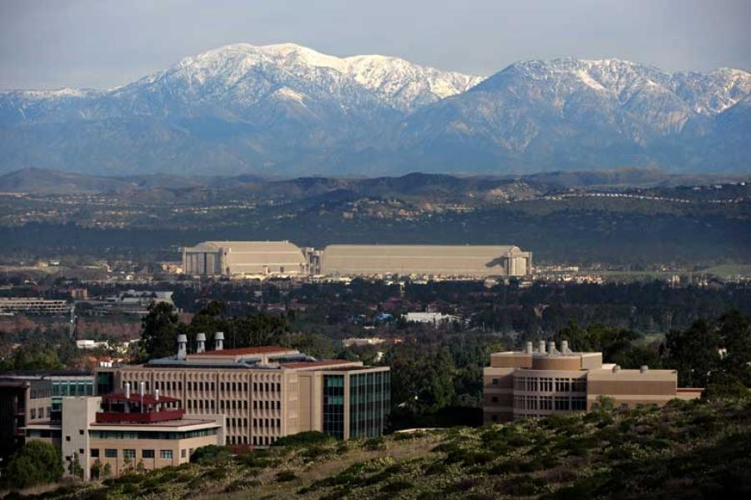
The Effects of Monetary Policy on Macroeconomic
Expectations: High-Frequency Evidence
from Prediction Markets
Eric T. Swanson
University of California, Irvine
Renxuan Wang
China Europe International Business School
Yanbin Wu
University of Florida
SED Meetings
Athens
July 2, 2026

Slide 2

Background: The “Fed Information Effect"
t indexes FOMC announcements
BCrev_{t} is one-month change in Blue Chip forecast around FOMC announcement
mps_{t} is measure of FOMC announcement surprise in 30-minute window around announcement
Standard macro models, VARs predict θ < 0 (for GDP, employment, inflation)
But empirical work sometimes estimates θ > 0

Slide 3
The “Fed Information Effect” Story
The Fed is a better forecaster than the private sector
When the Fed lowers interest rates, private sector infers that economy must be worse than they thought
So private sector lowers rather than raises GDP forecast
See: Romer and Romer (2000 AER), Campbell, Evans, Fisher, Justiniano (2012 BPEA), Nakamura and Steinsson (2018 QJE)
Note: the implied macro information content of Fed interest rate announcements is huge (and huge on average)
information effect
interest rate effect

Slide 4
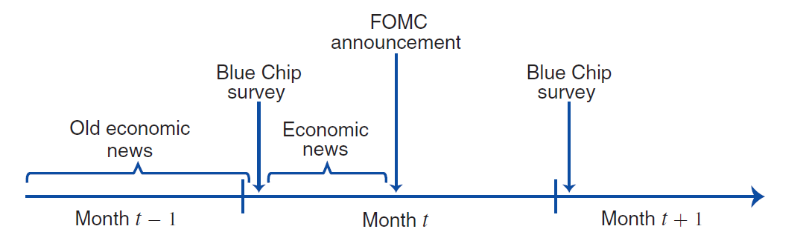
A Problem with “Fed Information Effect”: Low Frequency Forecasts
Blue Chip forecast is monthly (and SPF is quarterly)
In between monthly Blue Chip forecasts, significant economic news is often released:
Bauer and Swanson (2023 AER, NBERMA) show that FOMC responded to this news more aggressively than markets expected, leading to correlation between economic news and mps
This can explain “Fed Information Effect” regression results

Slide 5
High-Frequency Macroeconomic Forecasts from Kalshi
With high-frequency macroeconomic forecasts, we can distinguish between the “Fed Information Effect” and “Fed Response to News” stories
Kalshi:
Obtained license from the U.S. CFTC in 2021
U.S. investors and financial institutions can participate (unlike Polymarket)
Some U.S. institutions act as market makers, arbitrageurs
Investors can take positions of up to $7M per contract
Contracts trade essentially 24/7
Contracts available on macro data releases, economic events, pop culture, political events (since 2024), sporting events (since late 2025)
Open interest in prediction markets in the U.S. has been exploding
Trading platforms: Kalshi, Polymarket, CME/Fanduel, Cboe, Robinhood, Coinbase

Slide 6
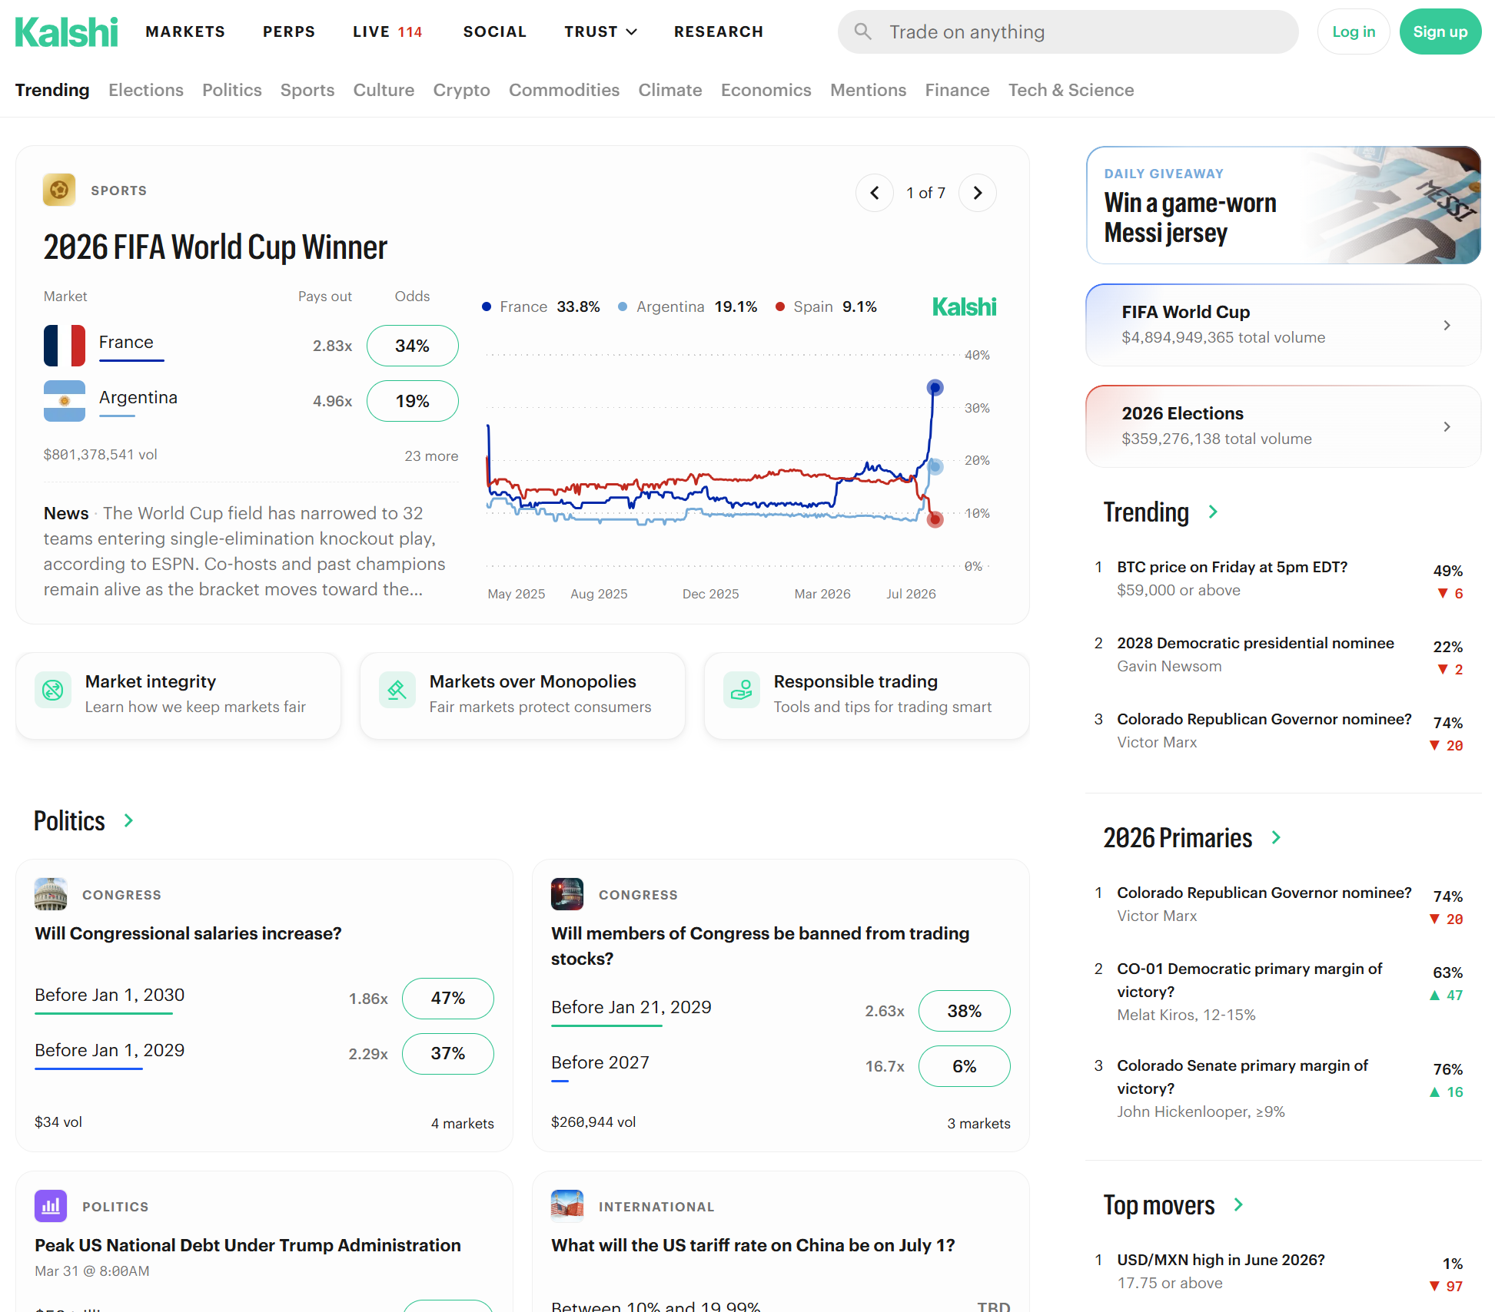
Kalshi

Slide 7
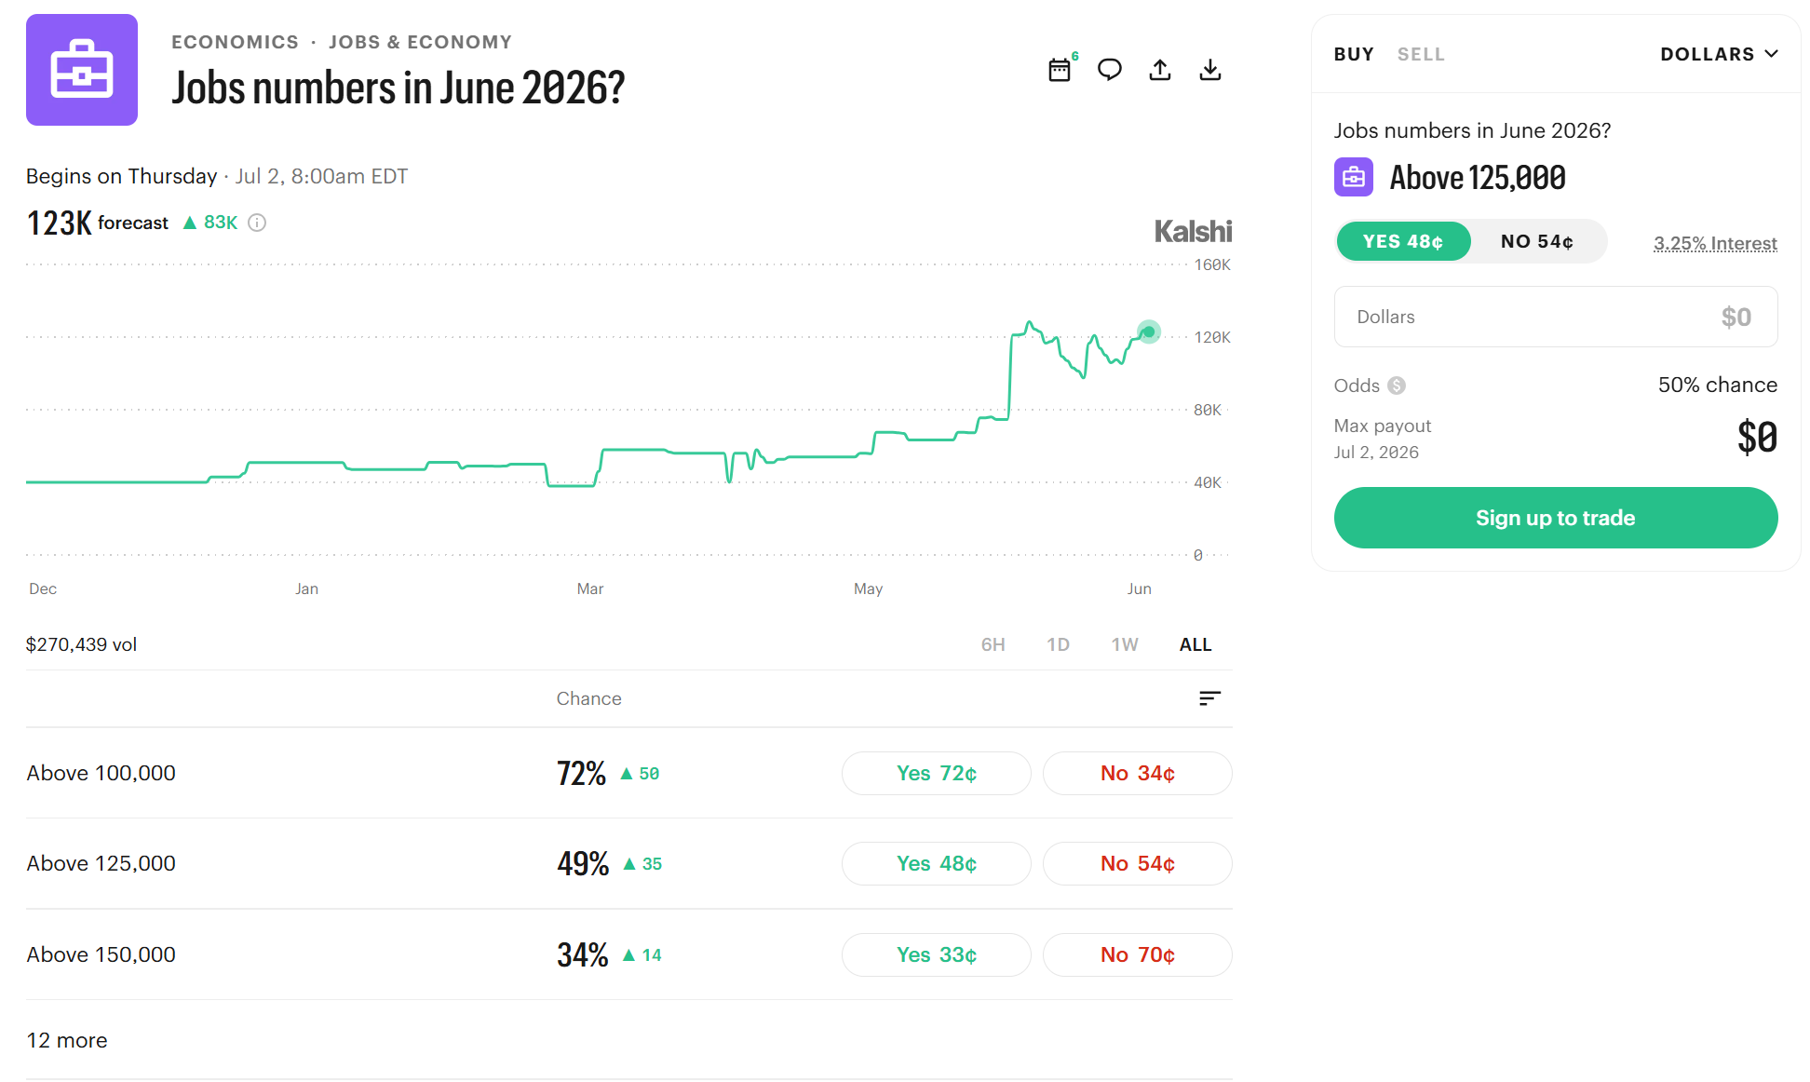
Example: Kalshi Nonfarm Payrolls June 2026 Contracts
Note:
contracts are binary options
“yes” contract pays $1 if resolve to “yes”, $0 if resolve to “no”
price of “yes” contract is market-implied prob. of “yes”

Slide 8
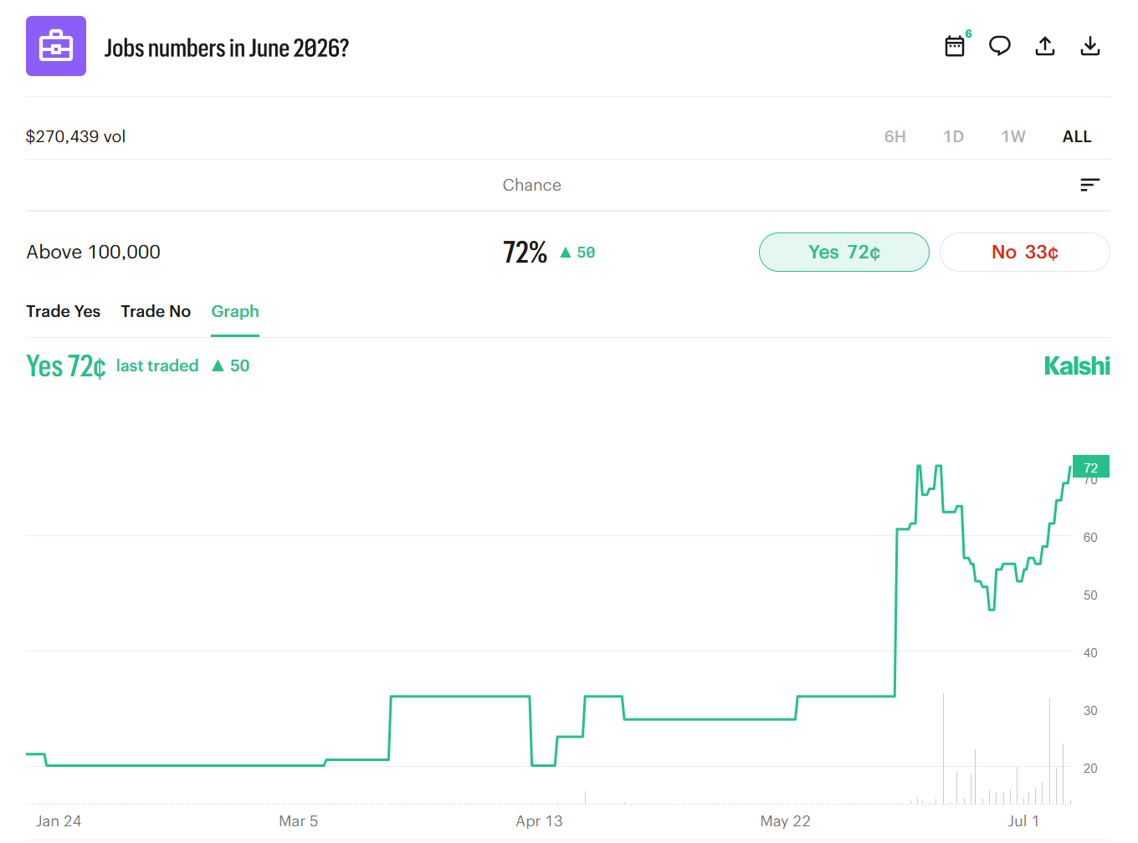
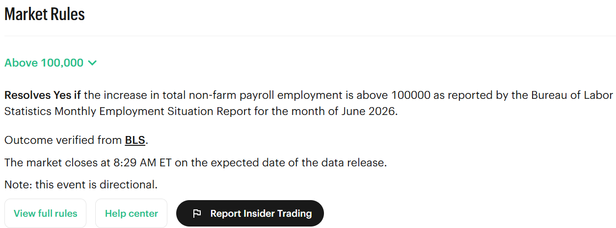
Example: Kalshi June 2026 Nonfarm Payrolls 100,000 Contract
Contract: Will the change in nonfarm payrolls in June 2026 be greater than 100,000?

Slide 9
Kalshi Contracts Trade Frequently, Respond to News

Slide 10
Kalshi Contracts Trade Frequently, Respond to News
Contract: Q3 2022 U.S. GDP growth above 2%?

Slide 11
Kalshi Market-Implied CDFs
“yes” contract payoffs
80K “yes” contract
90K “yes” contract
100K “yes” contract
125K “yes” contract
150K “yes” contract
$1
80K
90K
100K
125K
150K
June 2026 nonfarm payrolls realization
$1 – prices of “yes” contracts (equivalently, prices of “no” contracts) give Kalshi market-implied CDF of event outcome
  some technical details: take average of “no” price and $1-“yes” price, discard tails, impose monotonicity on CDFs, impose CDFs approach 1, etc.
Use market-implied CDFs, PDFs, to compute market-implied expectations

Slide 12
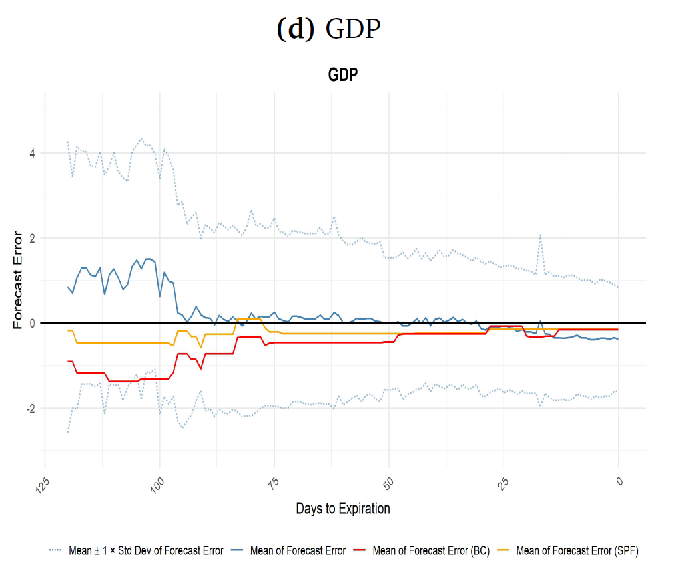
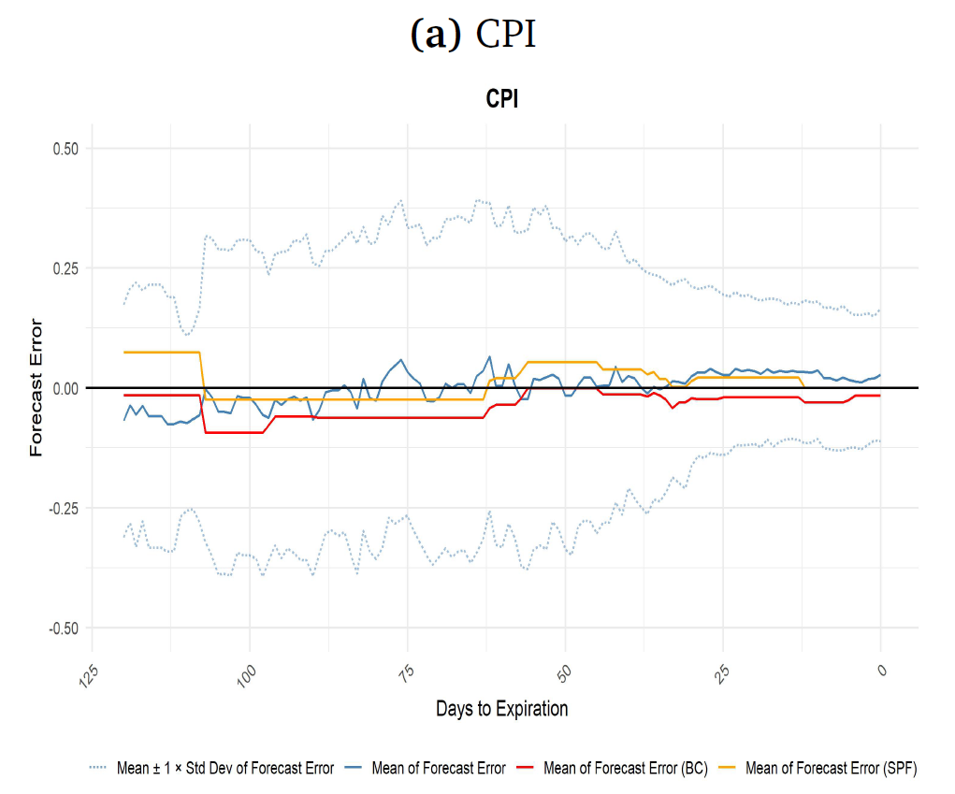
Kalshi Macro Forecast Errors vs. Blue Chip and SPF

Slide 13
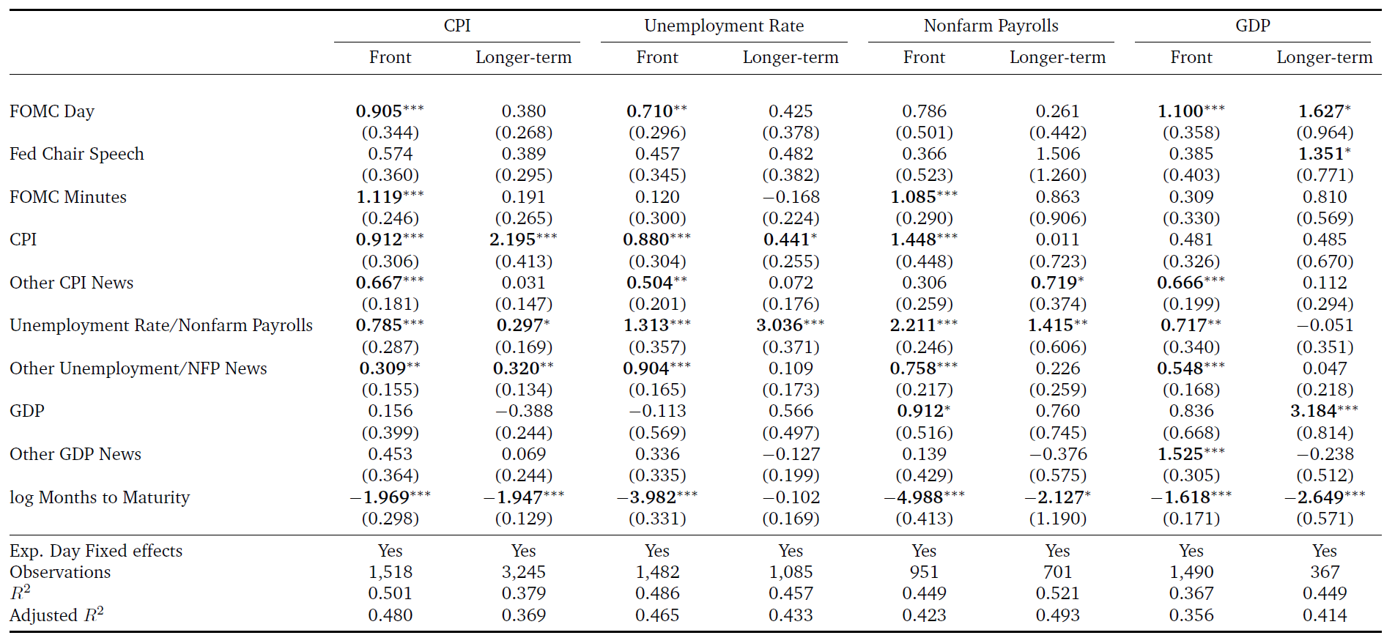
Kalshi Macro Contract Trading Volume Patterns

Slide 14
Kalshi Macro Contract Trading Volume Patterns
Takeaways:
Trading volumes increase as contract maturity approaches
Trading volumes spike around major macro, monetary announcements
  this is exactly what we want: liquidity is highest when new information arrives

Slide 15


Kalshi Market Macro Expectations Responses to Fed News
We run daily-frequency regressions of the form:
We consider
  Changes in for front Kalshi contract
  Changes in for longer-term contracts
  Changes in : fed funds rate target (Kuttner surprise)
  Changes in : forward guidance (GSS surprise)
  FOMC announcements
  Fed Chair speeches
  FOMC minutes releases

Slide 16
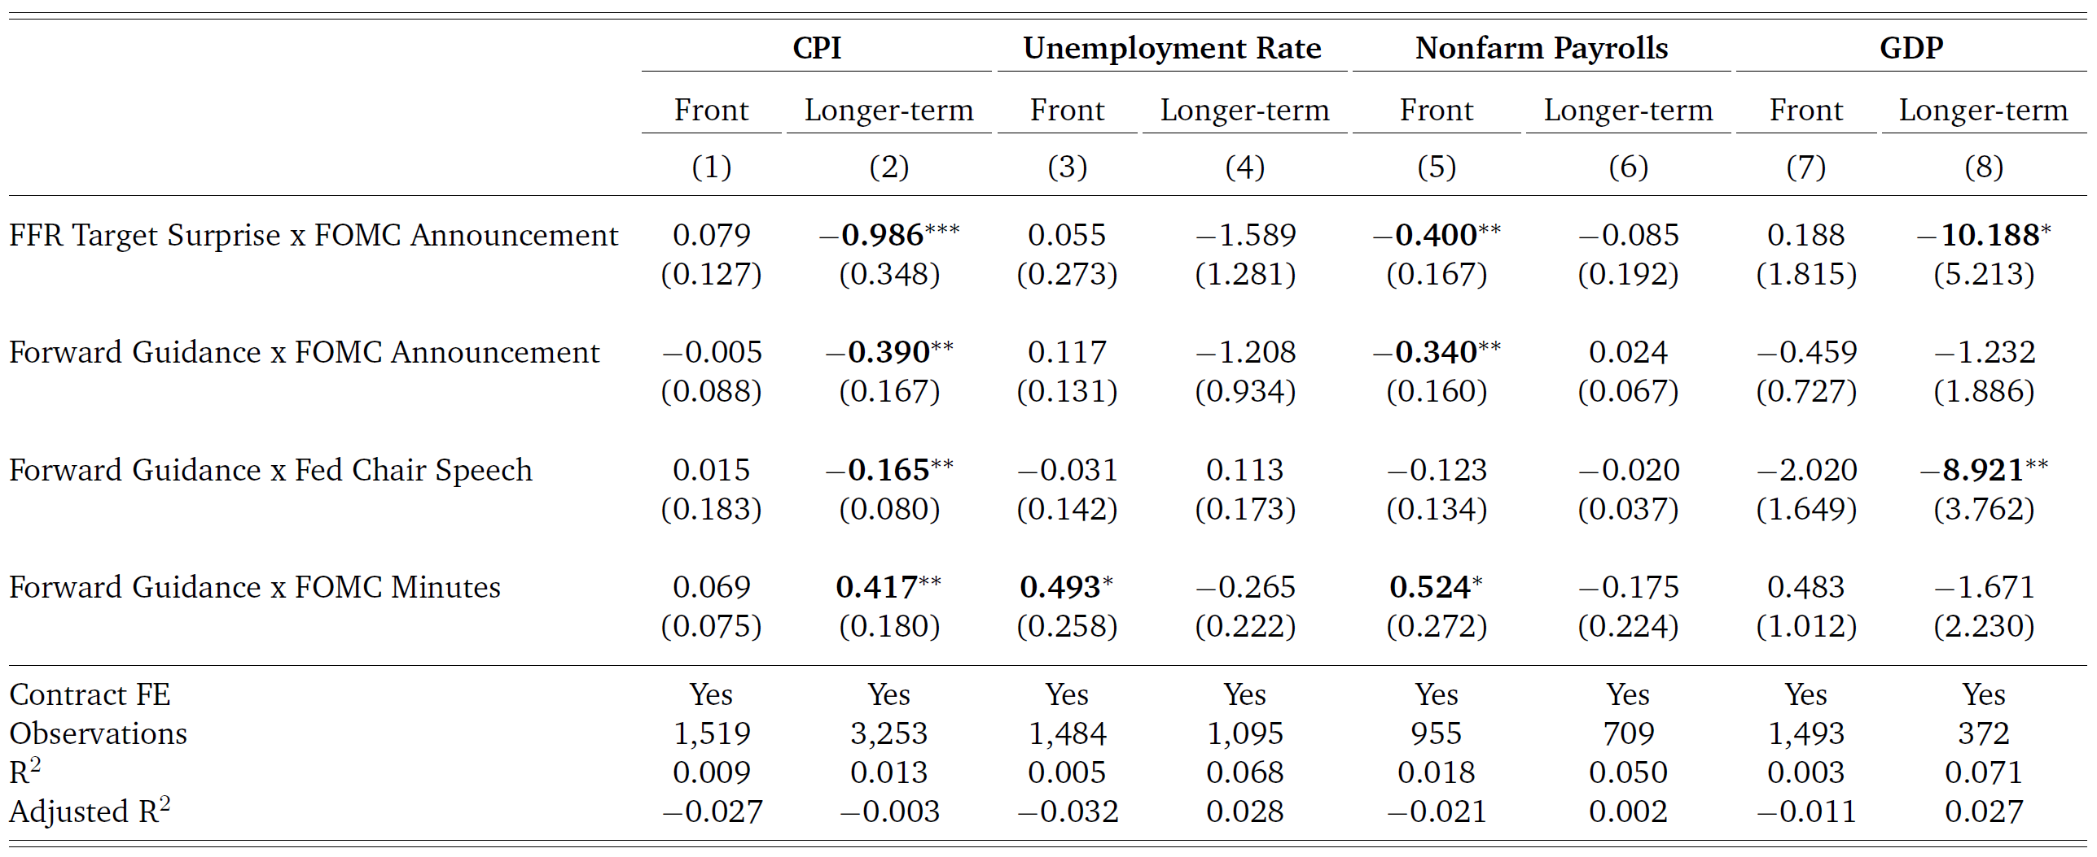
Kalshi Market Macro Expectations Responses to News

Slide 17
Kalshi Market Macro Expectations Responses to Fed News
Takeaways:
Kalshi market generally responds to FOMC announcements, Fed Chair speeches in the way predicted by standard macro models, VARs
  This does not imply there is never a “Fed Information Effect”, but it does contradict the usual story that the Fed Information Effect is always huge
Kalshi market sometimes responds to FOMC minutes releases in the way predicted by the “Fed Information Effect”
  If you want to look for a Fed Information Effect, you should probably look for it here

Slide 18
Related Evidence
Bauer-Swanson (2023 AER):
  asked Blue Chip forecasters how they revise macro forecasts in response to FOMC announcements
  forecasters report revising forecasts in standard direction (consistent with NK models, VARs)
Faust-Swanson-Wright (2004 BEJMacro):
  weekly macro forecast data from Wrightson Associates
  find no evidence of a “Fed Information Effect”

Slide 19
Conclusions
Prediction markets offer high-frequency macroeconomic forecast data
Kalshi forecasts compare favorably to Blue Chip, SPF but are available at much higher frequency
Kalshi trading volumes increase as maturity approaches and when macro/monetary information is released
Kalshi markets respond to FOMC announcements and Fed Chair speeches consistent with standard macro models, VARs
Kalshi markets sometimes respond to FOMC minutes with an opposite coefficient, potentially consistent with a “Fed Information Effect”
  although I still think an Information Effect explanation is not what’s going on here
Substantial other evidence suggests there is not a large Fed Information Effect related to FOMC announcements

Slide 20
Appendix
Appendix Slides

Slide 21
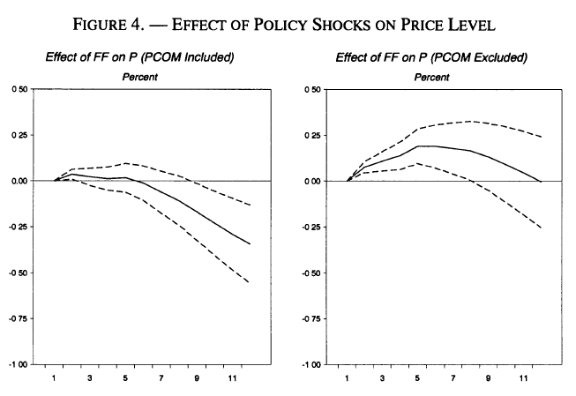
The “Price Puzzle”
Eichenbaum (1992 EER) and Sims (1992 EER) estimated that a monetary policy tightening caused prices to increase rather than decrease in a VAR
Sims and Zha (1994) and Christiano, Eichenbaum, and Evans (1996 REStat) argued an omitted variable (commodity prices) was driving the puzzle
Their story: an increase in commodity (esp. oil) prices was causing both the Fed to raise interest rates and inflation to increase

Slide 22
Bauer-Swanson (2023 AER): Omitted Variables
Including the omitted news variable on the right-hand side:
Greatly increases regression R², from about .01 to .42
Reduces standard errors of θ estimates
Increases statistical significance of θ
Reverses the sign of θ to the standard direction, consistent with macro models and VARs
Summary: Including omitted economic and financial news variables eliminates the “Fed Information Effect” puzzle

Slide 23
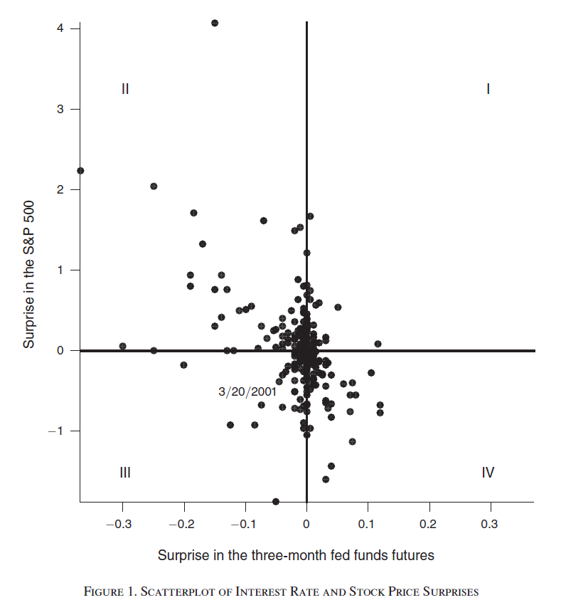
Jarocinski-Karadi (2020 AEJMacro)
Argue that there is a Fed Information Effect, but only sometimes
According to their Figure 1, standard interest rate channel of monetary policy usually dominates
This story is very different from Romer-Romer, CEFJ, NS
Bauer-Swanson evidence does not contradict this “occasional information shock” story

Slide 24
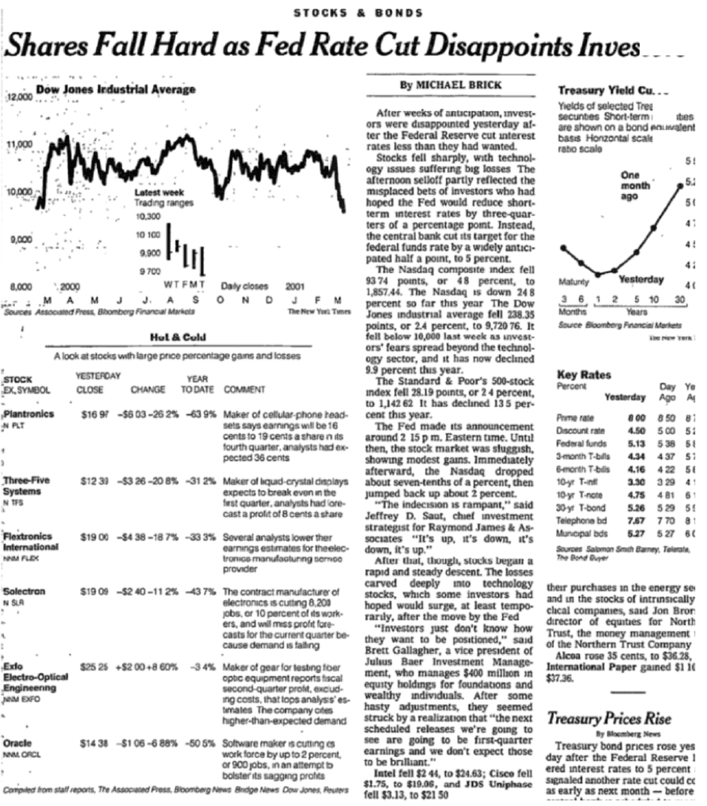
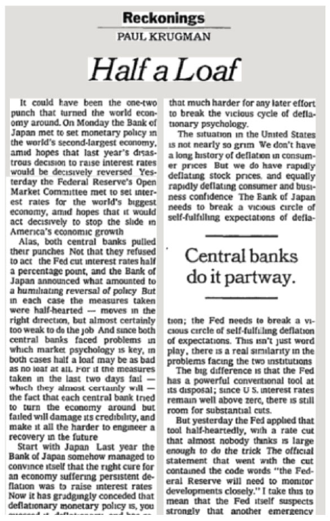
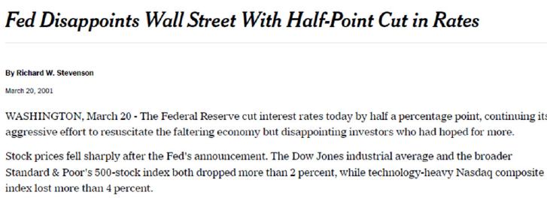
Jarocinski-Karadi (2020 AEJMacro): March 20, 2001
Nevertheless, my experience at the Fed suggests the Fed does not have an informational advantage
Instead, there is probably something else going on (e.g., on 3/20/2001):

Slide 25
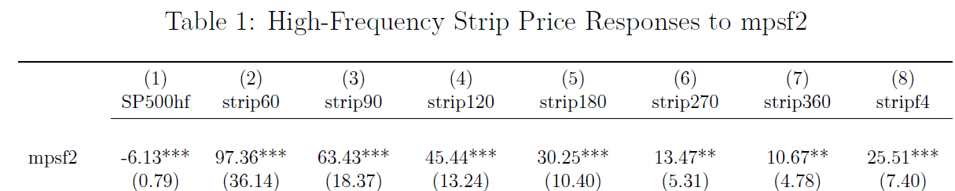
Dividend Strips
Golez and Matthies (2025 JFE) and Gilchrist, Yang, and Zhao (2025):
  although stocks respond very negatively to FOMC announcements
  near-term dividend STRIPs respond positively
Note: this is not the Jarocinski-Karadi (2020) story; it is always present
Also: the effect is driven by the nearest-maturity STRIP (60 days!)
Moreover, dividend futures do not show this effect

Slide 26
Dividend Futures vs. STRIPs
Dividend futures:
Settle based on cumulative actual dividends paid by index (S&P 500) constituents from issue date to maturity
Dividend STRIPs:
Synthetic security constructed by going long spot S&P 500 and short 60-day-ahead S&P 500 index future
This synthetic security earns the dividends paid over the next 60 days, but has no risk from index fluctuations
However, Boguth, Carlson, Fisher, Simutin (2023 RF):
Going long-short two very similar securities greatly amplifies (levers) the idiosyncratic noise/frictions in each
This idiosyncratic noise/friction seems to be related to short-term int. rates

