Slide 1
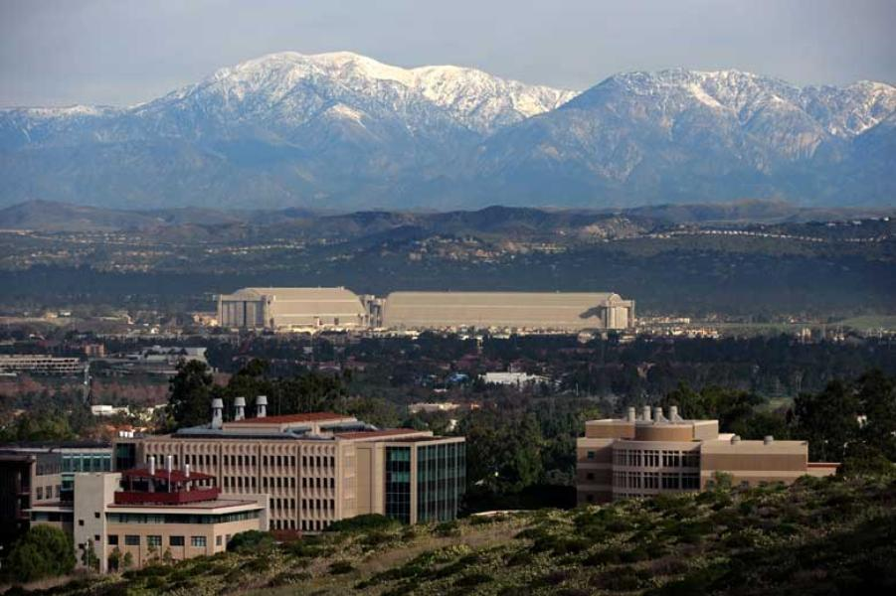
The Effects of Monetary Policy on Macroeconomic
Expectations: High-Frequency Evidence
from Prediction Markets
Eric T. Swanson
University of California, Irvine
Renxuan Wang
China Europe International Business School
Yanbin Wu
University of Florida
Virtual Seminar on Monetary Economics
March 5, 2026

Slide 2
Outline
Motivation and Background: The “Fed Information Effect”
The Kalshi Prediction Market
Kalshi Market-Implied Expectations
Kalshi Market Trading Volumes
The Response of Kalshi Market-Implied Expectations to FOMC News
Related Evidence
Conclusions

Slide 3

Background: The “Fed Information Effect"
t indexes FOMC announcements
BCrev_{t} is one-month change in Blue Chip forecast around FOMC announcement
mps_{t} is measure of FOMC announcement surprise in 30-minute window around announcement
Standard macro models, VARs predict θ < 0 (for GDP, employment, inflation)
But empirical work sometimes estimates θ > 0

Slide 4
The “Fed Information Effect” Story
The Fed is a better forecaster than the private sector
When the Fed lowers interest rates, private sector infers that economy must be worse than they thought
So private sector lowers rather than raises GDP forecast
See: Romer and Romer (2000 AER), Campbell, Evans, Fisher, Justiniano (2012 BPEA), Nakamura and Steinsson (2018 QJE)
Note: the implied macro information content of Fed interest rate announcements is huge
information effect
interest rate effect

Slide 5
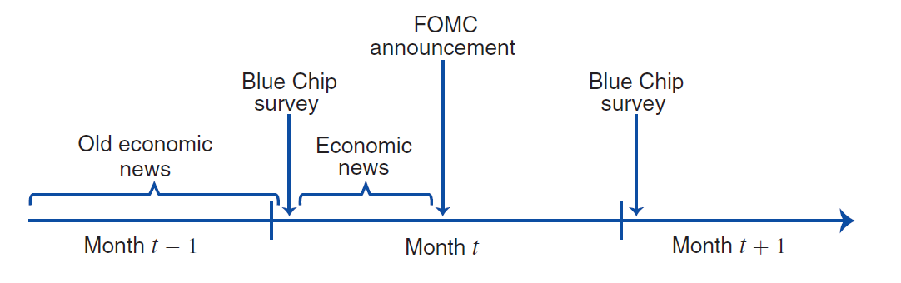
A Problem with “Fed Information Effect”: Low Frequency Forecasts
Blue Chip forecast is monthly (and SPF is quarterly)
In between monthly Blue Chip forecasts, significant economic news is often released:
Bauer and Swanson (2023 AER, NBERMA) argue that FOMC responded to this news more aggressively than markets expected, leading to correlation between economic news and mps
This can explain the “Fed Information Effect” regression results

Slide 6
Outline
Motivation and Background: The “Fed Information Effect”
The Kalshi Prediction Market
Kalshi Market-Implied Expectations
Kalshi Market Trading Volumes
The Response of Kalshi Market-Implied Expectations to FOMC News
Related Evidence
Conclusions

Slide 7
High-Frequency Macroeconomic Forecasts from Kalshi
With high-frequency macroeconomic forecasts, we can distinguish between the “Fed Information Effect” and “Fed Response to News” stories
In this paper, we use high-frequency macroeconomic forecast data from Kalshi, a prediction market and event contract exchange
Kalshi:
Obtained license from the U.S. CFTC in 2021
U.S. investors and financial institutions can participate (unlike Polymarket)
Some U.S. institutions act as market makers, arbitrageurs
Investors can take positions of up to $7M per contract
Contracts trade essentially 24/7
Contracts available on macro data releases, economic events, pop culture, political events (since 2024), sporting events (since late 2025)
Open interest in prediction markets in the U.S. has been exploding
Trading platforms: Kalshi, Polymarket, CME/Fanduel, Cboe, Robinhood, Coinbase

Slide 8
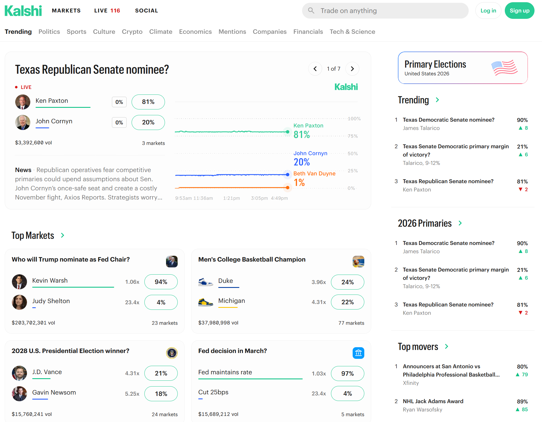
Kalshi

Slide 9
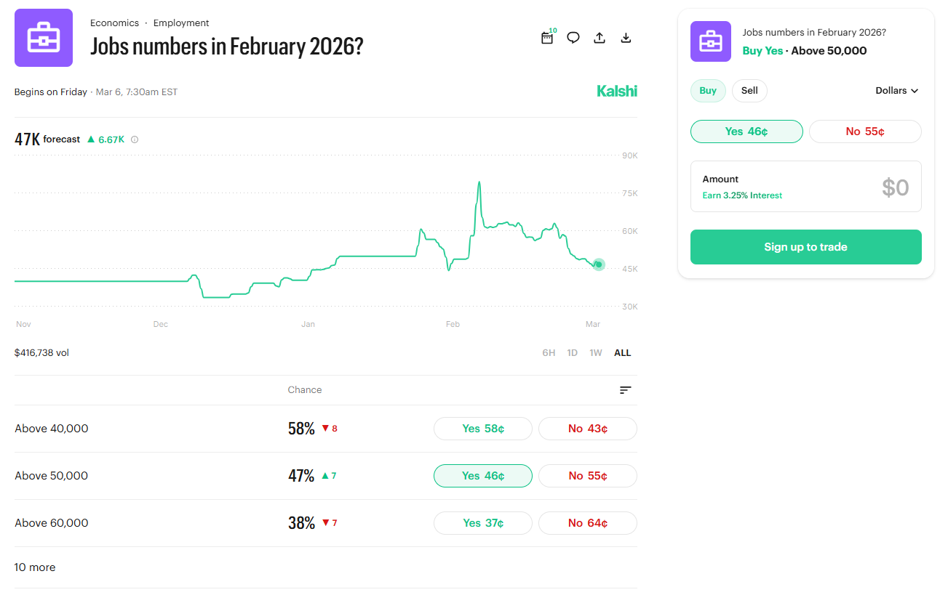
Example: Kalshi Nonfarm Payrolls Feb 2026 Contracts
Note:
contracts are binary options
“yes” contract pays $1 if resolve to “yes”, $0 if resolve to “no”
price of “yes” contract is market-implied prob. of “yes”

Slide 10
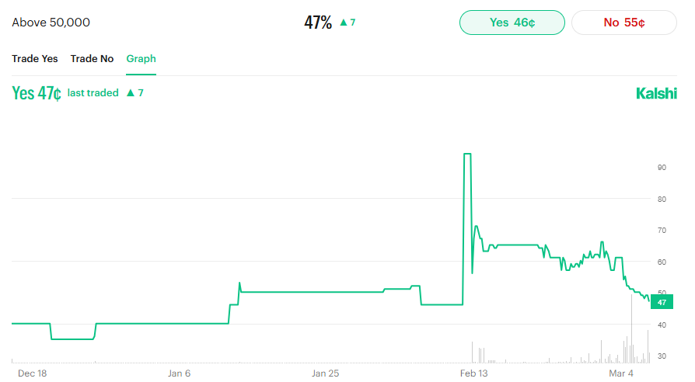
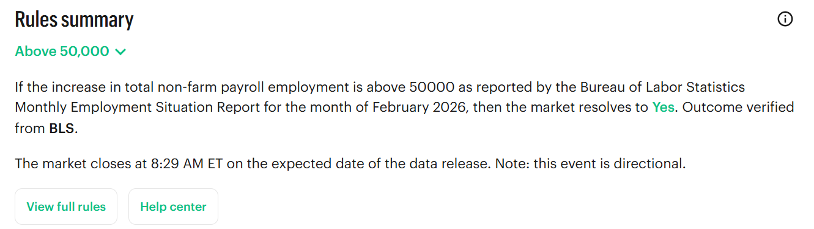
Example: Kalshi Feb 2026 Nonfarm Payrolls 50,000 Contract
Contract: Will the change in nonfarm payrolls in Feb 2026 be greater than 50,000?

Slide 11
Kalshi Contracts Trade Frequently, Respond to News

Slide 12
Kalshi Contracts Trade Frequently, Respond to News
Contract: Q3 2022 U.S. GDP growth above 2%?

Slide 13
Kalshi Contracts: Some Details
Note that Kalshi contract data vary by:
  Macroeconomic statistic
  Event date (expiration date): many future event dates for each macro variable
    e.g., front contract, 1 month ahead, 2 months ahead, 3 months ahead, etc.
  Contract strike: approx. 5-12 strike prices for each expiration
    e.g., 10K, 20K, 30K, 40K, 50K, 60K, 70K, 80K, 90K, 100K, 125K
  Trade date: contracts can trade 24/7 up until expiration
Contracts began trading in July 2021 (short sample)
  Nonfarm payrolls began trading in March 2023 (shorter sample)
  GDP contract events are only once per quarter (smaller sample)
  Our analysis ends in December 2025

Slide 14
Outline
Motivation and Background: The “Fed Information Effect”
The Kalshi Prediction Market
Kalshi Market-Implied Expectations
Kalshi Market Trading Volumes
The Response of Kalshi Market-Implied Expectations to FOMC News
Related Evidence
Conclusions

Slide 15
Kalshi Market-Implied CDFs
“yes” contract payoffs
30K “yes” contract
40K “yes” contract
50K “yes” contract
60K “yes” contract
70K “yes” contract
$1
30K
40K
50K
60K
70K
Feb 2026 nonfarm payrolls realization
$1 – prices of “yes” contracts (equivalently, prices of “no” contracts) give Kalshi market-implied CDF of event outcome
  some technical details: take average of “no” price and $1-“yes” price, discard tails, impose monotonicity on CDFs, impose CDFs approach 1, etc.

Slide 16
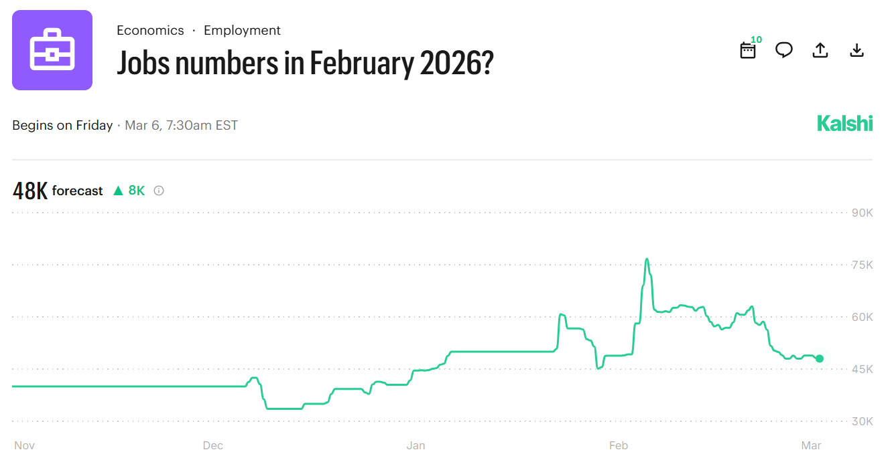
Kalshi Market-Implied CDFs and PDFs
We can then compute Kalshi market-implied PDFs from the CDFs
  some technical details: impose step function PDFs, impose PDFs integrate to 1, etc.
Compute daily frequency CDFs and PDFs for:
  federal funds rate
  CPI
  unemployment rate
  nonfarm payrolls (shorter sample)
  GDP
We focus on the Expected Value from these PDFs in our analysis
Note: Kalshi computes an Expected Value using similar methods and reports it on contract pages

Slide 17
Kalshi Macro Forecast Errors vs. Blue Chip and SPF

Slide 18
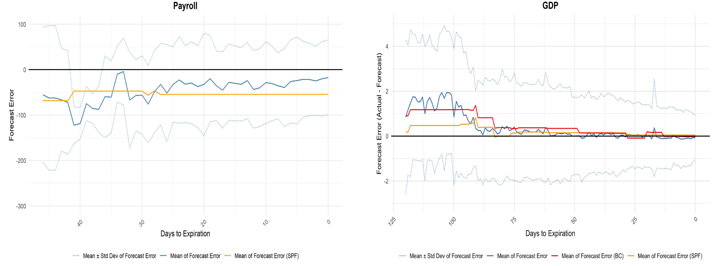
Kalshi Macro Forecast Errors vs. Blue Chip and SPF

Slide 19
Outline
Motivation and Background: The “Fed Information Effect”
The Kalshi Prediction Market
Kalshi Market-Implied Expectations
Kalshi Trading Volumes
The Response of Kalshi Market-Implied Expectations to FOMC News
Related Evidence
Conclusions

Slide 20
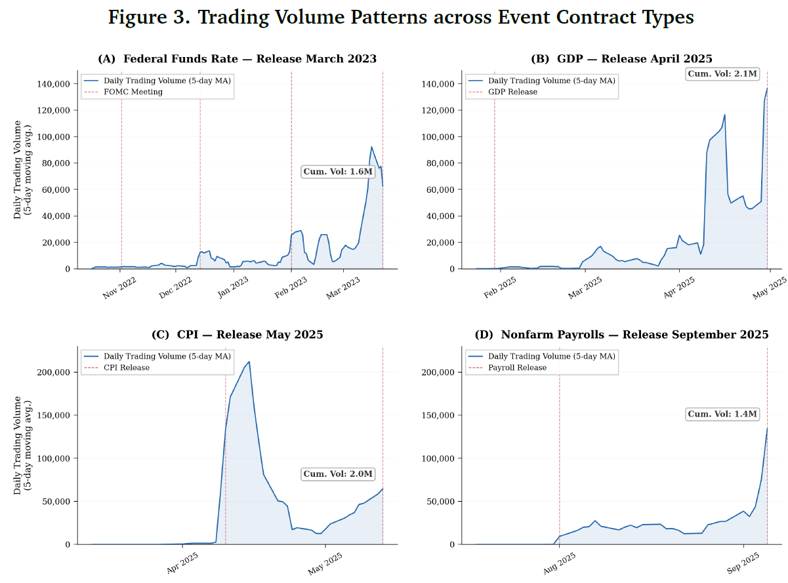
Kalshi Contract Trading Volumes

Slide 21
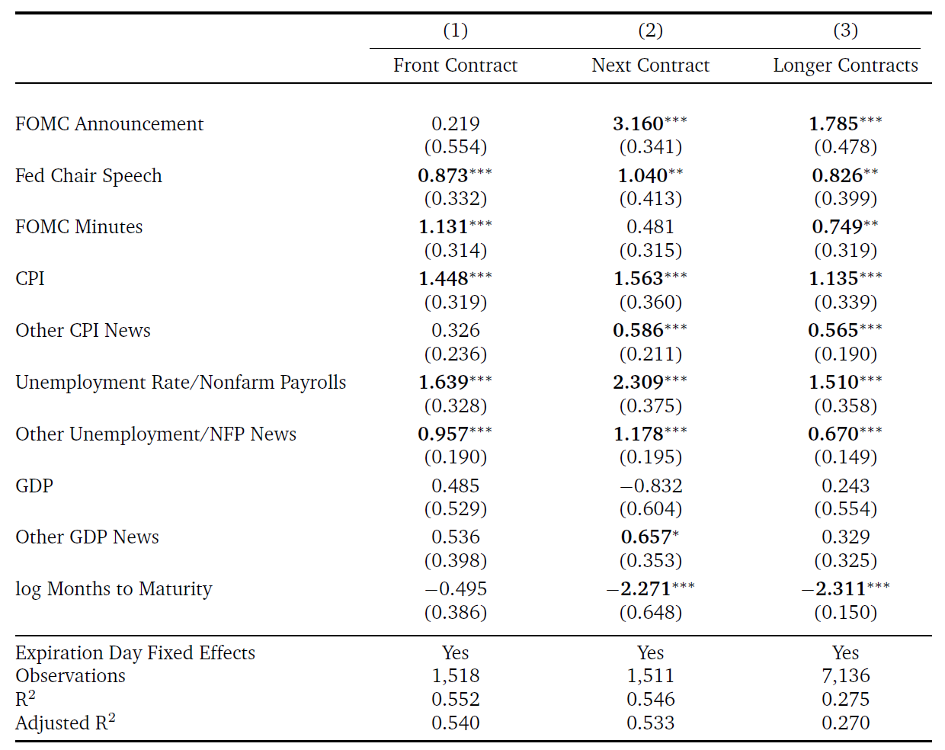
Kalshi Fed Funds Rate Contract Trading Volume Responses to News

Slide 22
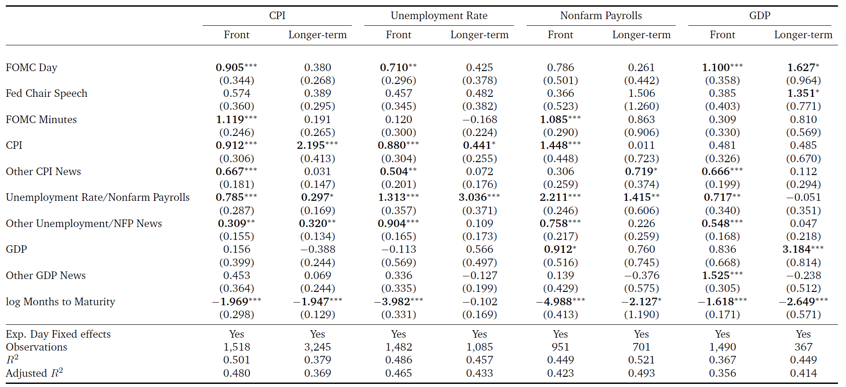
Kalshi Macro Contract Trading Volume Responses to News

Slide 23
Outline
Motivation and Background: The “Fed Information Effect”
The Kalshi Prediction Market
Kalshi Market-Implied Expectations
Kalshi Market Trading Volumes
The Response of Kalshi Market-Implied Expectations to FOMC News
Related Evidence
Conclusions

Slide 24
Kalshi Market Macro Expectations Responses to Fed News
We run daily-frequency regressions of the form:
We consider
  Changes in for front Kalshi contract
  Changes in for longer-term contracts
  Changes in : next-month fed funds futures change
  Changes in : one-year-ahead Eurodollar/SOFR futures change
  FOMC announcements
  Fed Chair speeches
  FOMC minutes releases

Slide 25
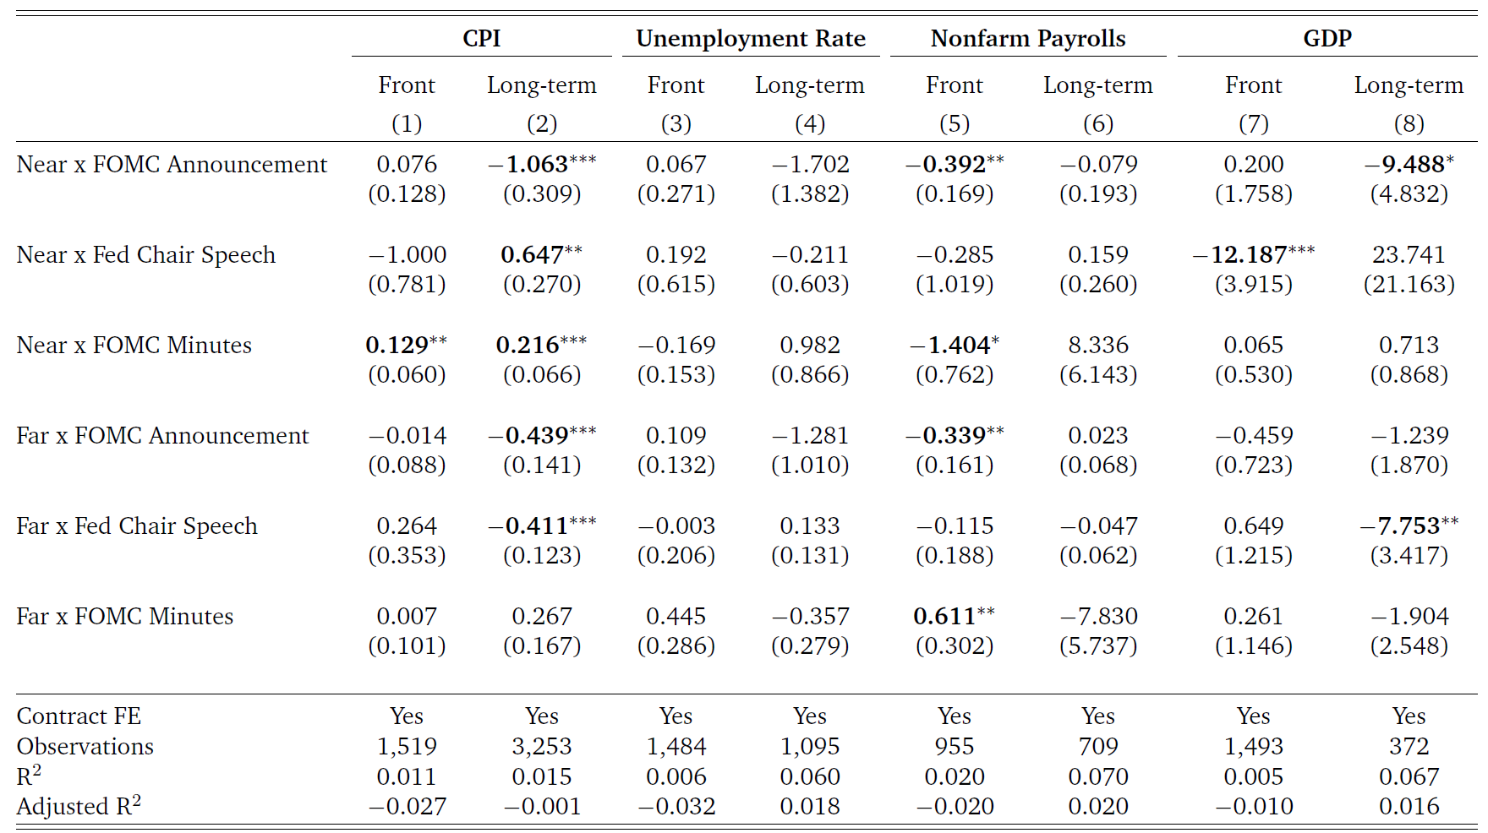
Kalshi Market Macro Expectations Responses to News

Slide 26
Kalshi Market Macro Expectations Responses to Fed News
Takeaways:
Kalshi market generally responds to FOMC announcements, Fed Chair speeches in the way predicted by standard macro models, VARs
  This does not imply there is never a “Fed Information Effect”, but it does contradict the usual story that the Fed Information Effect is always huge
Kalshi market sometimes responds to FOMC minutes releases in the way predicted by the “Fed Information Effect” literature
  If you want to look for a Fed Information Effect, you should probably look for it here
Kalshi market-implied unemployment rate expectations don’t respond significantly to Fed news over this sample

Slide 27
Outline
Motivation and Background: The “Fed Information Effect”
The Kalshi Prediction Market
Kalshi Market-Implied Expectations
Kalshi Market Trading Volumes
The Response of Kalshi Market-Implied Expectations to FOMC News
Related Evidence
Conclusions

Slide 28
Bauer-Swanson (2023 AER): Forecaster Survey
There are only 52 forecasters in the Blue Chip survey
We tracked down the contact information for the chief economist for each forecasting team, asked them:
Do you revise any of your macroeconomic forecasts (GDP, unemployment, or inflation) in response to the FOMC’s federal funds rate decision? If yes, please briefly explain which forecasts you revise and which direction you revise those forecasts (i.e., do you revise them up or down if the decision is more hawkish/dovish than expected).
Do you revise any of your macroeconomic forecasts in response to the FOMC statement? If yes, please briefly explain which forecasts you revise, and which direction you revise those forecasts (i.e., do you revise them up or down if the statement is more hawkish/dovish than expected).
Do you revise any of your macroeconomic forecasts in response to the dot plot released by the FOMC in the Summary of Economic Projections (SEP)? If yes, please briefly explain which forecasts you revise and which direction you revise those forecasts (i.e., do you revise them up or down if the dot plot is more hawkish/dovish than expected)
Do you revise any of your macroeconomic forecasts in response to SEP forecasts of GDP, unemployment, and inflation in the Summary of Economic Projections? If yes, please briefly explain which FOMC forecasts matter for you, which forecasts you revise, and which direction you revise those forecasts.

Slide 29
Bauer-Swanson (2023 AER): Forecaster Survey
There are only 52 forecasters in the Blue Chip survey
We tracked down the contact information for the chief economist for each forecasting team, asked them:
Do you revise any of your macroeconomic forecasts (GDP, unemployment, or inflation) in response to the FOMC’s federal funds rate decision? If yes, please briefly explain which forecasts you revise and which direction you revise those forecasts (i.e., do you revise them up or down if the decision is more hawkish/dovish than expected).
Do you revise any of your macroeconomic forecasts in response to the FOMC statement? If yes, please briefly explain which forecasts you revise, and which direction you revise those forecasts (i.e., do you revise them up or down if the statement is more hawkish/dovish than expected).
Do you revise any of your macroeconomic forecasts in response to the dot plot released by the FOMC in the Summary of Economic Projections (SEP)? If yes, please briefly explain which forecasts you revise and which direction you revise those forecasts (i.e., do you revise them up or down if the dot plot is more hawkish/dovish than expected)
Do you revise any of your macroeconomic forecasts in response to SEP forecasts of GDP, unemployment, and inflation in the Summary of Economic Projections? If yes, please briefly explain which FOMC forecasts matter for you, which forecasts you revise, and which direction you revise those forecasts.

Slide 30
Bauer-Swanson (2023 AER): Forecaster Survey
Zero forecasters say that they revise their forecast in the “Fed Information Effect” direction
Of the forecasters who do revise their forecasts, vast majority revise in the standard direction, consistent with macro models, VARs

Slide 31
Bauer-Swanson (2023 AER): Forecaster Survey
If there was a Fed Information Effect, we ought to see it here

Slide 32
Bauer-Swanson (2023 AER): Forecaster Survey
Some quotes:
“I trust my outlook more than the Fed’s. . . Their forecasting ability is pretty poor.”
“My view is that the Fed does not have superior information. . . The FOMC forecast tends to be off by a lot.”
“We tend to find that the Fed has no better information advantage over economists like myself… In fact, what we have found many times is Fed forecasts (per the SEP) tend to be somewhat stale.”
“I would be responding to the change in the policy outlook, not to the possibility that the Fed ‘knew’ something that I did not.”
“In the end, we are likely to get more information from speeches and press conferences than we are from the statement, the decision, or the dots. So by the time we get those things, it tends to be relatively ‘old news’, if you will.”

Slide 33
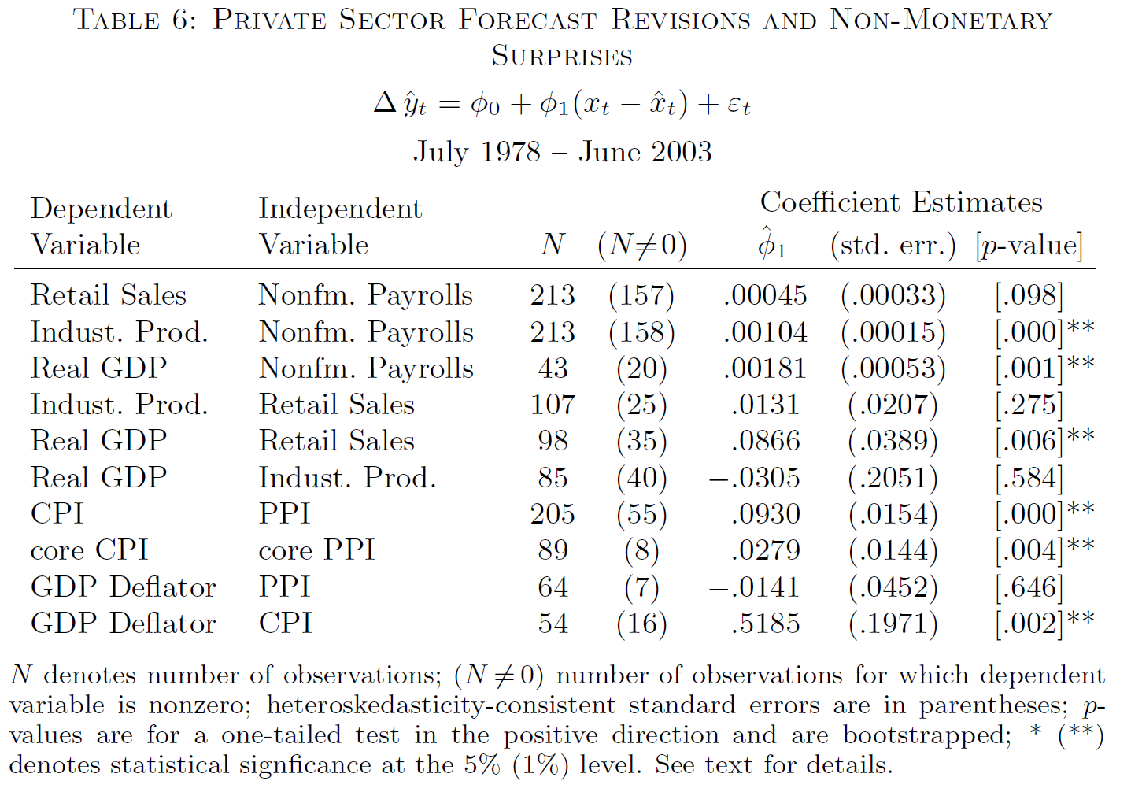
Faust, Swanson, and Wright (2004 BEJMacro)
Showed that private sector revises forecasts of upcoming data releases in response to major macroeconomic announcements:

Slide 34
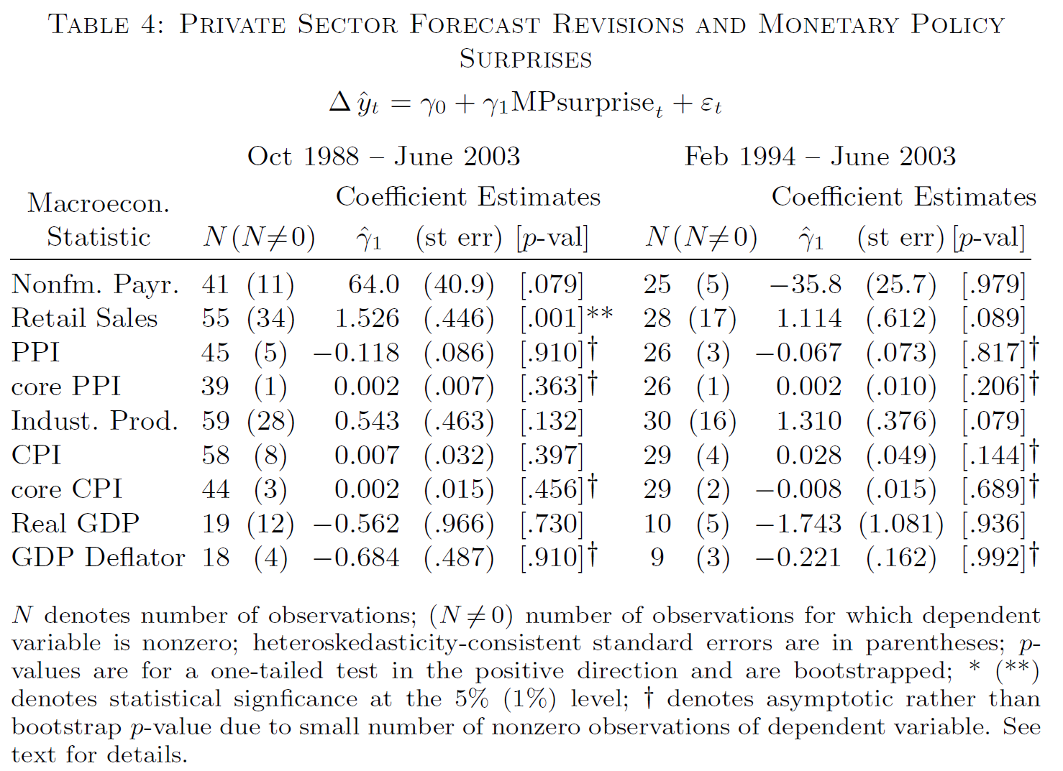
Faust, Swanson, and Wright (2004 BEJMacro)
But private sector does not revise those forecasts in response to FOMC announcements:

Slide 35
Outline
Motivation and Background: The “Fed Information Effect”
The Kalshi Prediction Market
Kalshi Market-Implied Expectations
Kalshi Market Trading Volumes
The Response of Kalshi Market-Implied Expectations to FOMC News
Related Evidence
Conclusions

Slide 36
Conclusions
Prediction markets offer high-frequency macroeconomic forecast data
Kalshi forecasts compare favorably to Blue Chip, SPF but are available at much higher frequency
Kalshi trading volumes increase around a variety of macroeconomic events
Kalshi markets respond to FOMC announcements and Fed Chair speeches consistent with standard macro models, VARs
Kalshi markets sometimes respond to FOMC minutes with an opposite coefficient, potentially consistent with a “Fed Information Effect”
  Although I still think an Information Effect explanation is not what’s going on here
Substantial other evidence suggests there is not a large Fed Information Effect related to FOMC announcements

Slide 37
Outline
Motivation and Background: The “Fed Information Effect”
The Kalshi Prediction Market
Kalshi Market-Implied Expectations
Kalshi Market Trading Volumes
The Response of Kalshi Market-Implied Expectations to FOMC News
Related Evidence
Conclusions

Slide 38
Appendix
Appendix Slides

Slide 39
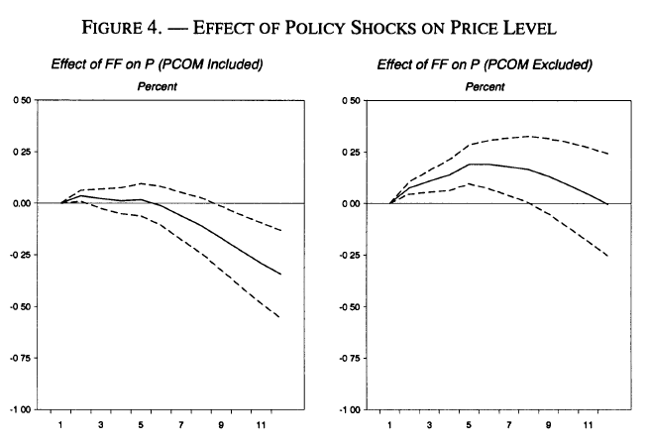
The “Price Puzzle”
Eichenbaum (1992 EER) and Sims (1992 EER) estimated that a monetary policy tightening caused prices to increase rather than decrease in a VAR
Sims and Zha (1994) and Christiano, Eichenbaum, and Evans (1996 REStat) argued an omitted variable (commodity prices) was driving the puzzle
Their story: an increase in commodity (esp. oil) prices was causing both the Fed to raise interest rates and inflation to increase

Slide 40
Bauer-Swanson (2023 AER): Omitted Variables
Including the omitted news variable on the right-hand side:
Greatly increases regression R², from about .01 to .42
Reduces standard errors of θ estimates
Increases statistical significance of θ
Reverses the sign of θ to the standard direction, consistent with macro models and VARs
Summary: Including omitted economic and financial news variables eliminates the “Fed Information Effect” puzzle

Slide 41
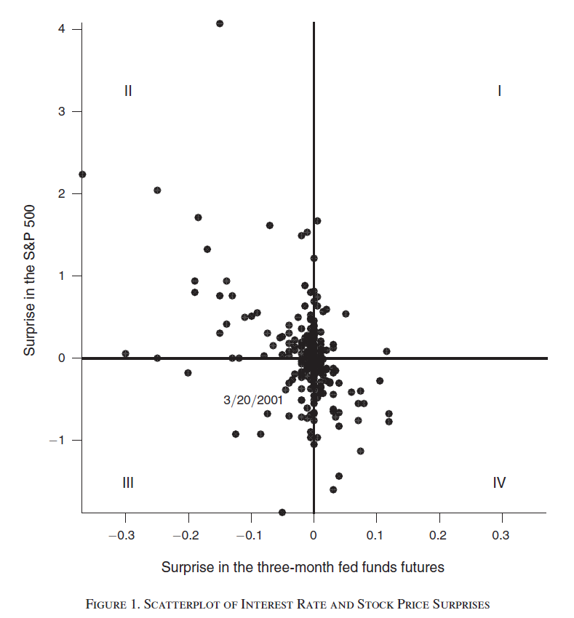
Jarocinski-Karadi (2020 AEJMacro)
Argue that there is a Fed Information Effect, but only sometimes
According to their Figure 1, standard interest rate channel of monetary policy usually dominates
This story is very different from Romer-Romer, CEFJ, NS
Bauer-Swanson evidence does not contradict this “occasional information shock” story

Slide 42
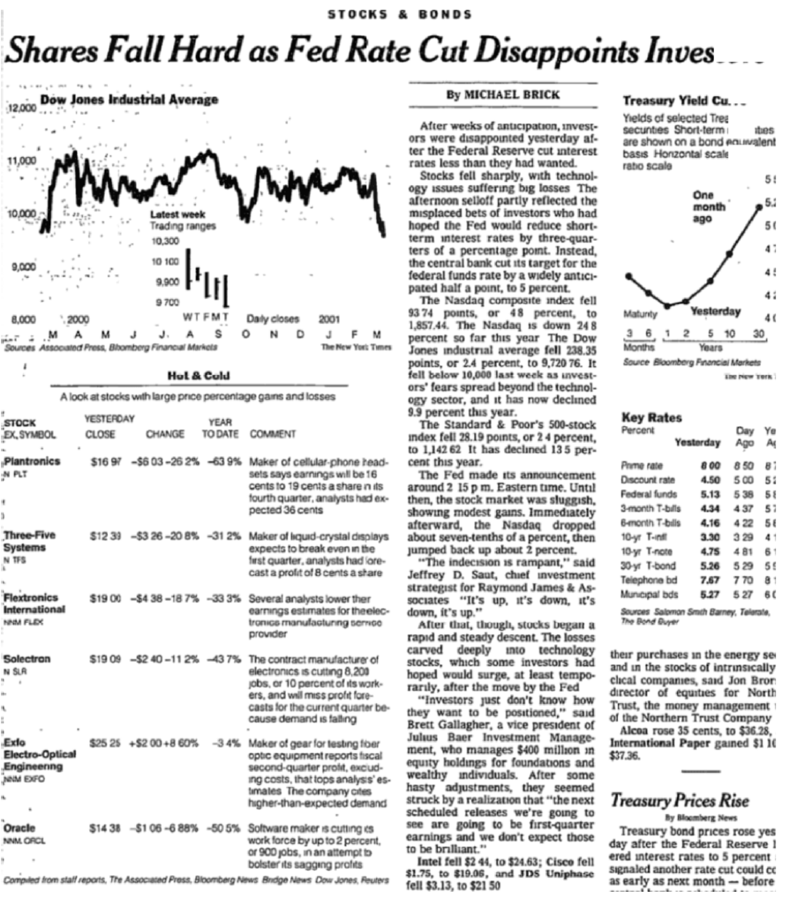
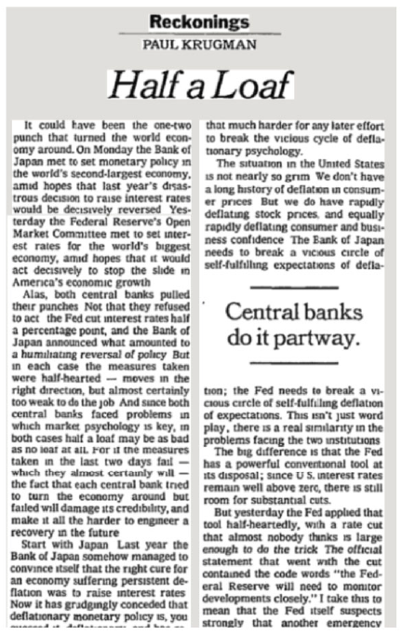
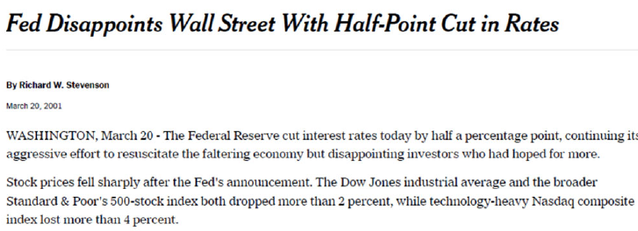
Jarocinski-Karadi (2020 AEJMacro): March 20, 2001
Nevertheless, my experience at the Fed suggests the Fed does not have an informational advantage
Instead, there is probably something else going on (e.g., on 3/20/2001):

Slide 43
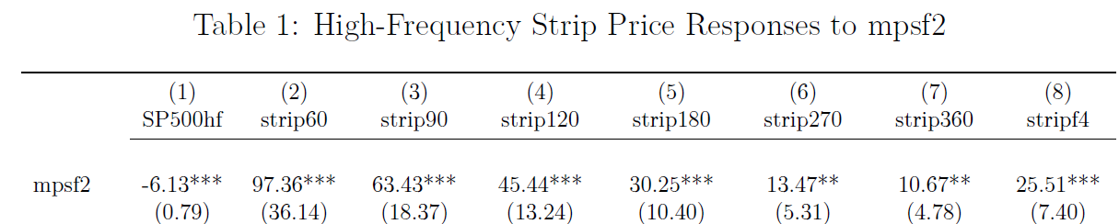
Dividend Strips
Golez and Matthies (2025 JFE) and Gilchrist, Yang, and Zhao (2025):
  although stocks respond very negatively to FOMC announcements
  near-term dividend STRIPs respond positively
Note: this is not the Jarocinski-Karadi (2020) story; it is always present
Also: the effect is driven by the nearest-maturity STRIP (60 days!)
Moreover, dividend futures do not show this effect

Slide 44
Dividend Futures vs. STRIPs
Dividend futures:
Settle based on cumulative actual dividends paid by index (S&P 500) constituents from issue date to maturity
Dividend STRIPs:
Synthetic security constructed by going long spot S&P 500 and short 60-day-ahead S&P 500 index future
This synthetic security earns the dividends paid over the next 60 days, but has no risk from index fluctuations
However, Boguth, Carlson, Fisher, Simutin (2023 RF):
Going long-short two very similar securities greatly amplifies (levers) the idiosyncratic noise/frictions in each
This idiosyncratic noise/friction seems to be related to short-term int. rates

